Slide 1
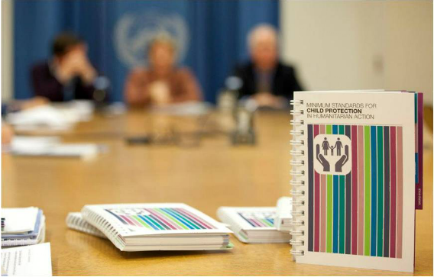
Overview of the:
Minimum Standards for Child Protection in Humanitarian Action (CPMS)

Slide 2
CPWG Members and Associates
Bureau for Population and Refugee Migration; Government of Canada; Child Frontiers; Child Helpline International; Child Soldiers International; ChildFund International; Columbia University, CPC Network; Danish Refugee Council; Department for International Development; Displaced Children and Orphans Fund; European Commission Humanitarian Office; EveryChild; Family for Every Child; Geneva Call; GOAL; Handicap International; Heartland Alliance; International Bureau for Children's Rights; International Committee of the Red Cross; International Labour Organization; International Rescue Committee; Islamic Relief Worldwide; Keeping Children Safe Coalition; Mercy Corps; Norwegian Refugee Council; U.S. Office for Foreign Disaster Assistance; Plan International; Retrak; Refugee Point; Save the Children; SOS Children's Villages International; Swiss Agency for Development and Cooperation; Terre des Hommes; The International Institute for Child Rights and Development; United Nations Children's Fund; United Nations Department of Peacekeeping Operations; United Nations High Commission for Refugees; War Child Canada; War Child Holland; War Child UK; Watchlist on Children and Armed Conflict; and World Vision International.
Notes:
The CPWG is the global level forum for coordination on child protection in humanitarian settings. In the humanitarian system, the CPWG constitutes an “area of responsibility” within the Global Protection Cluster.
The group brings together NGOs, UN agencies, academics and others under the shared objective of ensuring more predictable, accountable and effective child protection responses in emergencies.
The global Child Protection Working Group (CPWG) led the development of the CPMS and is helping to support its roll-out and implementation. A CPMS Task Force has been created within the global CPWG to support the initiative.
As you can see from the list, the development and roll-out are inter-agency processes with broad consensus.
The CPWG also includes individual members with expertise in the area, who are not included in the list on the slide.

Slide 3
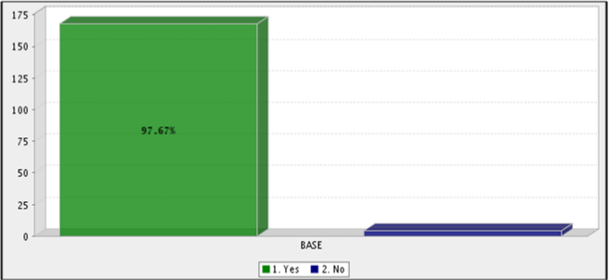
The need for minimum standards for Child Protection in Emergencies
"It would provide benchmarks for what is
a good enough child protection
programme“
"Indicators would allow organizations to
better evaluate their response work in
terms of child protection"
"To would help organizations prepare for
child protection issues during emergency
response“
"To enable new cluster members at country
level to benefit from evolution of the sector so
far, and encourage all actors to obtain a
minimum level of quality in responses"

Slide 4
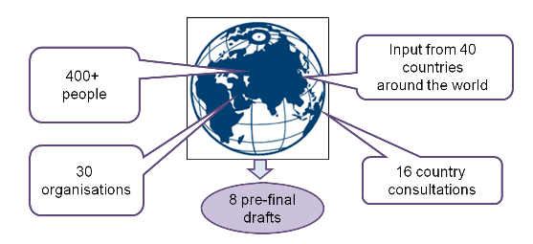
CPMS Development Process
November 2010
First Meeting
July 2011
Large Consultation
April 2012
Country Consultations (4 languages)
October 2012
Global Launch

Slide 5
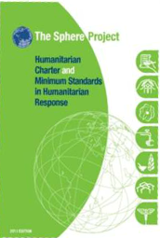
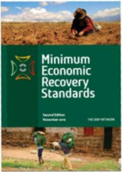
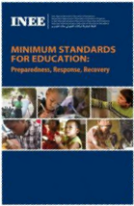
The CPMS became companion to Sphere Standards in May 2013.
CPMS and other Humanitarian Standards
The Sphere Project, the ICRC Professional Standards for Protection, INEE Standards, HAP and others help humanitarian actors to improve quality and accountability in Humanitarian Response.
Sphere Companion Standards:

Slide 6
CPMS Objectives
Establish common principles and strengthen coordination amongst child protection actors.
Improve the quality of child protection programming to achieve greater impact for children.
Improve accountability within the child protection sector during emergencies.
Further define the professional field of child protection.
Make available good practice in child protection to date.
Enable better advocacy and communication on child protection risks, needs and responses.
Notes:
Read each objective and if possible give 1 or 2 simple examples based on past professional experience

Slide 7
CPMS Structure
Introduction
CPMS follows the Sphere Standards’ format
Standard (one phrase)
Key Actions
Indicators
Guidance Notes
References
Notes:
The CPMS references and builds directly on existing guidelines such as interagency guidelines on child friendly spaces, mental health and psychosocial support, unaccompanied and separated children, working with CAAFAG, etc.
The CPMS will be available in French, Spanish, Arabic and English by the end of 2013. The English and French versions are already available (July 2013).

Slide 8
CPMS Foundations
CRC
Survival and development
Child Participation
SPHERE
Avoid exposing people to further harm
Ensure people’s access to impartial assistance
CPMS
Strengthen child protection systems
Strengthen children’s resilience in humanitarian action
Non-discrimination
Best Interest of the Child
Protect people from physical and psychological harm
Assist people to claim their rights, access available remedies and recover from the effects of abuse
10 key Principles

Slide 9
What is a minimum standard?
Agreed universal benchmarks to be achieved or aspired to without being altered.
A common agreement of what needs to be achieved and adequate quality.
Some Standards will need to be prioritized or phased, depending on the starting point in the context.
Some Standards will not be relevant for a particular context.
Notes:
Depending on the context, child protection may be strong or weak prior to the emergency. In contexts where child protection was weak, the minimum standards served as goals to work towards. It may not be possible to achieve them all at once.
Relevance – for example, the Standard on children associated with armed forces and armed groups will not be applicable to a context where recruitment of children does not occur.

Slide 10
Notes:
If the participants have hard copies of the CPMS, please refer to the back cover.
The handbook itself can seem large but each of the 26 Standard is an average of 6 pages.
3. See following slides for all Standards. Recap here:
Standards to ensure a quality child protection response
Standard 1 Coordination
Standard 2 Human resources
Standard 3 Communication, advocacy and media
Standard 4 Programme cycle management
Standard 5 Information management
Standard 6 Child protection monitoring
Standards to address child protection needs
Standard 7 Dangers and injuries
Standard 8 Physical violence and other harmful practices
Standard 9 Sexual violence
Standard 10 Psychosocial distress and mental disorders
Standard 11 Children associated with armed forces or armed groups
Standard 12 Child labour
Standard 13 Unaccompanied and separated children
Standard 14 Justice for children
Standards to develop adequate child protection strategies
Standard 15 Case management
Standard 16 Community-based mechanisms
Standard 17 Child-friendly spaces
Standard 18 Protecting excluded children
Standards to mainstream child protection in other humanitarian sectors
Standard 19 Economic recovery and child protection
Standard 20 Education and child protection
Standard 21 Health and child protection
Standard 22 Nutrition and child protection
Standard 23 Water, sanitation and hygiene (WASH) and child protection
Standard 24 Shelter and child protection
Standard 25 Camp management and child protection
Standard 26 Distribution and child protection

Slide 11
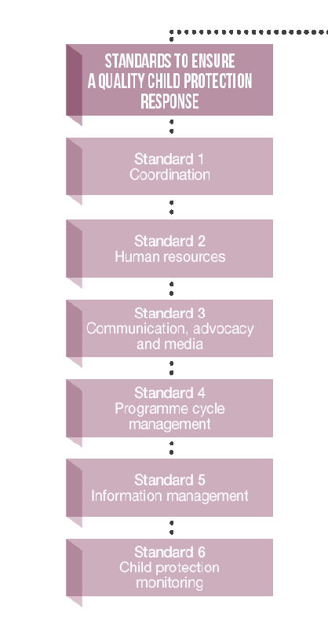
Standards to ensure a quality child protection response
Coordination
Communication, advocacy and media
Human Resources
Programme cycle management
Information management
Child Protection Monitoring
Notes:
This group of Standards look at systems that support programming and have major impact on the quality of the responses.
These Standards do not aim to replace the existing policies and tools on these issues, but rather to provide a child protection-oriented view of each area of work.

Slide 12
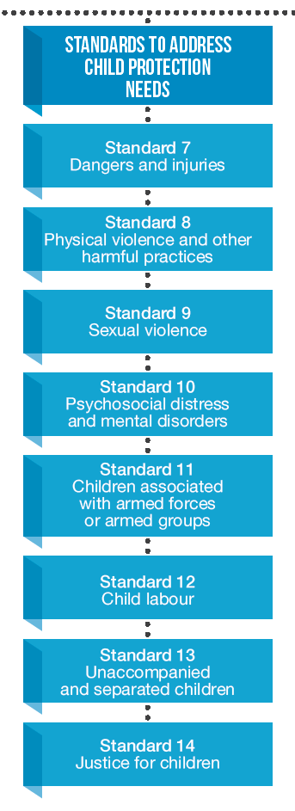
Standards to address child protection needs
Dangers and injuries
Physical Violence and other harmful practices
Sexual Violence
Psychosocial distress and mental disorders
Children associated with armed forces or armed groups
Child labor
Unaccompanied and separate children
Justice for children
Notes:
This group of standards cover the core critical issues in child protection in emergencies.
Some of the areas are more developed within the child protection sector (CAAFAG, UASC) while others where have little existing interagency guidance and tools (justice for children in emergencies, physical violence and other harmful practices). Through promotion of the CPMS, it is hoped that these areas will be able further strengthened.

Slide 13
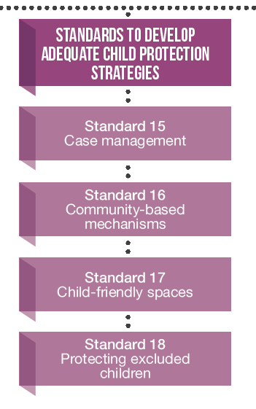
Standards to develop adequate child protection strategies
Case Management
Community-based child protection mechanisms
Child-friendly spaces
Protecting excluded children

Slide 14
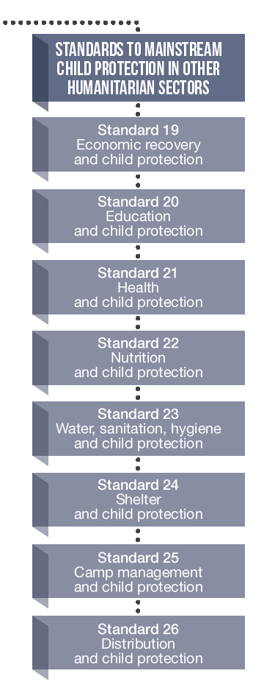
Standards to mainstream Child Protection in other Humanitarian Sectors
Economic Recovery
Education
Health
Nutrition
WASH
Shelter
Camp Management
Distribution
and Child Protection
Notes:
Mainstreaming standards focus on how child protection and the eight different sectors can work together to ensure children are protected in all humanitarian interventions. The main actions section is broken into two sections on what the other sector (Economic recovery, education, etc.) can do and what child protection actors can do. These Standards need to be shared with workers in other sectors to be achieved.

Slide 15
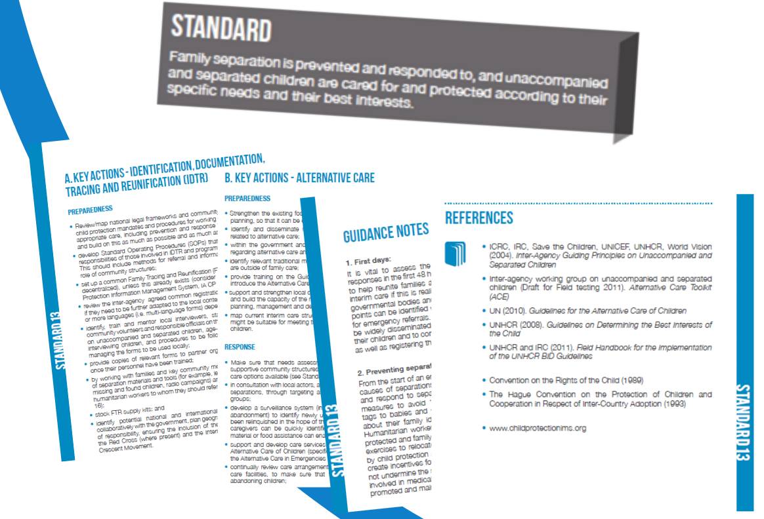

Slide 16
Who are the standards intended for?
Intended for use by those working on child protection or related areas of humanitarian action
Working directly with children, families and communities;
Planners and policy makers;
Coordinators;
Donors;
Academics;
It may also include those working in the justice system and security personnel;
Government personnel and those working in independent or multilateral organizations
As well as armed forces and groups;

Slide 17
How can the CPMS be used?
To plan and cost humanitarian interventions
To induct and train new staff or partners
To establish common and measurable expectations
As self-learning tool and reference text
To enable advocacy on child protection issues, and to brief decision-makers on child protection
To establish agreement on common principles between different actors
0
To monitor and evaluate the allocation of funding
To enable those working in other sectors of humanitarian action to protect children better

Slide 18
Activities at National/Local Levels
Implementation of the CPMS 2013-2015
Raise awareness – launch events, discussions
Contextualize the Standards in countries
Build capacity of all users (CP and other sectors)
Integrate CPMS in strategies, work plans and monitoring and evaluation tools
Provide feedback on the use and areas for improvement of the Standards
Translate the Standards into other languages
Notes:
1. The list suggests activities that can be organised at national and local levels as well as regional.
2. Launch events can take whatever form the country finds best suited to raising awareness among all users – government, local civil society, national and international NGOs, UN agencies, community leaders and donors.
3. Contextualisation means adapting the Standards to fit the context by making them more specific. Contexualisation should be an interagency undertaking that identifies the priority problems and Standards in the specific context and develops specific goals in relation to the general Standard.
3. Examples of using the CPMS in guidelines and strategies are available on the CPMS webpage – cpwg.net/minimum-standards
4. A feedback form on the Standards will be available on the cpwg.net webpage by August 2013, surveys will be conducted at the end of 2013 and consultations will be held in selected countries in 2014.
5. Translation of the CPMS is essential for all stakeholders to be able to use the Standards and for contextualisation to take place. Guidelines for translating the CPMS are available on the CPMS webpage.

Slide 19
Global Level Support
Implementation of the CPMS 2013-2015
Financial and technical support for regions and countries to carry out awareness raising and capacity building activities
Technical support for contextualization
Development of adaptable capacity building and communication materials
Monitor the use and application of the Standards
Ensure Standards exist in 4 major languages
Notes:
1. The global implementation plan for 2013-2015 is available and addresses three main areas – dissemination and awareness raising on the Standards, capacity building to apply the Standards (resource development and provision of technical human resource support) and promotion of institutionalisation of the Standards (integrating the Standards into agency policies and procedures).
2. Capacity building materials will include guidance support on response monitoring, overview training for field staff on how to use the CPMS, guidance on contextualising the CPMS to your context and mainstreaming briefing notes and case studies.
3. The CPMS will be available in French, Spanish and Arabic by end 2013. Support for other language translations is possible.

Slide 20
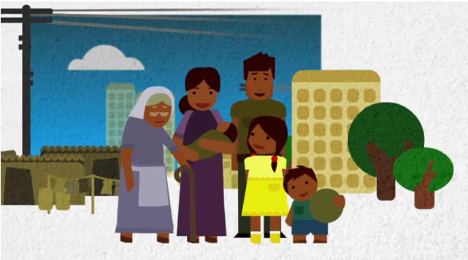
This is Samira – Overview of what the CPMS are about
العربية
English
Français
Español
Notes:
Show the video
Child Protection in Emergencies is the prevention of and response to abuse, neglect, exploitation and violence against children – both in
Preparedness and Response.
3. It is NOT the more general protection of Rights (such as a child’s right to education etc).
As we see in the video, emergencies due to natural disasters OR conflict have devastating effects on children’s lives. Children can be killed or
injured, separated from their families, recruited into armed forces, sexually abused and trafficked
This video is available at cpwg.net or CPWG YouTube page and is currently available in English, Spanish, French, Urdu, Pashto and Sindhi.
http://www.youtube.com/user/aliochasalagnac?feature=watch

