Slide 1
The Community-level Child Protection Online Learning Series
VIDEO 3: COMMUNITY-LEVEL CHILD PROTECTION IN HUMANITARIAN ACTION: THE NEED FOR A SHIFT IN MINDSET
Notes:
This presentation should be accompanied by the
CPMS 2019 revision https://alliancecpha.org/en/CPMS_home
Handout from the Capacity Building Package: Key Considerations.

Slide 2
Name of Activity
Location
Date

Slide 3
Aim of the online learning series
Aim:
To facilitate the operationalization of CPMS Standard 17 and the new interagency resource, A Reflective Field Guide: Community-level Approaches to Child Protection in Humanitarian Action
Objectives:
Child protection practitioners are aware of key Community Level CP terminology and concepts, and know where to access these resources..
Child protection practitioners reflection on current practices in light of research and learning.
Child protection practitioners engage in peer-led conversations on linking the practical usage of resources highlighted and working with communities in humanitarian settings.

Slide 4
Video 3: Community-level Child Protection in Humanitarian Action: The Need for a Shift in Mindset

Slide 5
Aim and learning outcomes
Aim:
To facilitate reflection on the shifts in mindsets child protection actors may need to effectively work alongside communities.
Learning Objectives:
Child protection practitioners can identify attitudes, behaviors and skills that contribute to effective community engagement.
Child protection actors can describe ways in which these attitudes, behaviors and skills can be applied in their work in communities..

Slide 6
Watch the Video!
Notes:
Embed a link to the video on YouTube or the Alliance website.

Slide 7
Let’s Debrief!
In small groups, take 5 to 10 minutes to think about the following question.
Questions:
What did the child protection actor do to effectively engage with Nina and others in the community?
List your answers on the flipchart paper
Be ready to present to the group

Slide 8
Where do we want to go?
Refer to Handout – Key Considerations.
Discuss the following:
What are Nina and others in the community doing to protect children, and how can the child protection actor build on those actions?
How do our agencies approach communities within the response?
Are we prepared to work towards a shift in mindset? If yes, what are some of the first steps we can take?
Notes:
Participants may stay in their small groups or do this exercise in plenary.
If participants have access to internet you may solicit “call-out” feedback using mentimeter.com “word cloud” or “open-ended” formats.

Slide 9
Key messages
Communities, civil society organizations, and local governments are at the forefront of humanitarian responses. As child protection actors, we need to pause and reflect on how we can be better partners to reach common goals, and create opportunities for more sustainable and effective work with communities.
Being able to engage with communities effectively requires more than our technical expertise in child protection. It relies on attitudes and behaviors that build trust and collaborative relationships. These include respect, humility, patience, and being a good listener and learner.

Slide 10
Please provide feedback to the Alliance Community-level Child Protection Task Force!
Before you go, please complete:
Sign-in sheet
Feedback exercise
Notes:
Include link if including online survey tracking.

Slide 11
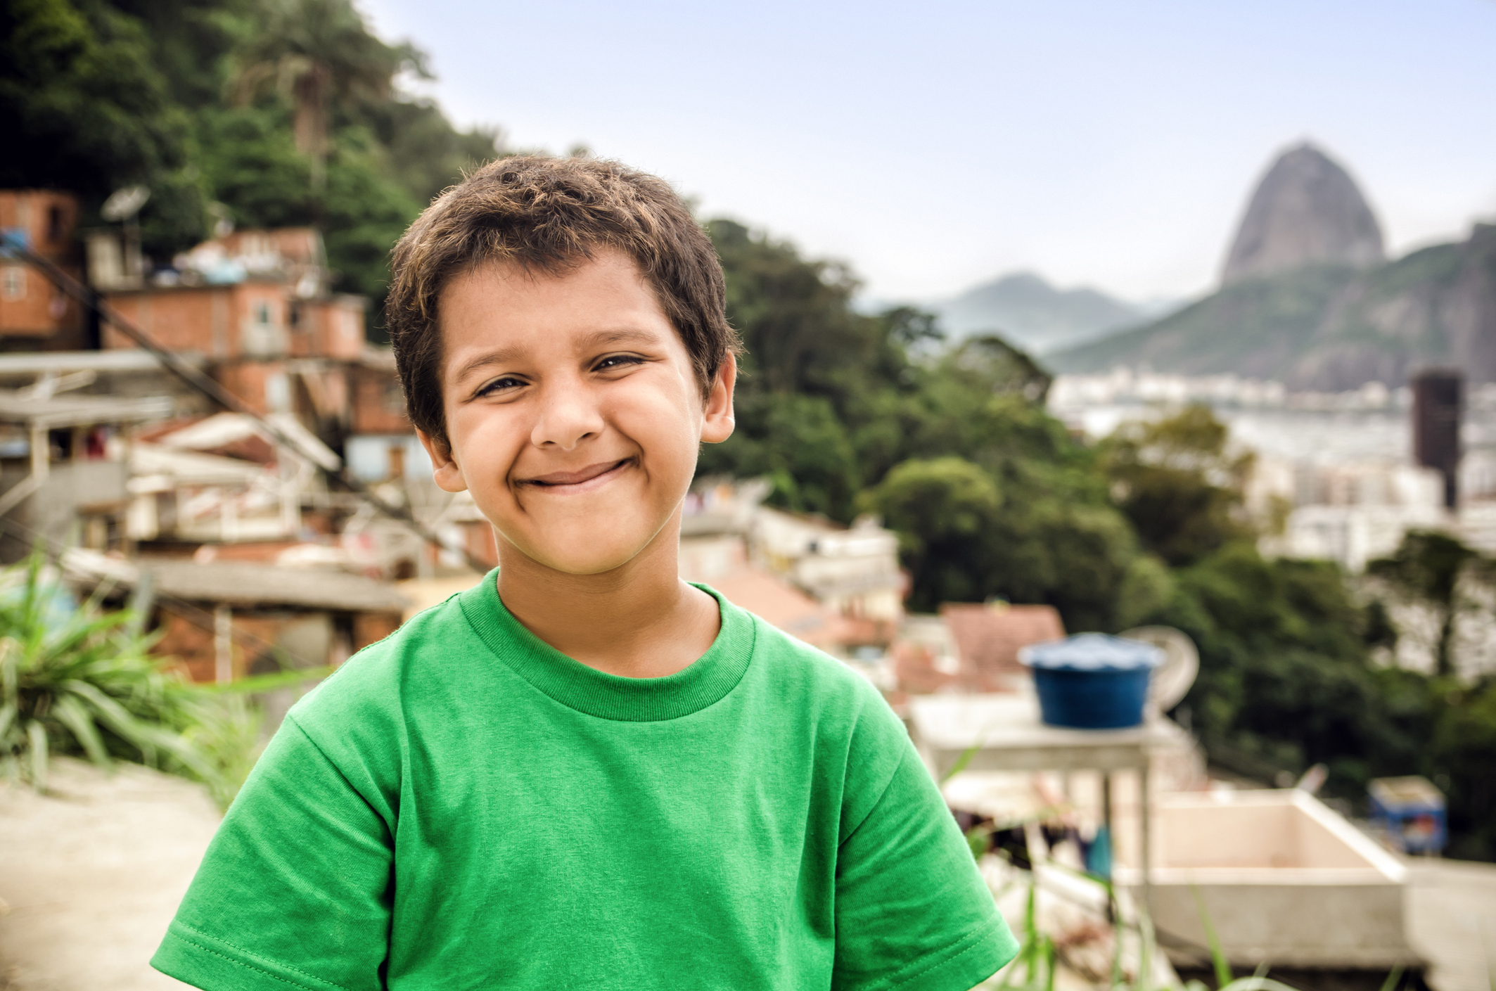
Thank You!

