Slide 1
The Community-level Child Protection Online Learning Series
VIDEO 1 - INTRODUCING STANDARD 17: COMMUNITY-LEVEL CHILD PROTECTION APPROACHES
Notes:
Participants should have a copy of CPMS Standard 17 for reference during this session. They can be found at https://alliancecpha.org/en/CPMS_home

Slide 2
Name of Activity
Location
Date

Slide 3
Aim of the online learning series
Aim:
To facilitate the operationalization of the 2019 Minimum Standards for Child Protection in Humanitarian Action (CPMS) Standard 17 and the new interagency resource, A Reflective Field Guide: Community-level Approaches to Child Protection in Humanitarian Action.
Objectives:
Child protection practitioners are aware of key Community Level CP terminology and concepts, and know where to access these resources..
Child protection practitioners reflection on current practices in light of research and learning.
Child protection practitioners engage in peer-led conversations on linking the practical usage of resources highlighted and working with communities in humanitarian settings.

Slide 4
Video 1- Introducing Standard 17: Community-level Child Protection Approaches

Slide 5
Aim and learning outcomes
Aim:
To introduce the changing priorities in the revised Child Protection Minimum Standard 17: Community-level approaches.
Learning outcomes:
Child protection practitioners can identify the importance of strong community-level engagement in their programming.
Child protection actors are confident to access and utilize the new CPMS Standard 17.

Slide 6
Watch the Video!
Notes:
Embed a link to the video on YouTube or the Alliance website.

Slide 7
Let’s
Debrief!
In small groups, take 5 to 10 minutes to think about the following questions.
Questions:
What are some of your experiences engaging communities in child protection?
Do you recognize any of the challenges presented in the video?
List your answers on the flipchart paper
Be ready to present to the group

Slide 8
Find the Guidance
Refer to
Standard 17: Community-level Approaches
Reflective Field Guide
Identify Key Actions that would have been useful for the humanitarian actors in this video.
Notes:
Participants may stay in their small groups or do this exercise in plenary.

Slide 9
Other possible questions
How does our understanding of community influence our approaches to community-level child protection?
What do we learn from Nina and her friends that can strengthen our programming?
What might be the impact of establishing programming without first understanding the context well?
What is one thing you will take from this video and use to guide your future programming?

Slide 10
Key messages
Communities play significant roles in preventing and responding to the risks children face in humanitarian settings. Communities organize themselves in a variety of ways to protect children – including adolescents – who are at risk.
There is no ‘one-size-fits-all’ model of community-level child protection. Humanitarian actors should seek to understand existing community capacities that promote children’s rights, safety, development, well-being and participation.
By working alongside communities, child protection actors can support meaningful and appropriate responses that make a difference in the lives of children around the world.

Slide 11
Please provide feedback to the Alliance Community-level Child Protection Task Force!
Before you go, please complete:
Sign-in sheet
Feedback exercise
Notes:
Include link if including online survey tracking.

Slide 12
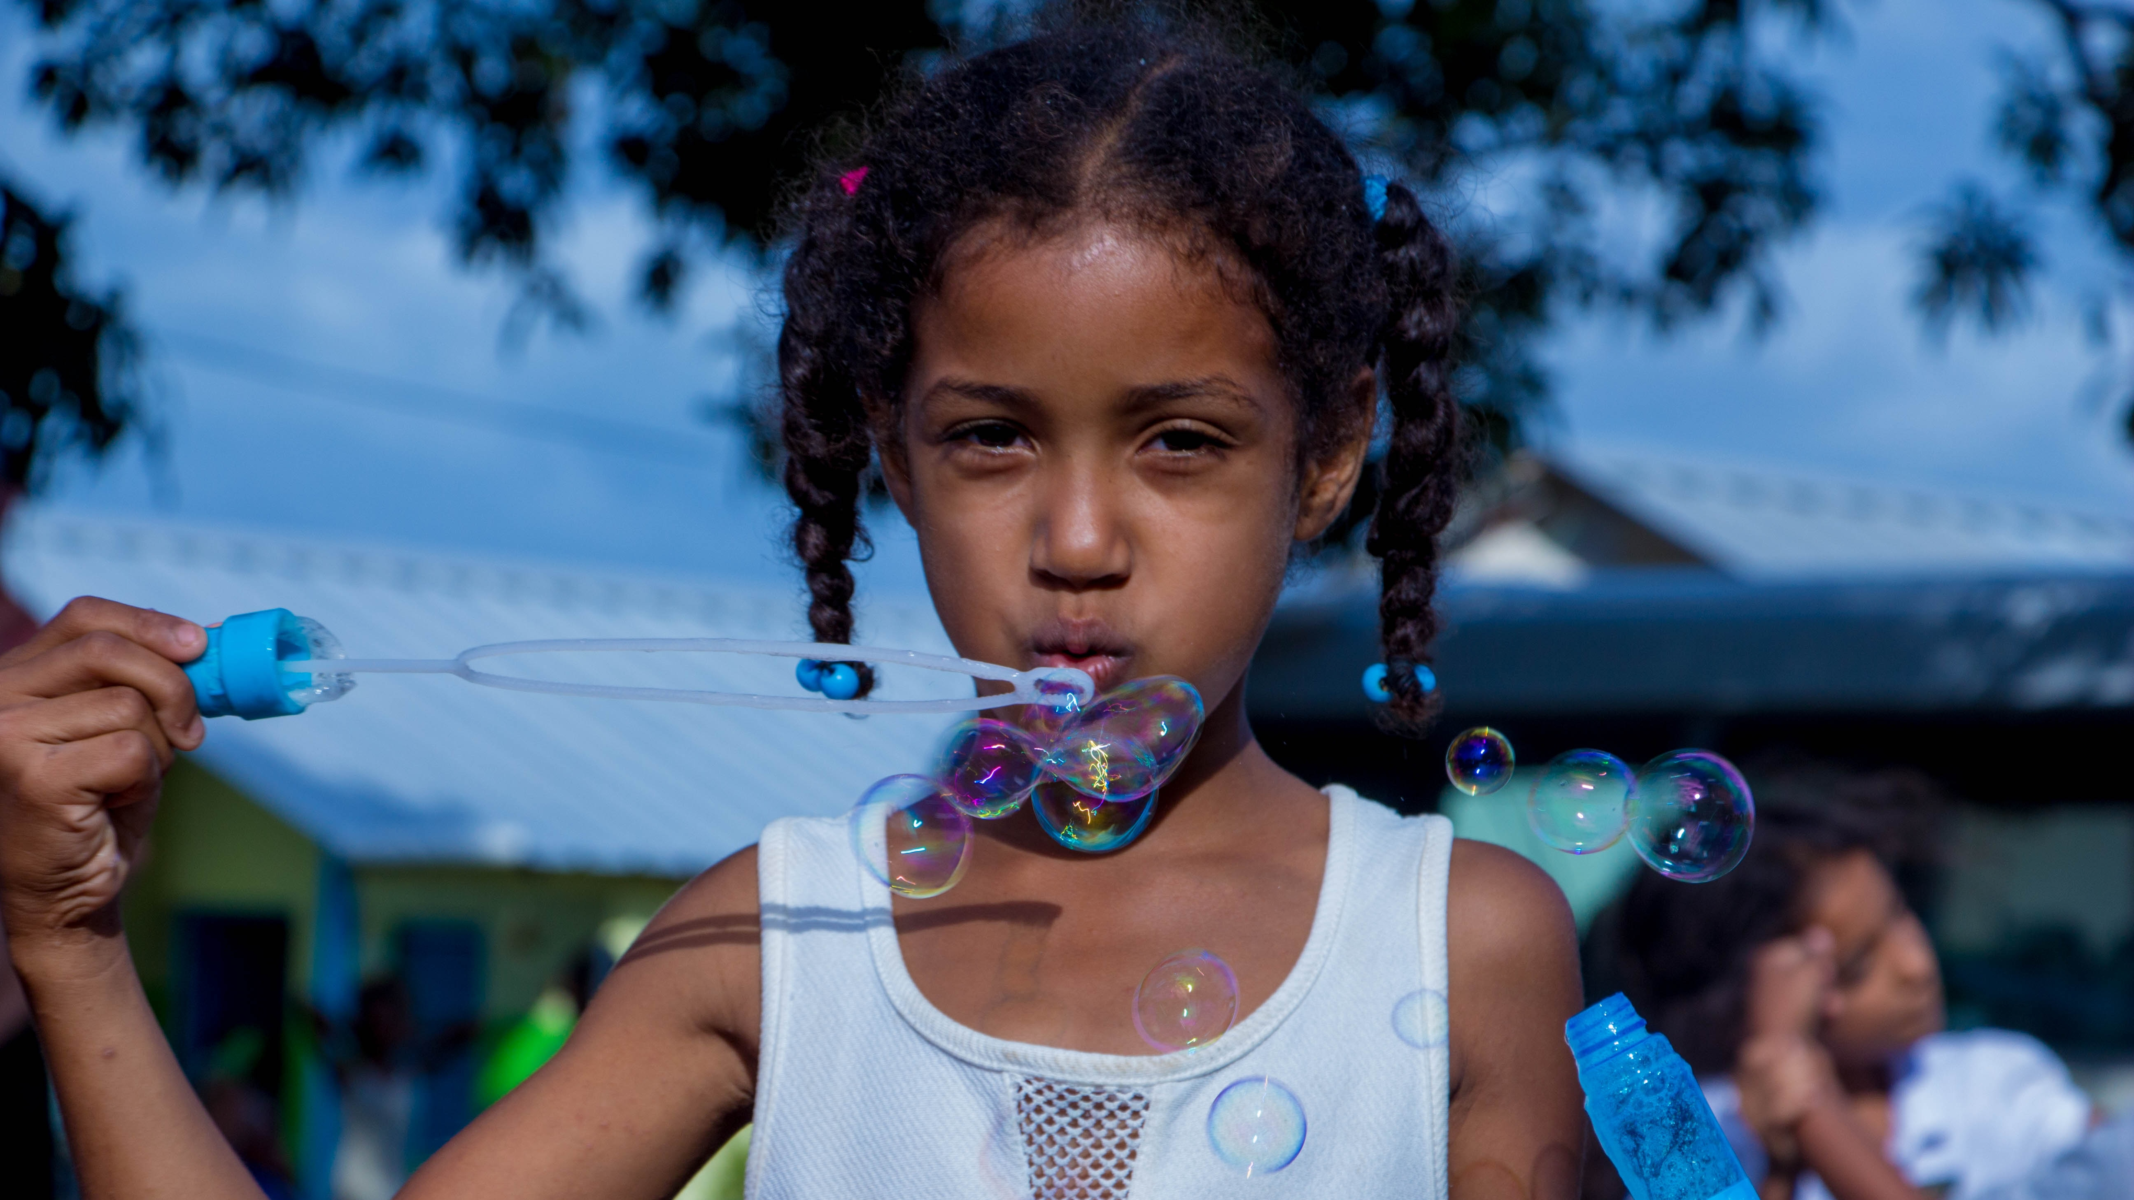
Thank You!

