Slide 1
Contextualizing the Child Well-Being Definition and Measurement Framework Training
Insert Date
Notes:
Make any necessary modifications that are specific to your context throughout this PowerPoint. For instance, you may want to hide or delete slides that relate to data analysis if the data collectors who will be trained are not analyzing the data. You may also want to add planning or logistical arrangements in the slide deck, such as explaining which data collector trainee will be carrying out which KIIs and FGDs etc., including the location. Please make any necessary modifications to best reflect your context.

Slide 2

Welcome and Hello!
Welcome and Hello!

Slide 3

Introductions, Facilitator Team, Background and Expectations

Slide 4
About the Training Team
(Introduce the team as per the example below)
Celina Jensen, Focal Point for the Assessment, Measurement and Evidence (AME) Working Group of the Alliance for Child Protection in Humanitarian Action

Slide 5
Background for Training
Contextualizing the Child Well-Being Definition and Measurement Framework Training
Ensuring children’s well-being is generally recognized as the ultimate goal of child protection in humanitarian action (CPHA). A global definition of child well-being and a framework by which to measure it that can be contextualized will improve efforts in program planning, coordination, and evaluation whether at the individual agency or inter-agency level.
Developed through a consultative process led by the Alliance for Child Protection in Humanitarian Action (CPHA) that included representatives from various child protection agencies, donors, and colleagues working in MHPSS, health, and education.

Slide 6
Training Goals and Learning Outcomes
Contextualizing the Child Well-Being Definition and Measurement Framework Training
The aim of this training is to familiarize you with the Child Well-Being Contextualization Guide and measurement framework. Knowledge of this Guide and the key steps to the contextualization of child well-being and its measurement will enable you to lead these processes in your own context.
You will be equipped with knowledge of the contextualization process and the tools that can be used to facilitate this process.
You will understand and be able to measure child well-being in your country context.

Slide 7
Ice Breaker
Speed Dating!
My favourite meal is________
If I would have chosen another career it would be:_______
One piece of advice that I would give to a person arriving in my office: __________
If you could play an instrument what would you play?________
The one thing I know for sure is:__________
Notes:
Note: You may not require an ice breaker if the participants are colleagues and know each other; however, it is still a fun activity and the questions can be amended to questions that the co-workers may not know about each other.
Facilitator: Ask all participants to stand up. Once the music starts they will need to find another participant to introduce themselves to. Play some music and set a timer, giving pairs 2 minutes each to introduce themselves to one another and answer the 5 questions before rotating. Repeat 4 or 5 times before asking participants to go back to their seats and doing a more general round of introductions.

Slide 8

Training Methods
Adult learning principles
Participatory approaches
Practical exercises/role play
PowerPoint
Discussions in plenary

Slide 9
Review the Agenda…
Insert Agenda (see example in the training package)
Notes:
Review the agenda with the group and answer any questions participants may have.

Slide 10





Learning Agreement
Notes:
To be developed with participants and placed in a prominent position in the training room.

Slide 11

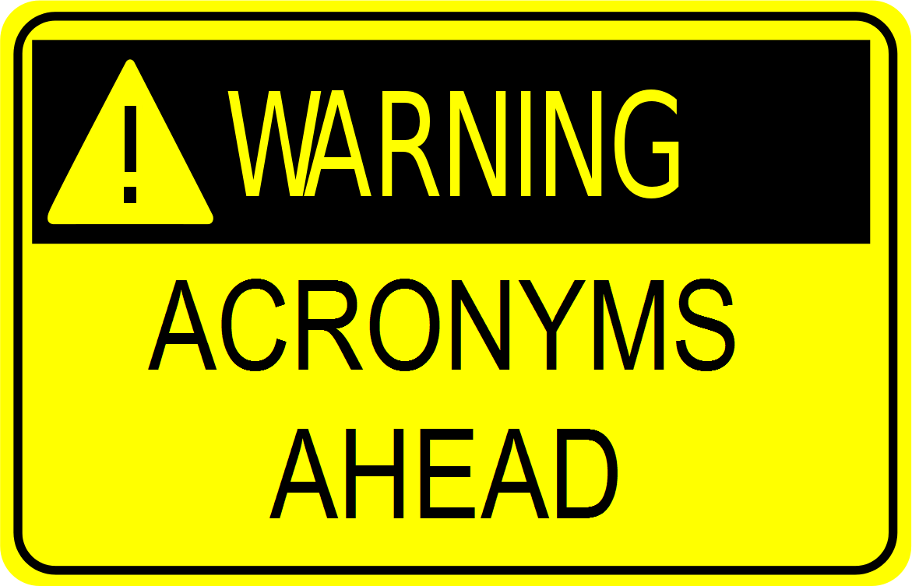
Acronyms and Parking Lot
Notes:
Create an acronyms page and a parking lot.

Slide 12
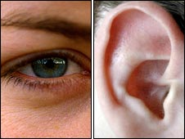


Housekeeping
Notes:
Time Keeper
Ice Breaker/energizers at any point
Explain where bathrooms are, break and lunch rooms
Explain the eyes and ears and ask for a volunteer each day
Evaluation at the end of the day

Slide 13

Any Questions Before Moving On?

Slide 14
Part 1: Global Child Well-Being Definition
In Part 1 we will review the definition of child well-being and the ages and stages of child development.
Child well-being is a dynamic, subjective and objective state of physical, cognitive, emotional, spiritual and social health in which children's optimal development is achieved through:
Safety from abuse, neglect, exploitation and violence;
Basic needs met, including those promoting survival and development;
Connection to and care provided by consistent, responsive caregivers;
Supportive relationships with relatives, peers, teachers, community members and society at large; and
Opportunity for children to exercise agency based on their evolving capacities.
Notes:
Explain to participants that the global definition of child well-being in humanitarian action highlights the multi-dimensional nature of health. Well-being is enhanced when all aspects of the child’s health (physical, cognitive, emotional, spiritual and social) are nurtured and children can act on their intentions in developmentally appropriate ways.

Slide 15
Child Development: Ages and Stages
Age groups harmonized with the IASC Guidelines for mental health and psychosocial support in emergency settings.
All cultures have ways of addressing these issues and may attribute specific development markers to different age groups of children. E.g. in many cultures, children’s roles and responsibilities change once they show physical signs of puberty.
Age groups should be modified as necessary in accordance with the cultural context.
Notes:
The recommended age groups are harmonized with those identified by the IASC Guidelines for mental health and psychosocial support in emergency settings. The age groups employed to obtain indicators of child well-being should be reflective of key developmental markers, especially brain development, puberty, and learning in accordance to the cultural context.

Slide 16
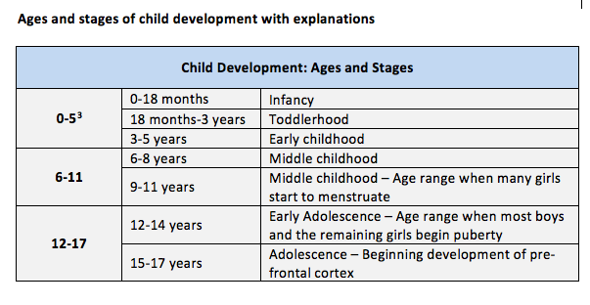
Notes:
0-5 age group reference: Erikson, E.H. (1950). Childhood and Society. New York: Norton; Piaget Piaget, J. (2003). Part I: Cognitive Development in Children--Piaget Development and Learning. Journal of research in science teaching, 40.

Slide 17
Activity
This activity can be done in pairs or in a small group of 3 or 4
Define the term: Define child well-being, happiness, resilience, and quality of life – or other related and relevant terms – in your understanding and in your cultural context.
What are the factors that contribute to each of the terms?
Notes:
Instruction: Provide flipcharts, different colored crayons or markers, scissors, and index cards to the participants.
Note: This is a practical exercise data collectors can complete to familiarize themselves not only with the objectives of this work but also with the tools that are used in the contextualization process instead of only reviewing/discussing the tools. This exercise is also one of the activities recommended for the contextualization workshop.
The participants will specify the characteristics of a child that is ‘doing well’. Each characteristic will be recorded on a single index card, and the resulting cards can be sorted into piles of what are seen as related characteristics by a number of different participants/small groups. Categorizing the cards in such a way will lead to identifying a number of ‘domains’, and a number of specific ‘indicators’ within each.
During the plenary discussion, the training facilitator will identify whether these are the same domains as specified in the global measurement framework or if new domains have arisen, which will be discussed next.

Slide 18
Practical Exercise in Pairs: Preparing for Key Informant Interviews (1 hour)
Free listing is a method used to identify what key informants perceive to be the characteristics of a “child who is doing well”.
The interviewer will ask a primary, open-ended, general question: “What are the characteristics of a child who is doing well?” to create a list, probing to make the list as long as possible.
The respondent is then asked to make descriptions of each of the terms in the list, and to identify other local people who are knowledgeable about each of the list items, which will support in identifying participants for the contextualization workshop (if you decide to have a contextualization workshop).
In pairs, practice this exercise as a role play in which one person is the interviewer and the other is the respondent. Ask what it means for a child to be doing well in accordance to the three main age categories.
After 20 minutes, switch roles. After a further 20 minutes, provide constructive feedback to each other.
Discuss the experience in plenary any differences in what came about in the exercise to the global definition and age categories.
Notes:
Note to facilitator(s): At the individual agency-level or inter-agency level, you will decide what methods to use to carry out the contextualization process. It is up to you and your team/colleagues to decide if key informant interviews with experts will be carried out.
Only carry out this exercise if key informant interviews will be conducted. Key informant interviews are to be facilitated as an expert consultation. Refer to the Part 3 of the Guide for further information. The KIIs are structured as a free listing exercise to define child well-being or related terms according to context and to identify the criteria by which well-being is understood in the cultural context.

Slide 19
Any Questions Before Moving On?

Slide 20
Part 2: Child Well-Being Measurement Framework
Review the domains and indicators located in the Contextualization Guide
Part 2 presents the measurement framework, including the four common child well-being domains and a table of indicators.
The framework’s purpose is to encourage the use of a select number of outcomes to build the evidence base on practices and programs that contribute to and promote the well-being of children.
The framework is not intended to replace existing or preferred measurement frameworks or approaches that individual agencies use to monitor and evaluate their programs. Rather it is organized in a simple manner that will allow child protection practitioners and agencies working in a specific humanitarian context to use a common definition of child well-being, domains, and indicators to complement their own measurement frameworks and project-specific designs.

Slide 21
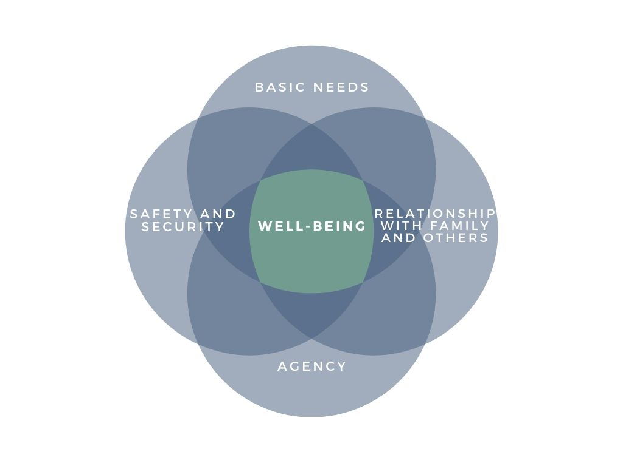
Child Well-Being Domains
Notes:
Review the four global child well-being domains together.
The four domains represented in the measurement framework were selected to build a holistic picture of children’s well-being in humanitarian action, ranging from safety and basic needs to children’s sense of belonging and ability to participate.
Each of these domains may vary according to the age and developmental stage of children, their gender, disability or other diversity factors, and it is likely that each of the domains will have a different meaning or level of importance depending on the age group.

Slide 22
Recommendations
Maintain the common domains to the extent possible.
Modify indicators according to cultural and contextual understandings of child well-being in line with the common domains or modifications made to them (as opposed to modifying on the basis of your opinion).
Given the multi-sectoral nature of child well-being it is important from the onset to engage with other sector colleagues.
Note that individual agencies implementing programs aimed at promoting the well-being of children should include indicators set out in the measurement framework that are relevant to the expected outcomes of their programs in program-specific M&E frameworks.
Notes:
The last point is an important one for data collectors/facilitators of the contextualization workshop to explain to the participants they’ll be interacting with.

Slide 23
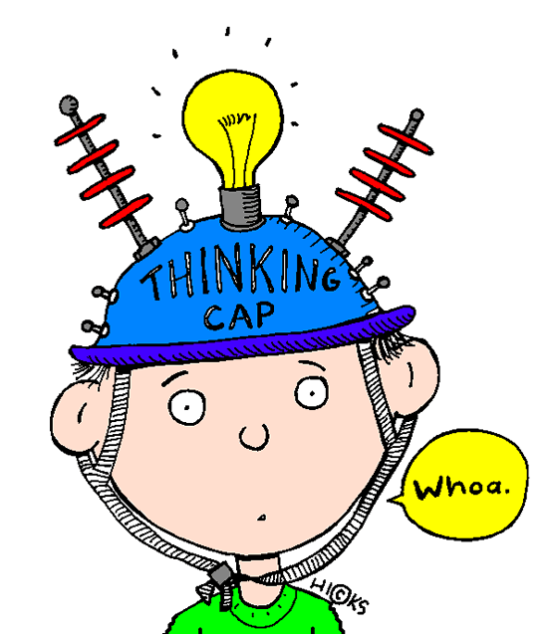
Activity
In your same group or with your same partner as the last activity, review the index cards.
Determine if there are any common themes or specific areas that are highlighted.
Review the global child well-being domains and determine if there are any amendments to make.
Discuss in plenary.
Notes:
This is a practical exercise for the data collectors as they will be facilitating this exercise with the inputs and responses they receive from participants during the data collection process and/or contextualization workshop. It is important to familiarize themselves with the activities that they will be leading in a practical manner.

Slide 24
Any Questions Before Moving On?

Slide 25
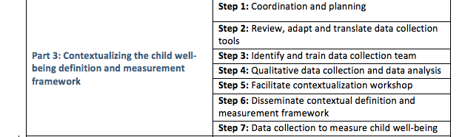
Part 3: Child Well-Being Contextualization Process and Tools
Part 3 of the Guide provides guidance on the key steps to the contextualization of the child well-being definition and measurement framework
Notes:
You are already on Step 3 of the process! You will also have already decided on the process (refer to decision tree in the Guide); in other words, the methods you will use to collect data. Only include those methods that will be used in this training. For instance:
Key informant interviews
Focus group discussions
Contextualization workshop
We will review the process and tools as well as provide an overview of key considerations when conducting interviews and focus groups. Note that this will be a review for the data collectors because they should already have experience in data collection with children and adults.

Slide 26
Key Informant Interviews
Key informants may include:
Key informants will be government staff, local child protection experts or experts from other sectors, service providers, or other relevant local authorities on how child well-being is defined in context. It is recommended that 4 to 12 key informants be interviewed per location.
1 to 2 government officials working for the child protection governing authority (e.g. the Ministry of Social Affairs)
2 to 3 local child protection actors working for international, national, or local organizations or civil society organizations
1 to 2 national/local MHPSS actors
1 to 2 national/local healthcare actors
1 to 2 national/local education actors
1 to 2 national/local social workers/caseworkers
Notes:
Importantly!
There are a balanced number of women and men
Informed consent is collected

Slide 27
Focus Group Discussions
In selecting focus group participants, consider:
A broad range of actors that directly or indirectly work to promote the well-being of children
Children from different age groups
Caregivers of children and community members, including community leaders and religious leaders
Notes:
Explain to the participants the key considerations for facilitating focus group discussions, particularly if you do not plan to use the option section on Interviewing Techniques.
It is important that two qualified facilitators facilitate the focus group discussions. One facilitator can lead the discussion while the other can provide back-up support and act as the note taker. The tips below can help you make focus groups as effective as possible.
Prepare the room
Arrive an hour early to set up the room. This allows time to deal with unexpected room scheduling, and to set up materials and refreshments.
Post plenty of signs so participants can find their way to the space. This helps participants feel welcome when they arrive.
Open the session
Introduce yourself and explain the purpose of the focus group. Explain to participants that they have been invited to share their opinions and feedback and that you will guide the discussion by asking the group to reflect on specific questions.
Explain the expected duration of the focus group.
Obtain informed consent (for children, also obtain informed assent prior to the focus group during the preparation phase).
Explain the ground rules for the focus group discussion. These will set the tone and expectations for behavior to enable everyone to feel safe, encouraging their participation.
Allow time for questions, and ask participants to introduce themselves.
Establish a supportive environment
Explain that participation in the focus group is voluntary
Make it clear that it is all right to abstain from discussing specific topics
All responses are valid—there are no right or wrong answers
Everyone must respect the opinions of others even if you do not agree
Participants can speak as openly as they feel comfortable
Help protect others’ privacy by not discussing details outside the group

Slide 28
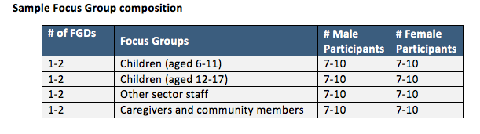
Suggested Focus Group Composition
Notes:
Determine in context whether it is necessary to have separate male and female FGDs with children and caregivers/community members.
Note to facilitator: Return to the Guide for further guidance on how to facilitate a focus group and, if necessary, review with the data collectors.

Slide 29
Reviewing the Focus Group Questionnaire
The sample questionnaire is designed to pose indirect questions to determine how participants perceive a child who is doing well at different age groups.
To understand any shifts in well-being as a result of the emergency, participants can be asked to think about a time before the humanitarian situation and the conditions that caused it, when life was “as it should be” before posing the questions.
Includes questions focused on key developmental tasks per different age groups. These questions will help you to also identify whether ages are perceived differently in accordance with the cultural context than the global age categories.
Notes:
Review the questionnaire together and answer any questions.
The sample FGD questionnaire is for adults as well as for older children aged 12-17 but this age group can be modified in country.
If thinking about life prior to the humanitarian crisis may cause distress or bring up upsetting memories, do not ask participants to reflect on this. It also may not be relevant in your context if it is a protracted crisis that has been ongoing for many years.

Slide 30
Collect Consent: A Refresher
Informed consent is the voluntary agreement of an individual who has the capacity to take a decision, who understands what they are being asked to agree to, and who exercises free choice. When obtaining informed consent, practitioners must disclose, in a child-friendly manner, what information will be collected, how it will be used, and any details regarding confidentiality and its limitations. Informed consent should only be sought from children above the age of consent, as determined by the local laws and mandates.
Informed assent is the expressed willingness to participate in a service or activity. Informed assent is sought from children who are by nature or law too young to give consent, but who are old enough to understand and agree to participate in services or activities. Informed consent from an adult caregiver is necessary in addition to informed assent.
Notes:
These definitions are from the Child Protection Minimum Standards. The importance of collecting consent is essential and you will have already modified the sample consent form in the Guide to make it applicable to your context. Review the definitions of consent with the data collectors, include the consent form.
Remind participants to always obtain informed consent and informed assent from child participants and informed consent from adult participants. For children’s participation, the informed consent is sought from their adult caregiver and informed assent should also be sought from the children themselves. Alternative informed consent/assent methods should be available for children or caregivers who cannot read or write and all relevant information should be presented in simple, age-appropriate language or pictures (if necessary). Support the right of children with disabilities to make their own informed choices. Participants should be reminded by data collectors that they can refuse or withdraw permission at any time.

Slide 31

Activity
Facilitating Focus Groups: A Practical Exercise
Review the focus group questionnaire and participatory activities for focus groups with children.
In a group of 3, facilitate a role play focus group with one person leading as the facilitator and the two others as participants. Each person can ask the questions assigned under one of the age categories (e.g. one person asks questions for early childhood, the next for middle childhood, etc.) and then rotate.
Each person will act as the facilitator for 20 minutes before rotating. Afterwards provide constructive feedback to each other before discussing in plenary.
Make sure to also practice reading out the informed consent/assent forms.
Notes:
This exercise can also be used an opportunity to make any final modifications to the questionnaire.

Slide 32
Thematic Data Analysis
Once data has been collected from KIIs and FGDs, analyze the data, pulling out common themes to present at the contextualization workshop.
Consolidate the responses into common themes and write a 1-2 page summary of the findings. This can be presented at the contextualization workshop when you are explaining the background and summarizing the KIIs and FGDs.
*If a workshop will not be held, simply modify the definition, domains, and indicators as necessary in accordance to the responses.

Slide 33
Any Questions Before Moving On?

Slide 34
Activity
In your groups, review the responses provided during the practical key informant and focus group discussion exercises.
Would you make any changes to the domains and indicators?
If yes, please explain why and what changes you would make.
If no, please explain why no changes are necessary.
Discuss all together in plenary.

Slide 35
Contextualization Workshop
Essentially, the practical exercises you have completed so far will be similar to those activities facilitated at the workshop.
Depending on your experience facilitating the KIIs and FGDs, you may also want to modify questions or activities. Refer to the Contextualization Guide for examples of activities in Annex 1.
Workshop is participatory
Includes no more than 25-30 participants
Participants may include: government representatives; community members, including community leaders, religious leaders, and others working directly or indirectly to promote the well-being of children; actors working in other sectors, such as health, nutrition, and education, camp management; MHPSS actors; caregivers of children, and children.
Notes:
Use this slide if a) there will be a contextualization workshop; and b) if the data collectors will be the same individuals facilitating or co-facilitating the workshop.

Slide 36
Workshop Outcomes
Final contextual definition.
Agreement on the developmental and social age groups: understand how the local community perceive different social and developmental age groups and agree on the ages for infancy, early childhood, childhood, early adolescence and late adolescence.
Final domains in accordance to key elements contributing to well-being in context.
Key indicators by age group to include in the measurement framework (may make suggestions and complete with support from M&E staff after the workshop as this activity may be time consuming).
Notes:
If there is no workshop, all of these points should be agreed upon and finalized following the KIIs and FGDs.

Slide 37
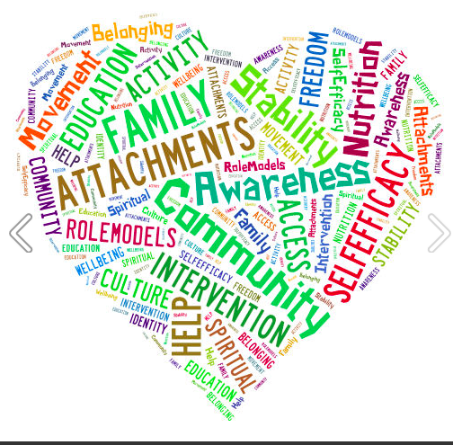
Disseminate Final Report and Share Findings
Whether this exercise is carried out at the individual agency or inter-agency level, it is essential that the findings be shared with child protection and other relevant actors.
A short final report should be drafted and disseminated widely.

Slide 38
Any Questions?
Thank you very much for your participation in today’s training!

Slide 39
Techniques for Facilitating Key Informant Interviews and Focus Group Discussions: A Refresher
Initiating and ending an interview/focus group
Before starting the interview:
Only conduct interviews/focus groups in a place that is secure and private
Be sure to respect cultural practices, such as the proper interaction between males/females, age groups, etc.
Notes:
Data collectors will already have knowledge and experience of interviewing and conducting focus group discussions with adults and children. The purpose of this optional session is to act as a refresher, reviewing the key considerations.
Explain to the participants that it is important that they choose a location that it is private and secure where other individuals cannot listen. When facilitating an interview it is advised that it be conducted outside where others can see you, but are not within earshot. Conducting the interview in a safe, secure location outside allows other members of your team to know where you are, and also avoids any potential risk, for instance, if a female interviewer is in the house alone with a male respondent or vice versa. It may be perceived as inappropriate for a male interviewer to be alone with a female respondent in the house if the father or husband is not present and it is best to avoid any potential conflicts.

Slide 40
Leading an Interview or Focus Group
The principal objective of a data collector is…
To help the respondent understand each question without influencing the answer
Notes:
Be sure to highlight the importance of patience here.
Note that these slides highlight some general principles and guidance related to facilitating key informant interviews and focus group discussions. You may wish to add further details or additional slides depending on the level of experience of data collectors.

Slide 41
Initiating an Interview or Focus Group
To begin:
Introduce yourself and your organization
Explain the objectives of the interview or focus group in a clear and comprehensive way
READ THE CONSENT/ASSENT FORM! Without this form, you cannot proceed with the interview
In some contexts men must interview boys and women must interview girls
Notes:
Remind data collectors to always be respectful, kind and friendly.

Slide 42
During the Interview or Focus Group
Take clear, brief notes if you are using paper
Be patient and kind to the respondent(s)
Do not insist that the respondent(s) answer a question if they appear to be uncomfortable
Be compassionate and listen carefully
Remember when engaging with children that their experiences are valid
Use simple and clear words
Respect the children like you would adult respondents
Notes:
Remind trainees that respondents can refuse to respond to a question or they can end the interview/leave a FGD at any time. The interviewer can ask why the respondent wishes to end the interviewer, but they should not push the interviewee to continue or to answer any questions that make them feel uncomfortable. Compassion, understanding, and patience are key!

Slide 43
Ending an Interview or Focus Group Discussion
Summarize the discussion and ask if there are any final comments to make
End the interview by thanking your respondent(s) for their time and contribution
Explain that they can contact the name of the focal point on the consent form at any time if they have questions or concerns

Slide 44
Leading an Interview or Focus Group
Techniques
The main technique to help respondents is probing
If the respondents do not understand a question or do not reply directly to the question, explain the question again
If necessary, ask them if they would like some more details
If there are certain words or phrases that are difficult to understand, explain them in a simpler manner
Example: The respondent answers the question: “What is the local understanding of child well-being?” by telling you that it means that a child is well

Slide 45
Probing Techniques
Elaboration
“Can you please tell me more about…”
Detail
“Can you please be more specific about…”
Clarification
“I heard you say ______. Does that mean _____?”
Support
“I understand that it may be difficult to talk about ___________”
BUT! Be careful with your probing: do not “lead” the respondent or imply that certain answers are better than others
Notes:
Explain the different phrases that can be used to probe. You can also add a practical exercise here for participants to practice probing.

Slide 46
Challenges in Facilitating Interviews and FGDs
What are some other challenges that may arise?
Refusals: Sometimes the respondent does not want to participate
Exhaustion: What happens if the respondent(s) get distracted or does not want to continue?
Dealing with ‘I Do not Know’: How do you respond if the person you are interviewing or the group answers “Do not know”?
Maintaining Privacy: What to do if other people try to listen to your conversation?
Notes:
1. Answer: Ask that they take some time to listen to you, but do not try to convince or force them to participate if they do not want to. Offer to arrange another time to discuss. Note that arranging the interview in advance will also help to mitigate any refusals.
2. Answer: Be understanding and patient, discuss with them, and ask them very kindly to continue. If this does not work, they are free to leave.
3. Answer: Ask them to take their time. Use some probing techniques. If they still answer the same way, do not push them; simply record it and move on.
4. Answer: Ask them nicely to allow some privacy and move along; you may offer to answer their questions later

Slide 47
Any Questions?
Thank you for your participation!

Slide 48
Measuring Child Well-Being
Introducing the child well-being measures
Objectives – What can these tools be used for?
The child well-being measures are self-reported measures of well-being. The tools can be used to gain a snapshot of how well children are doing in the communities where you are working or plan to implement activities. They are easy-to-use, child friendly tools that can be employed to:
  Broadly understand how well children are doing in a specific location
  Determine important characteristics and needs of children
  Identify priority areas of concern to inform program planning and interventions or areas in which to build strengths
  Monitor improvements in the dimensions of child well-being over time, and
  Support advocacy for resources or improvements in the quality of service provision.

Slide 49
Audience – Who Can Use These Tools?
These tools can be used by all actors working to enhance and promote the well-being of children. These actors include:
Child protection actors from local, national or international NGOs
Government representatives
Other relevant stakeholders that work with children, such as MHPSS, education or health actors

Slide 50
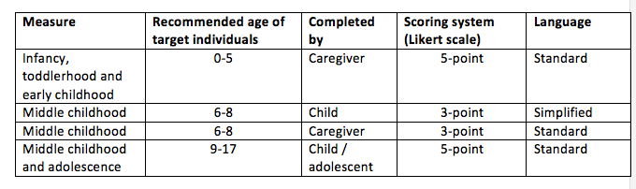
Introduction and Overview of Measures
The measures include four tools suitable for children aged 6-8 and 9-17, and adult caregivers who can report on children aged 0-5 and 6-8 who are in their care.
Scored on a 3- or 5-point Likert scale
Notes:
The items in the questionnaires are all formulated in the positive and therefore scoring involves simply summing up the responses. The measures targeting younger children aged 6-8 and their caregivers use a 3-point Likert scale. The questionnaire for child respondents in this age group uses simplified language to make sure the child respondents can easily understand the questions and that they are child-friendly.
The measure for caregivers of children aged 6-8 can be used on its own, for instance, in contexts where there are ethical or safety concerns related to children’s involvement in the child well-being survey, or alongside the measure for children aged 6-8.

Slide 51
Contextualizing the Measures
Important!
The items included in the measures, age groups, and language may need to be modified depending on the outcomes of the contextualization process.
If there are modifications to the child well-being definition, age groups, domains or indicators, amend the measures accordingly to ensure alignment and determine whether or not new statements need to be added or existing ones removed.
Notes:
Link this review to Day 1 and ask the participants if there are any items or domains that should be modified in line with the modifications (if any) that the definition, domains, or indicators received on Day 1 during the practical exercises. What amendments should be made, if any?

Slide 52
Administering the Measures
The measures can be administered on their own or used alongside wider population-based assessments.
They can be administered to participants in groups or individually (e.g. when conducting a household survey).
Each measure takes approximately 15-20 minutes to complete, depending on the age of the participant, their level of comprehension, and the addition of any new items.

Slide 53
Administering the Measures Continued
Review and explain the measure to participants, allowing time for questions.
Decide whether to read the items out loud to participants or allow them to complete the measure at their own pace. If you are unsure about the participants’ level of literacy or comprehension (most notably the 6-8 age group), reading aloud may be a better option. If participants have the measure read to them, their responses should still be self-completed to encourage truthfulness.
Consider turning the Likert responses to represent visual cues (such as smiley faces or cups filled with different amounts of water). Visual aids can help participants understand which response to choose.
Work individually with children aged 6-8 to make sure they understand each item in the measure.
Pilot each measure with 2 or 3 respondents and make any necessary adjustments prior to administering them to a larger sample.

Slide 54
Sampling
The sampling method you choose for the child well-being survey will depend on whether the survey questionnaires are administered alongside a wider child protection, multi-sector or joint assessment survey, or as a standalone survey. If you are using it alongside a wider assessment, follow the sampling procedure that is being used for the purpose of that assessment.
If you are completing the child well-being survey to inform the design of questions for a wider assessment or to derive data that can be triangulated with wider assessment findings, or simply as a standalone exercise, it is recommended that non-probability sampling be used.
The sample size should be no less than 30 participants per each of the measures in each target location.
Notes:
Non-probability sampling is a sampling technique in which samples are selected based on the subjective judgment of the child protection actors involved in measuring child well-being rather than on random selection. Non-probability sampling is often used when there are time or resource considerations. Despite the results from surveys administered using non-probability sampling not being representative to a wider population, the results can nonetheless be useful in identifying key themes in an area as well as the respondents’ prioritization of various issues.
It is important to consider the following when deciding on the sampling approach:
Objectives of sampling—whose voices do you need to hear, and why?
Access constraints—if you cannot access certain populations, are there ways you could connect with people who come from or who have information about those populations? For example, convenience sampling can often lead humanitarian workers to speak with those people who have the most access to humanitarian support. Be intentional in trying to reach out to children and adults who may benefit from humanitarian action but have less access to you.
Available resources (financial and human) and length of time to administer the measures.
If populations with distinct characteristics (such as language, ethnicity, place of origin, status, etc.) live together in one site, and you believe that these characteristics are likely to have an impact on how each group understands child well-being, these locations should be divided into multiple sites along the lines of those distinct characteristics regardless of their size. Likewise, be intentional about sampling children and adults whom you understand from preliminary research or data collection activities to be more vulnerable to child protection violations. These may include gender differences, disability status, ethnic or racial affiliation, sexual orientation or gender identity/expression, or other locally salience considerations.

Slide 55
Scoring
Items within the measures can be directly summed to gain a total score of the child’s well-being.
All items in the measures are weighted equally.
Notes:
Add the total scores according to the measures you will be using and any modifications that you have made to them.
Importantly, in addition, a sub-score will be provided for each of the domains. These sub-scores will show whether there are certain aspects of well-being that are lacking, and can be used to inform appropriate interventions.
If a respondent skips or misses an item, their scores cannot be computed, as their overall score will be artificially lower than others who complete the measure. If this happens, the incomplete result should be discarded.

Slide 56
Understanding and Interpreting Scores
Higher scores indicate characteristics associated with well-being.
Compare high scorers to low scorers and investigate potential reasons for these differences.
Very important that the sub-scores for each domain also be analyzed.
The data derived can be triangulated with wider assessment data. Recall that in triangulation, we collect the same information (e.g., a particular set of indicators) from different sources or using different methods.
Notes:
While aggregating the total scores can provide an overall picture of how well children are doing at a given time and in a specific location, aggregated scores across all of the domains do not reflect the possible variation underlying those total scores, which may result in serious issues affecting children being underestimated.

Slide 57
Measures with a Scale of 1-5:
5 = Very well The child is doing very well and there are no concerns or apparent risks for the child.
4 = Well The child is doing well; there are no concerns and no apparent risk for the child.
3 = Fair The child or their situation is generally acceptable, but there is room for improvement. Additional resources, services or support will be helpful.
2 = Not doing well There is concern that the child or situation they are in will lead to harm. Additional resources, services or support are needed.
1 = Very bad The child is at serious risk of harm or is already experiencing harm. Urgent attention to the child or the situation is needed.

Slide 58
Measures with a Scale of 1-3:
3 = Doing Well The child is doing well; there are no concerns and no apparent risk for the child.
2 = Fair The child or their situation is generally acceptable, but there is room for improvement. Additional resources, services or support will be helpful.
1 = Not doing well There is concern that the child or situation they are in will lead to harm. Additional resources, services or support are needed.

Slide 59
Activity (1h30)
Practice administering one or two of the measures in role play
While the measures are self-reported, for the purpose of this role play exercise, one partner should act as the data collector and the other partner as the respondent before switching.
The data collector should read and practice explaining each item.
Work together to total the scores and discuss what the total scores mean in line with the guidance provided. What do the scores per each domain tell you?
Based on the scores, what activities might you/your agency prioritize? Discuss with your partner before sharing in plenary.

Slide 60
Any Questions?
Thank you for your participation!
Notes:
Ask if there are any final questions before closing the training.
Discuss next steps. For instance, provide the participants with a schedule or timeline of who they will be interviewing, the focus group discussions, the workshop with dates and locations, etc.

