Slide 1
The Minimum Standards for Child Protection in Humanitarian Action
CPMS
SLIDE DECK
Notes:
Facilitators:
This briefing is for any potential user of the CPMS. It is geared primarily toward child protection staff, so consider broadening some questions or providing more detail, if colleagues from other sectors join you.
It is assumed that the group is about 20 people and that everyone in the room knows each other (perhaps colleagues from your agency or the CP coordination group). if not, add 5 minutes for quick introductions.
PREPARE: a flipchart with the objectives of the session
By the end of the session, participants will be able to:
Describe the content of Standard 7
Explain & Share its key messages
Demonstrate how & why to use the handbook
NOTE: if you have already done a Session on Pillar(s), Principles or other Standard(s), skip slide 2 & 8
TIP: Slides are animated -> for each click you’ll make, some few words, a title or an image will appear on the slide.
Read the corresponding notes from the facilitators notes, before showing the following content, so participants have time to process what you say, and read each point.

Slide 2
Aim of the Standards
Benchmark for CPHA.
Collaborative, inter-agency tool
Links with Core Humanitarian Standard
Contextualisation for local ownership
Purpose:
quality and accountability
impact for children’s protection and well-being
Notes:
Donors, local governments, colleagues in other sectors and our beneficiaries themselves want to know what we are doing and why. The CPMS are our benchmark. They are the key way to operationalise or make real children's rights in the practice of humanitarian response.
They are a collaborative, inter-agency tool, that links with other initiatives, such as the Core Humanitarian Standard, INSPIRE and the Humanitarian Inclusion Standards
Wherever relevant, the CPMS align with INSPIRE’s 7 strategies to end violence against children – initiative’s icons are actually scattered through the text. In addition, the Core Humanitarian Standard on Quality and Accountability is highlighted in the Introduction and resonates throughout the handbook.
Contextualisation is encouraged and can create ownership of the standards at every level. It builds a deeper understanding of child protection in the specific context for a wide range of actors. National coordination groups are therefore encouraged to adapt the CPMS. Please raise it with colleagues locally and then seek the guidance of the global CPMS team. For more information, watch the short contextualization video on the Alliance’s youtube channel.
BOX: The CPMS aim at improving the quality and accountability of our programing and increasing impact for children’s protection and well-being in humanitarian action (across all contexts), by establishing common principles, evidence, prevention and goals to achieve. They provide a synthesis of good practice and learning to date.

Slide 3
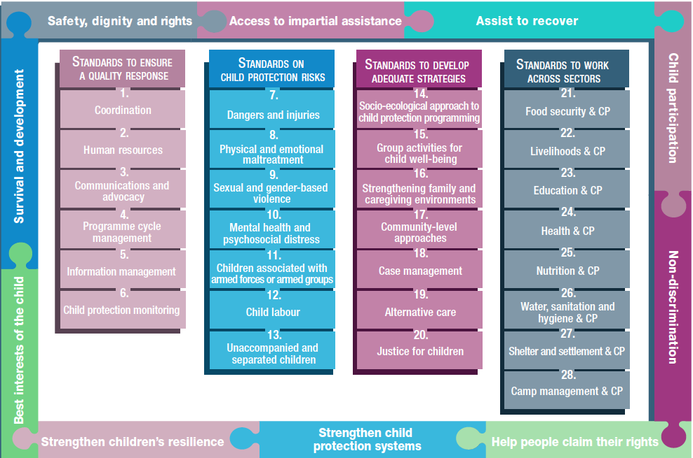
Overview
Notes:
This is an overview of the CPMS structure: there are 28 Standards across 4 pillars and 10 CPHA principles threaded throughout.
You can find this overview on the back of the CPMS handbook or in the online handbook; it’s a practical way of locating quickly a specific topic.
This presentation focuses on Standard 7: Dangers & Injuries

Slide 4
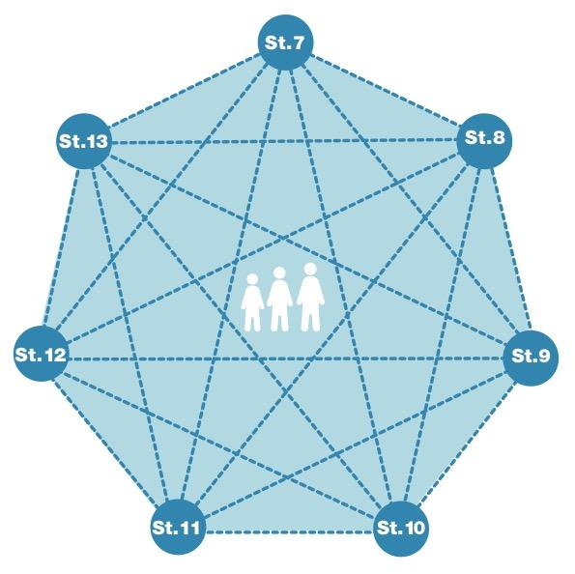
General intro to Standard 7
Part of 2nd Pillar, related to child protection risks
RISK = Nature & Extent of hazard + Vulnerability - Resilience
Protection against injury, impairment and death
Physical safety as a priority concern
Multisectoral and coordinated interventions
What types of hazards & dangers can you think of?
Notes:
This Standard is part of the second Pillar related to child protection risks that children may face in humanitarian settings. All the seven different risk standards are linked, as they address overlapping vulnerabilities and risks. The risks cannot be addressed in isolation.
Child protection risks are potential violations and threats to children's rights that will cause harm to children. To understand a child's risk, we need to understand the nature (type of hazard, situation, threat…) & extent of the risk and the individual child’s vulnerability to that risk, but also the family/child coping or survival strategies (meaning their resilience and ability to withstand the risk). Vulnerability is understood as the extent to which a child has characteristics that reduce his ability to withstand adverse impact. We have to record that vulnerability is specific to each person and each situation
Humanitarian crises can increase everyday hazards and risks, as well as create new ones, particularly for children who are displaced in unfamiliar surroundings. This standard addresses the prevention of and response to physical and environmental dangers that injure, impair and kill children in humanitarian crises, considering that children consistently identify their physical safety as a priority concern, and they are a leading cause of death amongst children of all ages globally
It calls for a multisectoral and coordinated response, a linkage with sectors like health, and tailored support, that prevent and reduce the impact of childhood injuries and impairments. The Standard stresses the importance to establishing and strengthening data-sharing protocols, injury case definitions and systematic referrals between child protection, health and other sectors’ service providers. [→ the case management icon]
Discussion Prompt: What types of hazards & dangers can you think of?
->Common unintentional injuries include:
Drowning (in ponds, rivers, lakes, oceans, wells, domestic water tanks, pit latrines, etc.);
Fall-related injuries (trees, play equipment, cliffs, pits, trenches, structures, etc.);
Burns (fire, hot liquids/food, electrocution);
Road traffic crashes;
Wounds or bites from animals (snakes, insects, etc.);
Unintentional poisonings (cleaning agents, medicines, chemicals, etc.);
Wounds from sharp objects (knives, barbed wire, glass, vegetation, etc.); and
Exposure to hazardous waste and other environmental pollutants.
Areas affected by disaster and conflict may present additional hazards such as:
Collapsed or damaged infrastructure (including exposed electrical and barbed wires);
Construction sites;
Falling or flying objects (trees or branches, bricks, rubble, roof tiles, etc.);
Explosive ordnance (landmines and other unexploded ordnance such as cluster munitions, improvised explosive devices [IEDs], mortars, grenades, ammunition, etc.);
Chemical weapons; and
Exposure to crossfire, guns and other weapons

Slide 5
“All children and caregivers are aware of and protected against injury, impairment and death from physical and environmental dangers, and children with injuries and/or impairments receive timely physical and psychosocial support.”
Systematic childhood injury surveillance & data
Working across sectors/actors and with communities
–> prevention, mitigation and response measures
Mines/explosive ordnance survivors
Notes:
Standard 7 states: “All children and caregivers are aware of and protected against injury, impairment and death from physical and environmental dangers, and children with injuries and/or impairments receive timely physical and psychosocial support.”
Child protection actors should coordinate with health actors to establish or strengthen systematic childhood injury surveillance. The definition of an ‘injury case’ (whether a child has an injury or injury-related condition) forms the basis of injury surveillance and data analysis, and identifies specific clinical criteria and limitations on the child, event, time and place. It should be developed locally and may be used for all and/or specific types of injury. Harmonised, coordinated and disaggregated data sets provide an evidence base for injury prevention policy and practice (by Sex/gender, age and disability; Cause of injury/death, location and circumstances)
There is a clear link between this surveillance/data and designing prevention and response measures, which are based on information about how where and why children are killed or injured. Also working across sectors/actors and with communities is critical to put in place practical, evidenced based, locally driven prevention and response measures
Survivors of mines/explosive ordnance should be identified. The Child Functioning module provides a standard method for assessing the prevalence of functional difficulties among children and monitoring their participation in services.

Slide 6
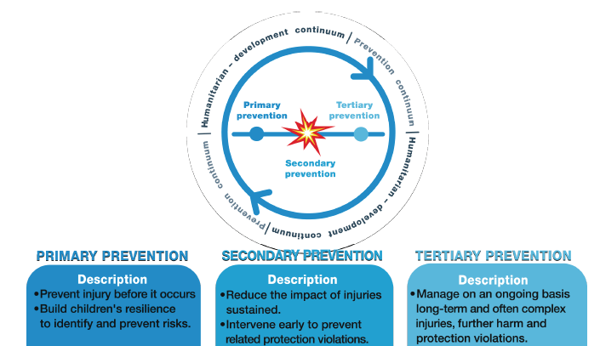
Promoting children’s safety
Prevention
Activities:
Risks identification and reporting
Evidence base and targetting
Response
Behavioural change
Prevention and awareness-raising
Peer-to-peer education
Tailored risk education
Notes:
Programmes that promote children’s safety should include:
The identification and reporting of risks;
Evidenced base and targetting : develop an evidence base about which children are killed or injured; by what; when; where; and under which circumstances. This should inform targeted and tailored prevention, mitigation and response for those who are most at risk;
Timely response by service providers;
The likelihood that people change their behaviour to support children’s physical safety;
Implementing prevention and awareness-raising activities
Peer-to-peer education (youth radio, role-plays, street theatre, etc.) that enable children to share knowledge by age-appropriate means.
Tailored risk education methods in educational facilities and for children & adolescents out of school, in child labour, with disabilities or attending non-formal or religious schools or learning environments
-> Those activities must be child-led initiatives and projects, as well as community-level activities, and led by CP mechanisms, structures, and system.
Practical example: if through injury surveillance or reporting at the camp level it’s identified that burns are frequently occurring in adolescent girls who are cooking or using ovens while their parents are working etc., mitigation measures can be put in place and risk education can be targeted.
Actions for primary, secondary and tertiary prevention of injuries should be based on evidence. Prevention happens across all phases of humanitarian (and development) action. See diagram

Slide 7
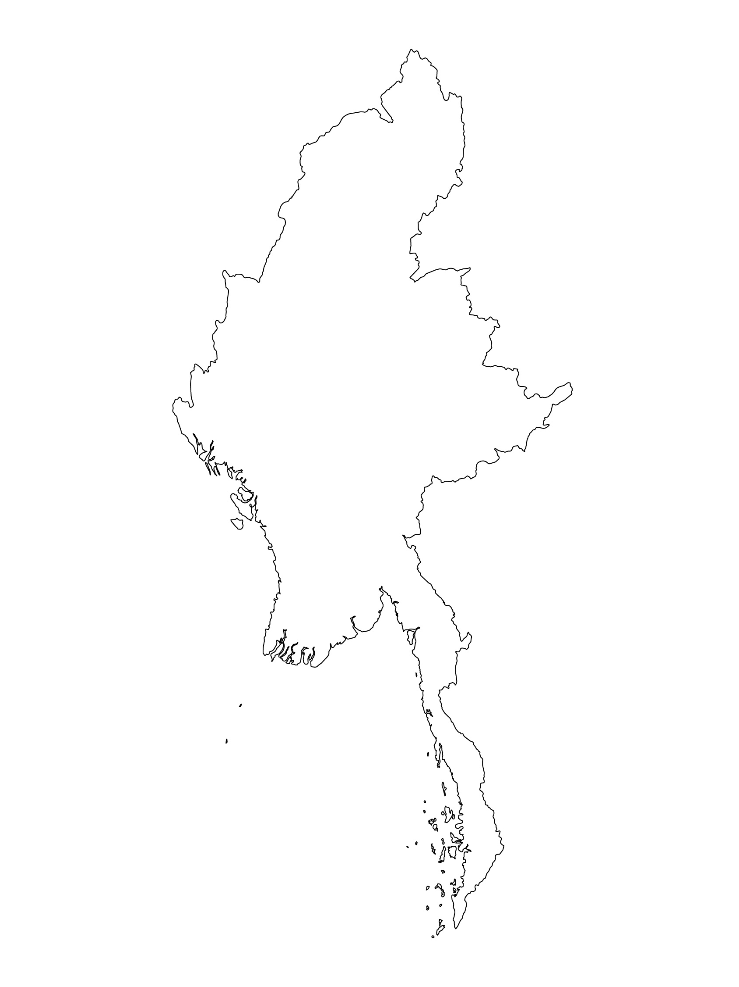
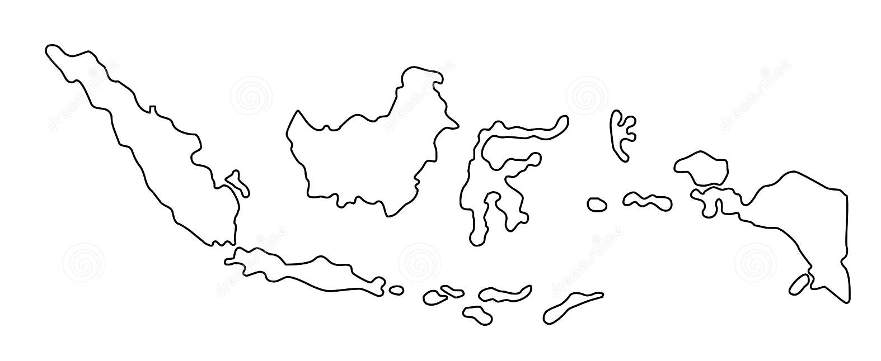
Examples from the Region
[COUNTRY NAME]
Add key presentation sentence about a specific program/project Standard 7
Add name of organisations
Add key message / numbers
[ COUNTRY NAME]
Add key presentation sentence about a specific program/project using Standard 7
Add name of organisations
Add key message / numbers
[ COUNTRY NAME]
Add key presentation sentence about a specific program/project using Standard 7
Add name of organisations
Add key message / numbers
Notes:
Depending on the time you have for facilitation, consider adding here examples from the Region/ Country/ Response, of programming that meets the standards.
This could be a draft slide that you could update or remove if necessary.
For each example, you could add:
A short, concise, key presentation sentence about the specific program/project using Standard 7
Add the name of organisations and partners involved
Add practical lessons learnt, key actions, message or numbers, that will attract interest of your audience
Another option, if you have longer (and also depending on the audience you have), this slide can be completed in an interactive way during the session.
In that case, you could:
split the groups into 2 or 3 smaller groups,
allow 15 – 20 min for them to prepare a short presentation of an example from the Region/ Country/ Response, of programming that meets the standard
in plenary, have the groups present their examples, and discuss /compare lessons learnt out of them.
If you will be sending this presentation to the participants after the training, you can fill up this slide, to keep records of the presentations.
TIP: you can use https://thenounproject.com/ to get map outlines like those.

Slide 8
Need more than the hard copy?
On the Alliance website
PDF version
Briefing & Implementation Pack
25-page Summary
E-course
YouTube videos
A gallery of illustrated Standards
👉 www.AllianceCPHA.org
On the Humanitarian Standards Partnership website
Online, interactive version
HSP App for mobile phones and tablets
👉 www.HumanitarianStandardsPartnership.org
Notes:
[Facilitators - if you can project from the internet, then we suggest you navigate people there and show them]
HSP:
1. Online handbook
2. The Humanitarian Standards Partnership App
– It is the 2nd most popular app on that site after Sphere
CPMS page:
1. Interactive handbook – our greatest resource
2. A Summary: At just 32 pages, it means that it I CPHA topline but can be used to introduce the idea of minimum standards or start child protection discussions with government colleagues or other humanitarians without overwhelming them with the huge handbook.
Alliance website:
The PDF & all materials available can be downloaded if people want to print just portions of the CPMS, on the Alliance site
The “Introduction to CPMS” Briefing Pack contains this PPT and facilitation notes, plus the 2 page Introduction handout.
A gallery of illustrated Standards
Discover our free CPMS e-course with a range of modules
Videos on the Alliance Youtube channel
ASK: What should our next steps as a team/agency/individual be?
(i.e. you might schedule a longer meeting to digest the changes and create a plan; or ask colleagues to present certain new/revised standards and their implications for the programme; or set up a training or ask Senior Management for a meeting to discuss accountability to children, etc)
[Facilitators - Printed copies – there is a small stockpile of the Handbook and Summary that the global Alliance has in Geneva; however, countries and regions are encouraged to print & manage their own copies locally. Usually, this would be done through the inter-agency Coordination structure. On request, the Alliance can share a print-ready PDF.]
Thank you so much for coming together and starting to explore the CPMS. I will follow up on the next steps we discussed. And that’s the key – the CPMS is a gift that just keeps on giving every time you open it!

