Slide 1
The Minimum Standards for Child Protection in Humanitarian Action
CPMS
SLIDE DECK
Notes:
Facilitators:
This briefing is for any potential user of the CPMS. It is geared primarily toward child protection staff, so consider broadening some questions or providing more detail, if colleagues from other sectors join you.
It is assumed that the group is about 20 people and that everyone in the room knows each other (perhaps colleagues from your agency or the CP coordination group). if not, add 5 minutes for quick introductions.
PREPARE: a flipchart with the objectives of the session
By the end of the session, participants will be able to:
Describe the content of Standard 4
Explain & share its key messages
Demonstrate how & why to use the handbook
NOTE: if you have already done a Session on Pillar(s), Principles or other Standard(s), skip slide 2 & 8
TIP: Slides are animated -> for each click you’ll make, some few words, a title or an image will appear on the slide.
Read the corresponding notes from the facilitators notes, before showing the following content, so participants have time to process what you say, and read each point.

Slide 2
Aim of the Standards
Benchmark for CPHA.
Collaborative, inter-agency tool
Links with Core Humanitarian Standard
Contextualisation for local ownership
Purpose:
quality and accountability
impact for children’s protection and well-being
Notes:
Donors, local governments, colleagues in other sectors and our beneficiaries themselves want to know what we are doing and why. The CPMS are our benchmark. They are the key way to operationalise or make real children's rights in the practice of humanitarian response.
They are a collaborative, inter-agency tool, that links with other initiatives, such as the Core Humanitarian Standard, INSPIRE and the Humanitarian Inclusion Standards
Wherever relevant, the CPMS align with INSPIRE’s 7 strategies to end violence against children – initiative’s icons are actually scattered through the text. In addition, the Core Humanitarian Standard on Quality and Accountability is highlighted in the Introduction and resonates throughout the handbook.
Contextualisation is encouraged and can create ownership of the standards at every level. It builds a deeper understanding of child protection in the specific context for a wide range of actors. National coordination groups are therefore encouraged to adapt the CPMS. Please raise it with colleagues locally and then seek the guidance of the global CPMS team. For more information, watch the short contextualization video on the Alliance’s youtube channel.
BOX: The CPMS aim at improving the quality and accountability of our programing and increasing impact for children’s protection and well-being in humanitarian action (internal displacement and refugee contexts), by establishing common principles, evidence, prevention and goals to achieve. They provide a synthesis of good practice and learning to date.

Slide 3
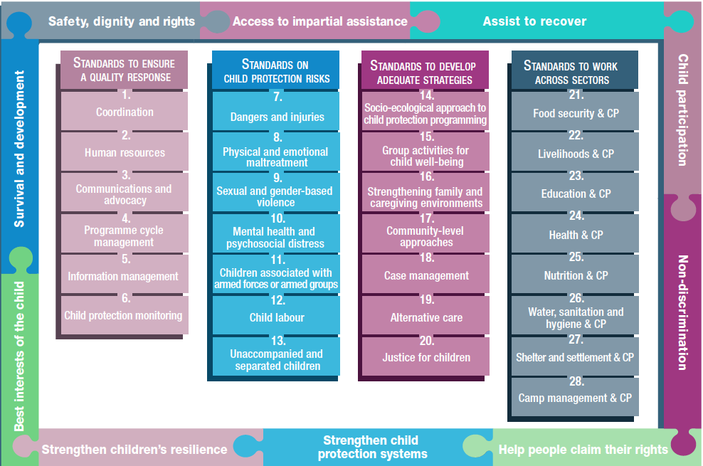
Overview
Notes:
This is an overview of the CPMS structure: there are 28 Standards across 4 pillars and 10 CPHA principles threaded throughout.
You can find this overview on the back of the CPMS handbook or in the online handbook; it’s a practical way of locating quickly a specific topic.
This presentation focuses on Standard 4: Programme cycle management

Slide 4
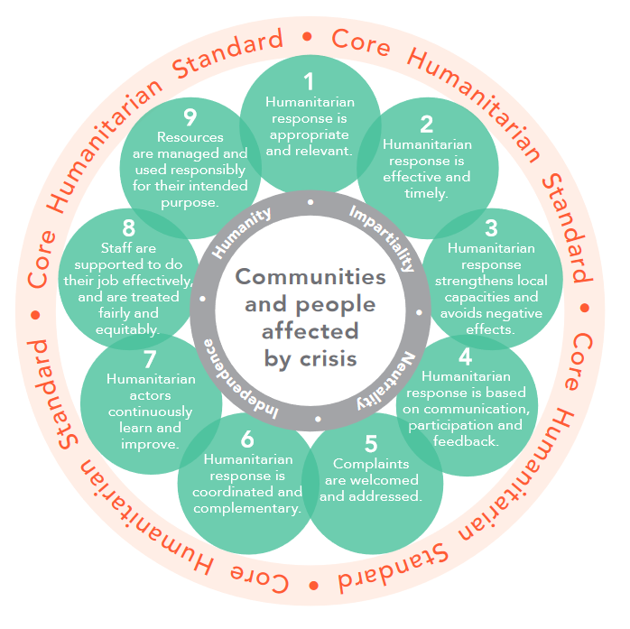
General intro to Standard 4
Part of Pillar 1 related to quality response
To be used w/ Standards (7–28) & the CPMS principles
CHS
Child-protection oriented programming
Processes and methodologies to design, plan and manage
Learning to adjust programmes
Feedback and complaints mecanisms
What are the steps in
PCM?
Notes:
This Standard is part of the first Pillar related to quality response, which are common across all areas of child protection programming, applicable in all situations and contexts, during preparedness and response phases. They are ALL fundamental to reach the level of quality we are aiming for as practitioners.
These Quality standards should be used in conjunction with all the rest of the Standards (7–28) & the CPMS principles
This Standard is complementary to the Core Humanitarian Standard on Quality and Accountability (CHS),as a whole, and should be used with it.
DEF: Programme cycle management is the cyclical process of designing, planning, managing, monitoring and evaluating programmes. Based on learning and evidence generated through the 5 steps, programming should be continuously adapted. (see image of the programme cycle)
This standard brings a child protection focus to programme cycle management by including considerations related to child development and child rights in humanitarian action. It highlights the importance of child-protection oriented programming.
The idea is to ensure that CP programmes are designed, planned, managed, monitored and evaluated through structured processes and methodologies
It stresses the importance of continuously adapting our programmes, based on learning and evidence generation collected by contextualized PCM methods, tools and procedures
We need to set up proactive mechanisms to gather the feedback from the children and the community members (which can include inquiries and complaints) to reorient / adjust intervention (the approach, methodology…) or address safeguarding issues (CHS commitment 4 and 5)
This Standard links especially with the approach of prevention, intending to mitigate any risks programming might directly or indirectly cause (w/ data collection for instance) [→ the prevention icon]
Discussion Prompt: what are the steps in PCM?
-> The programme cycle consists of five core steps: (1) preparedness; (2) needs assessment and situation analysis; (3) design and planning; (4) implementation and monitoring; and (5) evaluation and learning.

Slide 5
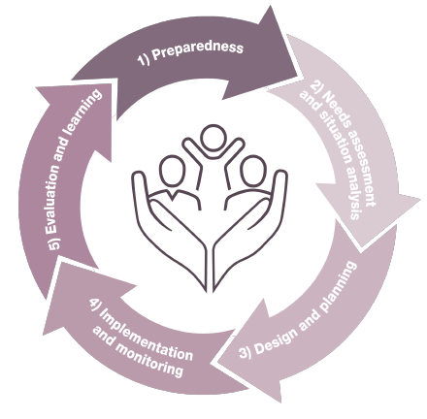
“All child protection programmes are designed, planned, managed, monitored and evaluated through structured processes and methodologies that build on existing capacities and resources, address evolving child protection risks and needs, and are continuously adapted based on learning and evidence.
STEP 1: Preparedness
Understand:
child protection systems
cultural and social norms
community-level CP capacities
laws and policies
-> risks, needs and capacities
Notes:
Standard 4 states: “All child protection programmes are designed, planned, managed, monitored and evaluated through structured processes and methodologies that build on existing capacities and resources, address evolving child protection risks and needs, and are continuously adapted based on learning and evidence.”
(1) Preparedness:
The Standard emphasises that the starting point for any intervention is an understanding of the current child protection situation in a given context. This includes:
- Understanding formal and informal child protection systems at all levels of the socio-ecological model
Understanding cultural and social norms related to children and their protection, gender roles and identities
Investigating community-level child protection interventions and protection capacities, including traditional coping mechanisms;
Knowing about the the international legal framework, domestic laws and policies related to children’s rights and at-risk populations; and
Other information relevant to the protection of children.
This entails not only looking at needs, but also understanding the inherent capacities of children, families, communities and the child protection system in a given context, and where possible, using a rights-based approach.

Slide 6
STEP 3: Design & Planning
Unmet CP needs
Responding to needs (St.15-18)
Complementarity
Programme focus
Achievement(s) & Budget
STEP 2: Assessment / Analysis
Context, stakeholders, needs, vulnerabilities and capacities
Evidence base for strategic planning
Quality process
STEP 4: Implementation / Monitoring
Outputs and outcomes
Quality (St. 1-6)
Safeguarding
Do no harm
STEP 5: Evaluation & Learning
CPMS as guide
Involvement of stakeholders / children
Joint learning initiatives
Flexibility in programming
Notes:
(2) Needs assessment and situation analysis
A structured and coordinated assessment and analysis of child protection needs and communities’ resources and capacity to protect children is a critical part of a child protection humanitarian response.
Assessments and analysis of the data provide the evidence base for strategic planning, and establish baseline information upon which situation and response monitoring systems will rely.
How information is gathered, shared, protected, analysed and used to inform programme and project design determines whether it is a quality process that enables better protection for children and meets their needs in an appropriate and respectful manner that facilitates community ownership.
(3) design and planning
Child protection programmes should be designed to address the most prevalent and widespread child protection needs that cannot or will not be met by the existing State or community capacities, prioritising life-saving actions in the early response phase, while building on functioning structures/sustainable, community-level approaches where they do exist
The CPMS child protection strategies (Standards 15-18) can be used to address the priority child protection needs as detailed in Standards 7-14.
Plan and implement actions that create complementarity between community-, national-, and international-level organisations so that the humanitarian response strengthens, and does not undermine, existing structures and systems.
Child protection programmes should focus on: Preventing or mitigating the factors that expose children to risk; strengthening children’s resilience; supporting families to care for and protect their children; considering marginalised children and those most at risk; reinforcing the existing protective mechanisms within communities, including informal community-based protection mechanisms and other community- based organisations; and fortifying or extending the existing components of the child protection system.
It is important to think through the end game during the design phase in terms of what the programme should achieve and a budget covering quality implementation, monitoring, evaluation and learning activities.
(4) implementation and monitoring
Checking on how our activities impact on the children, what progress the programmes are accomplishing, through outputs and outcomes monitoring, is key.
The CPMS Standards 1-6 can be used to ensure quality, that depends on: coordination; human resources, including child safeguarding policies; communication, advocacy and media; programme cycle management; information management and monitoring.
The CPMS details key considerations as regards child safeguarding considerations (i.e. child-friendly and gender-, age-, disability- and culturally sensitive mechanisms).
Programme plans and services should be inclusive and accessible from the beginning of implementation, and should mitigate risks, unintended negative consequences of programme interventions, and ensure that engaging children and communities in monitoring will not cause harm
(5) evaluation and learning
One of the key ways the Standards can be used is to guide evaluation of the quality and effectiveness of humanitarian interventions. The CPMS can help structure and inform the evaluation by providing a baseline of good practice, benchmarks for key actions & indicators against which the child protection project or programme can be assessed.
The CPMS also inform the evaluation process, guiding the evaluation process itself, through involvement of stakeholders and consideration of the principles. The people affected, including children, are the best judges of changes in their lives and the CPMS emphasise their participation in the evaluation and learning processes.
This standard encourage coordinating and engaging in joint learning initiatives
It is important to allow flexibility in programming to incorporate feedback, adjust programmes and inform the design of future interventions

Slide 7
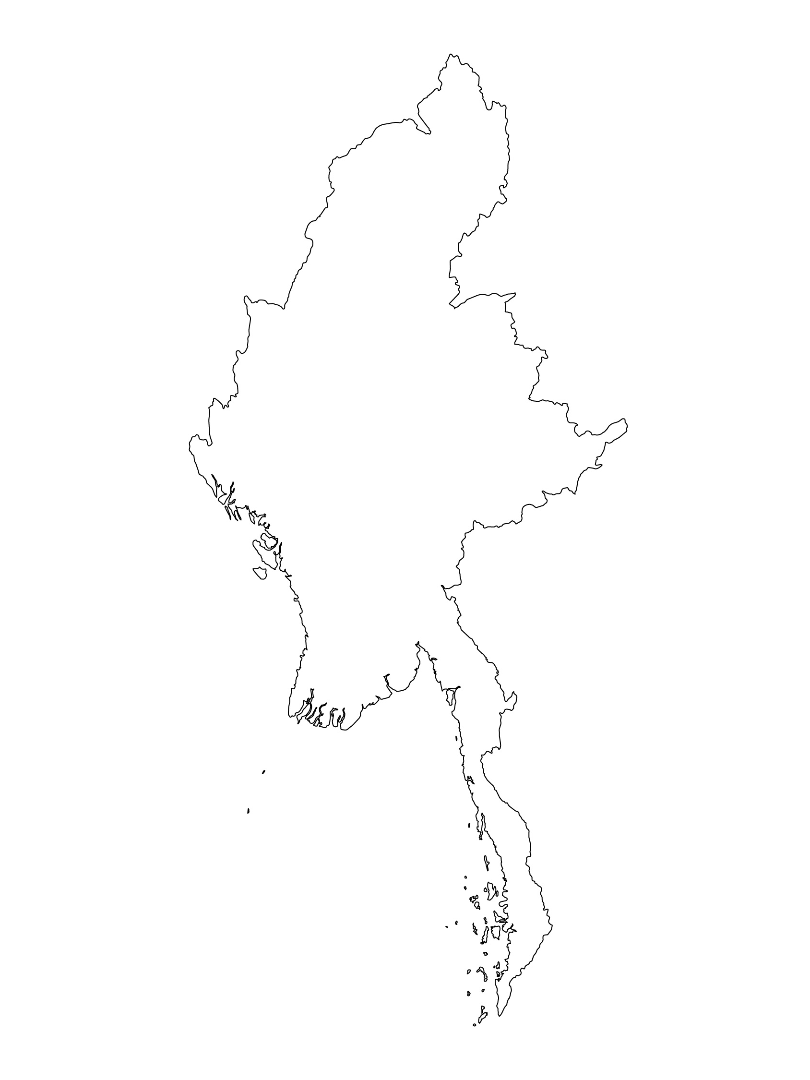
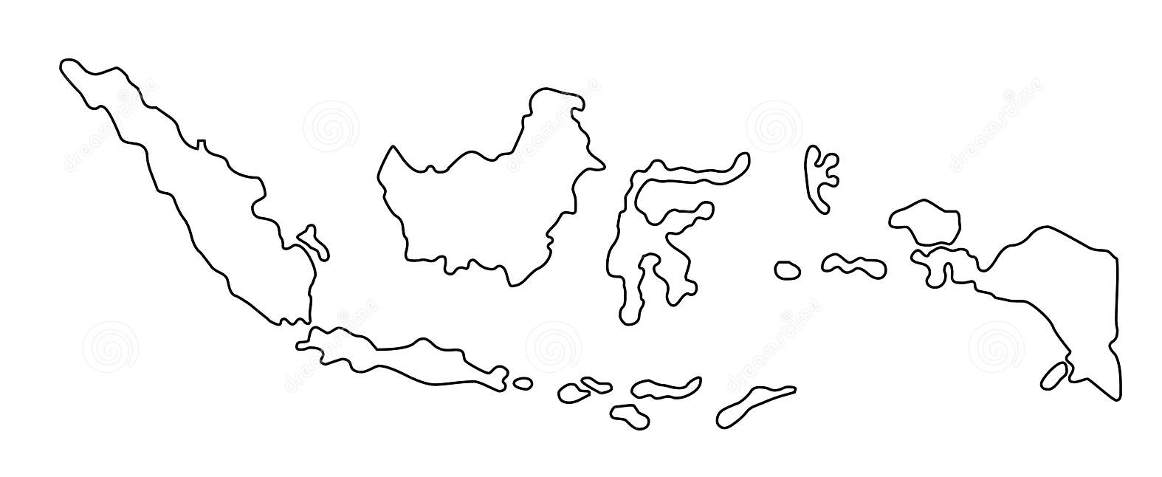
Examples from the Region
[COUNTRY NAME]
Add key presentation sentence about a specific program/project using Standard 4
Add name of organisations
Add key message / numbers
[ COUNTRY NAME]
Add key presentation sentence about a specific program/project using Standard 4
Add name of organisations
Add key message / numbers
[ COUNTRY NAME]
Add key presentation sentence about a specific program/project using Standard 4
Add name of organisations
Add key message / numbers
Notes:
Depending on the time you have for facilitation, consider adding here examples from the Region/ Country/ Response, of programming that meets the standards.
This could be a draft slide that you could update or remove if necessary.
For each example, you could add:
A short, concise, key presentation sentence about the specific program/project using Standard 4
Add the name of organisations and partners involved
Add practical lessons learnt, key actions, message or numbers, that will attract interest of your audience
Another option, if you have longer(and also depending on the audience you have), this slide can be completed in an interactive way during the session.
In that case, you could:
split the groups into 2 or 3 smaller groups,
allow 15 – 20 min for them to prepare a short presentation of an example from the Region/ Country/ Response, of programming that meets the standard
in plenary, have the groups present their examples, and discuss /compare lessons learnt out of them.
If you will be sending this presentation to the participants after the training, you can fill up this slide, to keep records of the presentations.
TIP: you can use https://thenounproject.com/ to get map outlines like those.

Slide 8
Need more than the hard copy?
On the Alliance website
PDF version
Briefing & Implementation Pack
25-page Summary
E-course
YouTube videos
A gallery of illustrated Standards
👉 www.AllianceCPHA.org
On the Humanitarian Standards Partnership website
Online, interactive version
HSP App for mobile phones and tablets
👉 www.HumanitarianStandardsPartnership.org
Notes:
[Facilitators - if you can project from the internet, then we suggest you navigate people there and show them]
HSP:
1. Online handbook
2. The Humanitarian Standards Partnership App
– It is the 2nd most popular app on that site after Sphere
CPMS page:
1. Interactive handbook – our greatest resource
2. A Summary: At just 32 pages, it means that it I CPHA topline but can be used to introduce the idea of minimum standards or start child protection discussions with government colleagues or other humanitarians without overwhelming them with the huge handbook.
Alliance website:
The PDF & all materials available can be downloaded if people want to print just portions of the CPMS, on the Alliance site
The “Introduction to CPMS” Briefing Pack contains this PPT and facilitation notes, plus the 2 page Introduction handout.
A gallery of illustrated Standards
Discover our free CPMS e-course with a range of modules
Videos on the Alliance Youtube channel
ASK: What should our next steps as a team/agency/individual be?
(i.e. you might schedule a longer meeting to digest the changes and create a plan; or ask colleagues to present certain new/revised standards and their implications for the programme; or set up a training or ask Senior Management for a meeting to discuss accountability to children, etc)
[Facilitators - Printed copies – there is a small stockpile of the Handbook and Summary that the global Alliance has in Geneva; however, countries and regions are encouraged to print & manage their own copies locally. Usually, this would be done through the inter-agency Coordination structure. On request, the Alliance can share a print-ready PDF.]
Thank you so much for coming together and starting to explore the CPMS. I will follow up on the next steps we discussed. And that’s the key – the CPMS is a gift that just keeps on giving every time you open it!

