Slide 1
The Minimum Standards for Child Protection in Humanitarian Action
CPMS
SLIDE DECK
Notes:
Facilitators:
This briefing is for any potential user of the CPMS. It is geared primarily toward child protection staff, so consider broadening some questions or providing more detail, if colleagues from other sectors join you.
It is assumed that the group is about 20 people and that everyone in the room knows each other (perhaps colleagues from your agency or the CP coordination group). if not, add 5 minutes for quick introductions.
PREPARE: a flipchart with the objectives of the session
By the end of the session, participants will be able to:
Describe the content of Standard 3
Explain & Share its key messages
Demonstrate how & why to use the handbook
NOTE: if you have already done a Session on Pillar(s), Principles or other Standard(s), skip slide 2 & 8
TIP: Slides are animated -> for each click you’ll make, some few words, a title or an image will appear on the slide.
Read the corresponding notes from the facilitators notes, before showing the following content, so participants have time to process what you say, and read each point.

Slide 2
Aim of the Standards
Benchmark for CPHA.
Collaborative, inter-agency tool
Links with Core Humanitarian Standard
Contextualisation for local ownership
Purpose:
quality and accountability
impact for children’s protection and well-being
Notes:
Donors, local governments, colleagues in other sectors and our beneficiaries themselves want to know what we are doing and why. The CPMS are our benchmark. They are the key way to operationalise or make real children's rights in the practice of humanitarian response.
They are a collaborative, inter-agency tool, that links with other initiatives, such as the Core Humanitarian Standard, INSPIRE and the Humanitarian Inclusion Standards
Wherever relevant, the CPMS align with INSPIRE’s 7 strategies to end violence against children – initiative’s icons are actually scattered through the text. In addition, the Core Humanitarian Standard on Quality and Accountability is highlighted in the Introduction and resonates throughout the handbook.
Contextualisation is encouraged and can create ownership of the standards at every level. It builds a deeper understanding of child protection in the specific context for a wide range of actors. National coordination groups are therefore encouraged to adapt the CPMS. Please raise it with colleagues locally and then seek the guidance of the global CPMS team. For more information, watch the short contextualization video on the Alliance’s youtube channel.
BOX: The CPMS aim at improving the quality and accountability of our programing and increasing impact for children’s protection and well-being in humanitarian action (internal displacement and refugee contexts), by establishing common principles, evidence, prevention and goals to achieve. They provide a synthesis of good practice and learning to date.

Slide 3
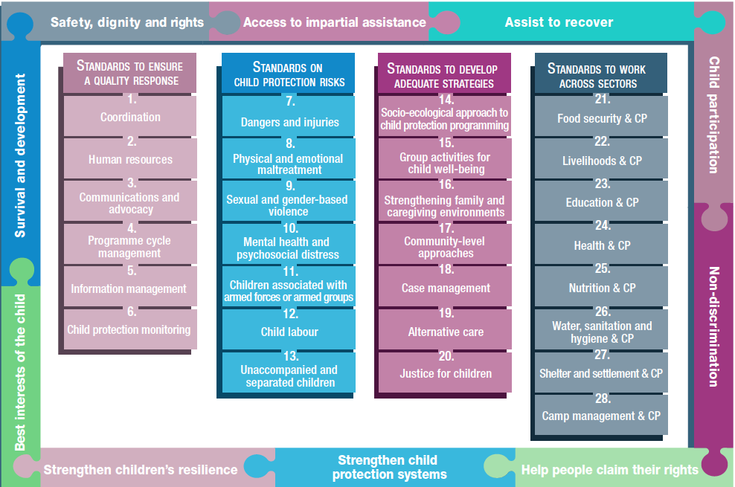
Overview
Notes:
This is an overview of the CPMS structure: there are 28 Standards across 4 pillars and 10 CPHA principles threaded throughout.
You can find this overview on the back of the CPMS handbook or in the online handbook; it’s a practical way of locating quickly a specific topic.
This presentation focuses on Standard 3: Communication & Advocacy
If participants request additional readings, see below. Do not hesitate, if you have time, to lead the participants to these documents / print them for distribution / share them on a USB stick for later reading :
Humanitarian Advocacy
https://www.open.edu/openlearncreate/mod/resource/view.php?id=53750
UNICEF Communication for development
ROSA C4D Strategic Framework.pdf (unicef.org)
Advocacy
C4D approaches | Communication for Development (C4D) | UNICEF
Children’s Participation
The Nine Basic Requirements for Meaningful and Ethical Children's Participation | Resource Centre (savethechildren.net)
Ethical Approaches to Gathering Information from Children and Adolescents in International Settings: Guidelines and Resources

Slide 4
General intro to Standard 3
Part of Pillar 1 related to quality response
To be used w/ Standards (7–28) & the CPMS principles
Commitment 4 of the CHS
Dignity, best interests and safety
Children’s voices
Do no harm
What is the difference between communication and advocacy?
Notes:
This Standard is part of the first Pillar related to quality response, which are common across all areas of child protection programming, applicable in all situations and contexts, during preparedness and response phases. They are ALL fundamental to reach the level of quality we aim for as practitioners.
These Quality standards should be used in conjunction with all the rest of the Standards (1–6) & the CPMS principles
This Standard is complementary to the Core Humanitarian Standard on Quality and Accountability (CHS), and should be used with it. More specifically, it links with Commitment 4, which describes the need for accurate, ethical and respectful external communications.
Child protection issues must be advocated for and communicated with respect for children’s dignity, best interests and safety.
Effective communications and advocacy can support children’s self-expression, protection and empowerment.
Communication and advocacy materials, including for awareness campaigns, messaging and strategies, must prioritise the principles of do no harm and the best interests of the child (BIC); ensure confidentiality, data protection & support child protection
This Standard links especially with the question of prevention: risk assessments must be conducted prior to communications and advocacy work, to identify and mitigate any potential negative impacts on children, families, and communities. Campaigns should also use local communication methods, contextualised messages, and should promote protective and safe behaviours
[→ the prevention icon]
Discussion Prompt: What is the difference between communication and advocacy?
-> Communications and advocacy are often complimentary. It is difficult to engage in any form of advocacy without some kind of communication, and most communications are wanting to influence opinions, policies, and/or decision makers. However, communications and advocacy are different.
DEF: Communication for Development : An evidence-based process that utilizes a mix of communication tools, channels and approaches to facilitate participation and engagement with children, families, communities, networks for positive social and behaviour change in both development and humanitarian contexts” (UNICEF, 2018, p. 1)
DEF: Advocacy: An activity by an individual or group that aims to influence decisions within political, economic, and social institutions. Advocacy includes activities and publications to influence public policy, laws and budgets by using facts, their relationships, the media, and messaging to educate government officials and the public (UNICEF C4D Advocacy).

Slide 5
“Child protection issues are advocated for and communicated with respect for children’s dignity, best interests and safety.”
Protective and safe communication/ advocacy :
Field-tested
Contextualised
Inclusive
Accessible
Understandable
Useful
Realistic
Persuasive
Local & national, formal and informal actors
What do we mean by communication material?
Notes:
Standard 3 states: “Child protection issues are advocated for and communicated with respect for children’s dignity, best interests and safety.”
Messages, and the methods used to deliver them, should be field-tested before finalisation to ensure they are contextualised, inclusive, accessible to children of all capacities and backgrounds, understandable, useful, realistic and persuasive.
The humanitarian response should strengthen the advocacy capacity of formal and informal, local and national child protection actors by supporting stronger collaboration and cooperative action. Coordinating with them will serve to support the empowerment of children and communities, enhance affective communication and advocacy, help harmonise messaging and reduce confusion and duplication.
Discussion Prompt: what do we mean by communication material?
-> All communications and type of tools products would we use for advocacy – including text, images, audio, video, mass media, community figures, posters and leaflets, social media and/or mobile applications (radio, local and community means….)

Slide 6
Children participation
DO
Promote potective and safe behaviour
Ensure equity
Emphasize capacity, ability and resilience
Conduct risk assessments
Secure informed consent/assent
DON’T
Diversity considerations
Present children as victims or passive recipients of aid
Raise expectations
Force children to participate
Notes:
Children’s participation can improve the quality, accuracy and persuasiveness of child protection messaging. It can also empower children and help them regain a sense of control, identity, ability and resilience.
Children’s participation in communications and advocacy must be safe, ethical and meaningful and should only take place with the full and informed consent/assent of the child and any caregivers.
Communications and advocacy must:
DO
Promote protective and safe behaviour;
Promote equity;
Emphasise children’s capacity, ability and resilience;
Particularly in humanitarian contexts, where we can't assume that children's participation is always going to be the best approach and in line with principles to do no harm, a risk assessment should be conducted to reduce children’s risk (abuse, exploitation or violence, stigma or rejection, negative impacts) to determine whether we can use child’s real name. There are often risks or dangers in publicly revealing a child’s identity and/or image: carefully assess each participant’s ability to give informed consent/assent, according to the principles of the best interests of the child and do no harm
Informed consent/assent, which supports participants’ ownership over their personal information and prevents possible conflicts of interest between data collectors and respondents.
DON’T
Skip the full range of affected children’s experiences, including the views of children of all genders, ages, disabilities and other characteristics or aspects of diversity;
Children are stakeholders with their own rights and capacities to contribute. They should not be viewed as passive recipients or victims.
Manage the expectations of all participants in communications and advocacy activities. They must understand that efforts made may not directly lead to increased assistance and resources or to a significant change in the context.
They should not be forced to repeatedly discuss a difficult experience, as this can be distressing. They have the right to stop participating at any time, regardless of the setting. Child advocates should be trained to deliver effective messages without necessarily disclosing their own personal experiences.
Remember that:
involving children helps deliver better decisions for children –better informed responses, solutions and outcomes.
children benefit from participation – it contributes to their skills, power, confidence, enjoyment.
meaningfully engaging children helps makes us more accountable – by recognising and acting on children’s contributions.
children have the right to influence decisions that affect them

Slide 7
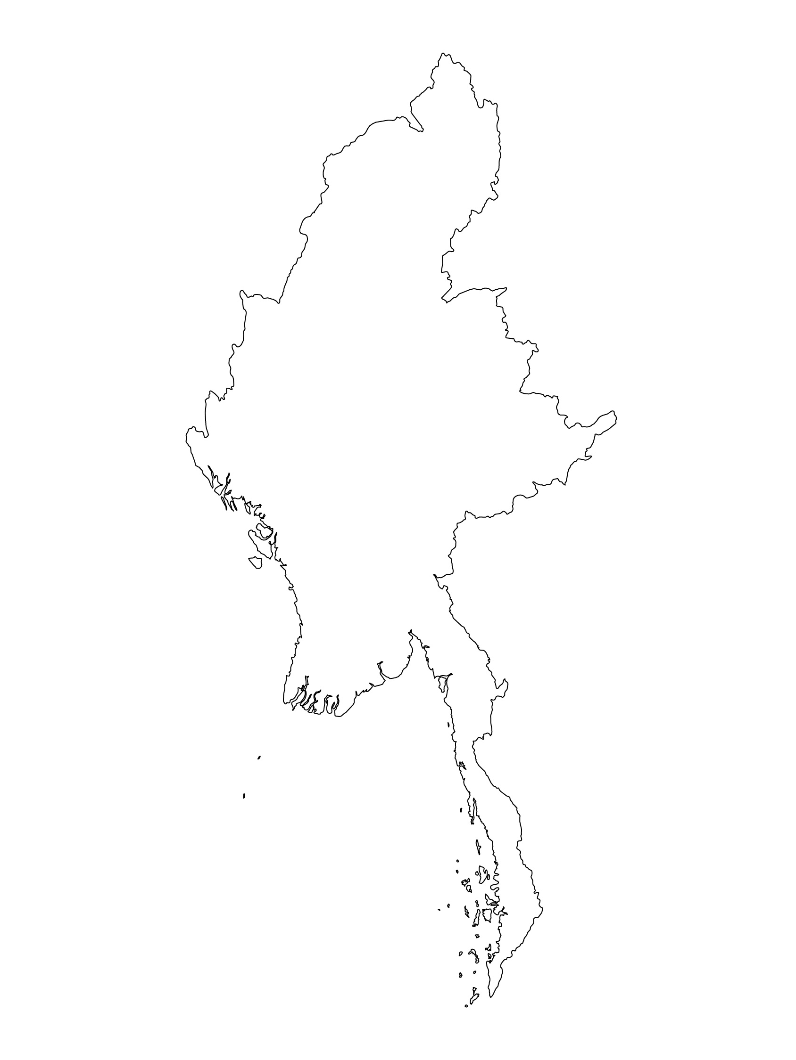
Examples from the Region
[COUNTRY NAME]
Add key presentation sentence about a specific program/project using Standard 3
Add name of organisations
Add key message / numbers
[ COUNTRY NAME]
Add key presentation sentence about a specific program/project using Standard 3
Add name of organisations
Add key message / numbers
[ COUNTRY NAME]
Add key presentation sentence about a specific program/project using Standard 3
Add name of organisations
Add key message / numbers
Notes:
Depending on the time you have for facilitation, consider adding here examples from the Region/ Country/ Response, of programming that meets the standards.
This could be a draft slide that you could update or remove if necessary.
For each example, you could add:
A short, concise, key presentation sentence about the specific program/project using Standard 3, using communications and/or advocacy in humanitarian settings as part of ensuring children’s protection.
Describe the key communications or advocacy activities and the outcomes.
Add practical lessons learnt, that will attract interest of your audience
Another option, if you have longer (and also depending on the audience you have), this slide can be completed in an interactive way during the session.
In that case, you could:
split the groups into 2 or 3 smaller groups,
allow 15 – 20 min for them to prepare a short presentation of an example from the Region/ Country/ Response, of programming that meets the standard
in plenary, have the groups present their examples, and discuss /compare lessons learnt out of them.
If you will be sending this presentation to the participants after the training, you can fill up this slide, to keep records of the presentations.
TIP: you can use https://thenounproject.com/ to get map outlines like those.

Slide 8
Need more than the hard copy?
On the Alliance website
PDF version
Briefing & Implementation Pack
25-page Summary
E-course
YouTube videos
A gallery of illustrated Standards
👉 www.AllianceCPHA.org
On the Humanitarian Standards Partnership website
Online, interactive version
HSP App for mobile phones and tablets
👉 www.HumanitarianStandardsPartnership.org
Notes:
[Facilitators - if you can project from the internet, then we suggest you navigate people there and show them]
HSP:
1. Online handbook
2. The Humanitarian Standards Partnership App
– It is the 2nd most popular app on that site after Sphere
CPMS page:
1. Interactive handbook – our greatest resource
2. A Summary: At just 32 pages, it means that it I CPHA topline but can be used to introduce the idea of minimum standards or start child protection discussions with government colleagues or other humanitarians without overwhelming them with the huge handbook.
Alliance website:
The PDF & all materials available can be downloaded if people want to print just portions of the CPMS, on the Alliance site
The “Introduction to CPMS” Briefing Pack contains this PPT and facilitation notes, plus the 2 page Introduction handout.
A gallery of illustrated Standards
Discover our free CPMS e-course with a range of modules
Videos on the Alliance Youtube channel
ASK: What should our next steps as a team/agency/individual be?
(i.e. you might schedule a longer meeting to digest the changes and create a plan; or ask colleagues to present certain new/revised standards and their implications for the programme; or set up a training or ask Senior Management for a meeting to discuss accountability to children, etc)
[Facilitators - Printed copies – there is a small stockpile of the Handbook and Summary that the global Alliance has in Geneva; however, countries and regions are encouraged to print & manage their own copies locally. Usually, this would be done through the inter-agency Coordination structure. On request, the Alliance can share a print-ready PDF.]
Thank you so much for coming together and starting to explore the CPMS. I will follow up on the next steps we discussed. And that’s the key – the CPMS is a gift that just keeps on giving every time you open it!

