Slide 1
The Minimum Standards for Child Protection in Humanitarian Action
CPMS
SLIDE DECK
Notes:
Facilitators:
This briefing is for any potential user of the CPMS. It is geared primarily toward child protection staff, so consider broadening some questions or providing more detail, if colleagues from other sectors join you.
It is assumed that the group is about 20 people and that everyone in the room knows each other (perhaps colleagues from your agency or the CP coordination group). if not, add 5 minutes for quick introductions.
PREPARE: a flipchart with the objectives of the session
By the end of the session, participants will be able to:
Describe the content of Standard 26
Explain & Share its key messages
Demonstrate how & why to use the handbook
NOTE: if you have already done a Session on Pillar(s), Principles or other Standard(s), skip slide 2 & 8
TIP: Slides are animated -> for each click you’ll make, some few words, a title or an image will appear on the slide.
Read the corresponding notes from the facilitators notes, before showing the following content, so participants have time to process what you say, and read each point.

Slide 2
Aim of the Standards
Benchmark for CPHA.
Collaborative, inter-agency tool
Links with Core Humanitarian Standard
Contextualisation for local ownership
Purpose:
quality and accountability
impact for children’s protection and well-being
Notes:
Donors, local governments, colleagues in other sectors and our beneficiaries themselves want to know what we are doing and why. The CPMS is our benchmark. They are the key way to operationalise or make real children's rights in the practice of humanitarian response.
They are a collaborative, inter-agency tool, that links with other initiatives, such as the Core Humanitarian Standard and the Humanitarian Inclusion Standards
Wherever relevant, the CPMS align with INSPIRE’s 7 strategies to end violence against children – initiative’s icons are actually scattered through the text. In addition, the Core Humanitarian Standard on Quality and Accountability is highlighted in the Introduction and resonates throughout the handbook.
Contextualisation is encouraged and can create ownership of the standards at every level. It builds a deeper understanding of child protection in the specific context for a wide range of actors. National coordination groups are therefore encouraged to adapt the CPMS. Please raise it with colleagues locally and then seek the guidance of the global CPMS team. For more information, watch the short contextualization video on the Alliance’s youtube channel.
BOX: The CPMS aim at improving the quality and accountability of our programing and increasing impact for children’s protection and well-being in humanitarian action (internal displacement and refugee contexts), by establishing common principles, evidence, prevention and goals to achieve. They provide a synthesis of good practice and learning to date.

Slide 3
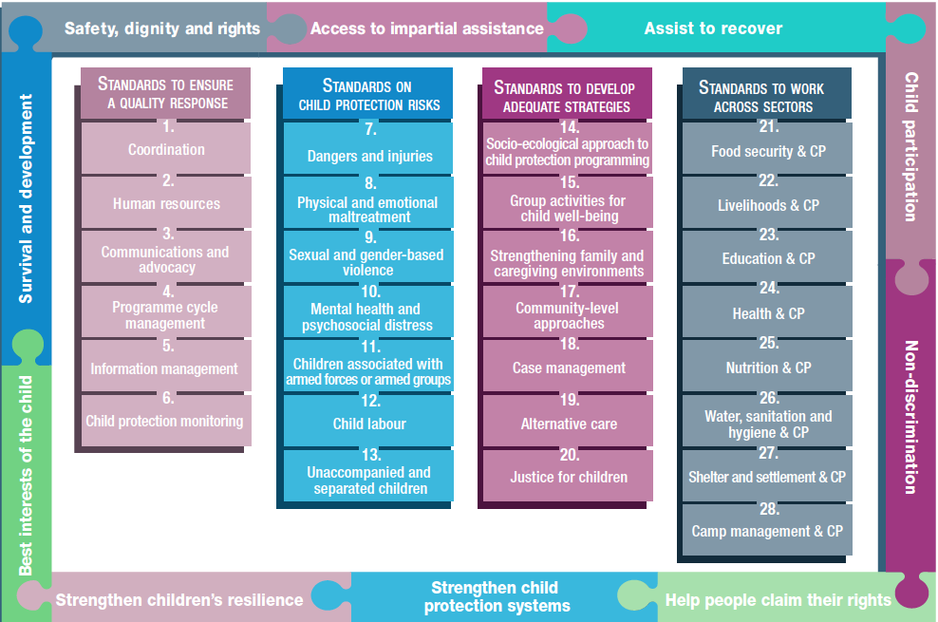
Overview
Notes:
This is an overview of the CPMS structure: there are 28 Standards across 4 pillars and 10 CPHA principles threaded throughout.
You can find this overview on the back of the CPMS handbook or in the online handbook; it’s a practical way of locating quickly a specific topic.
This presentation focuses on Standard 26: Water, Sanitation and Hygiene & Child Protection

Slide 4
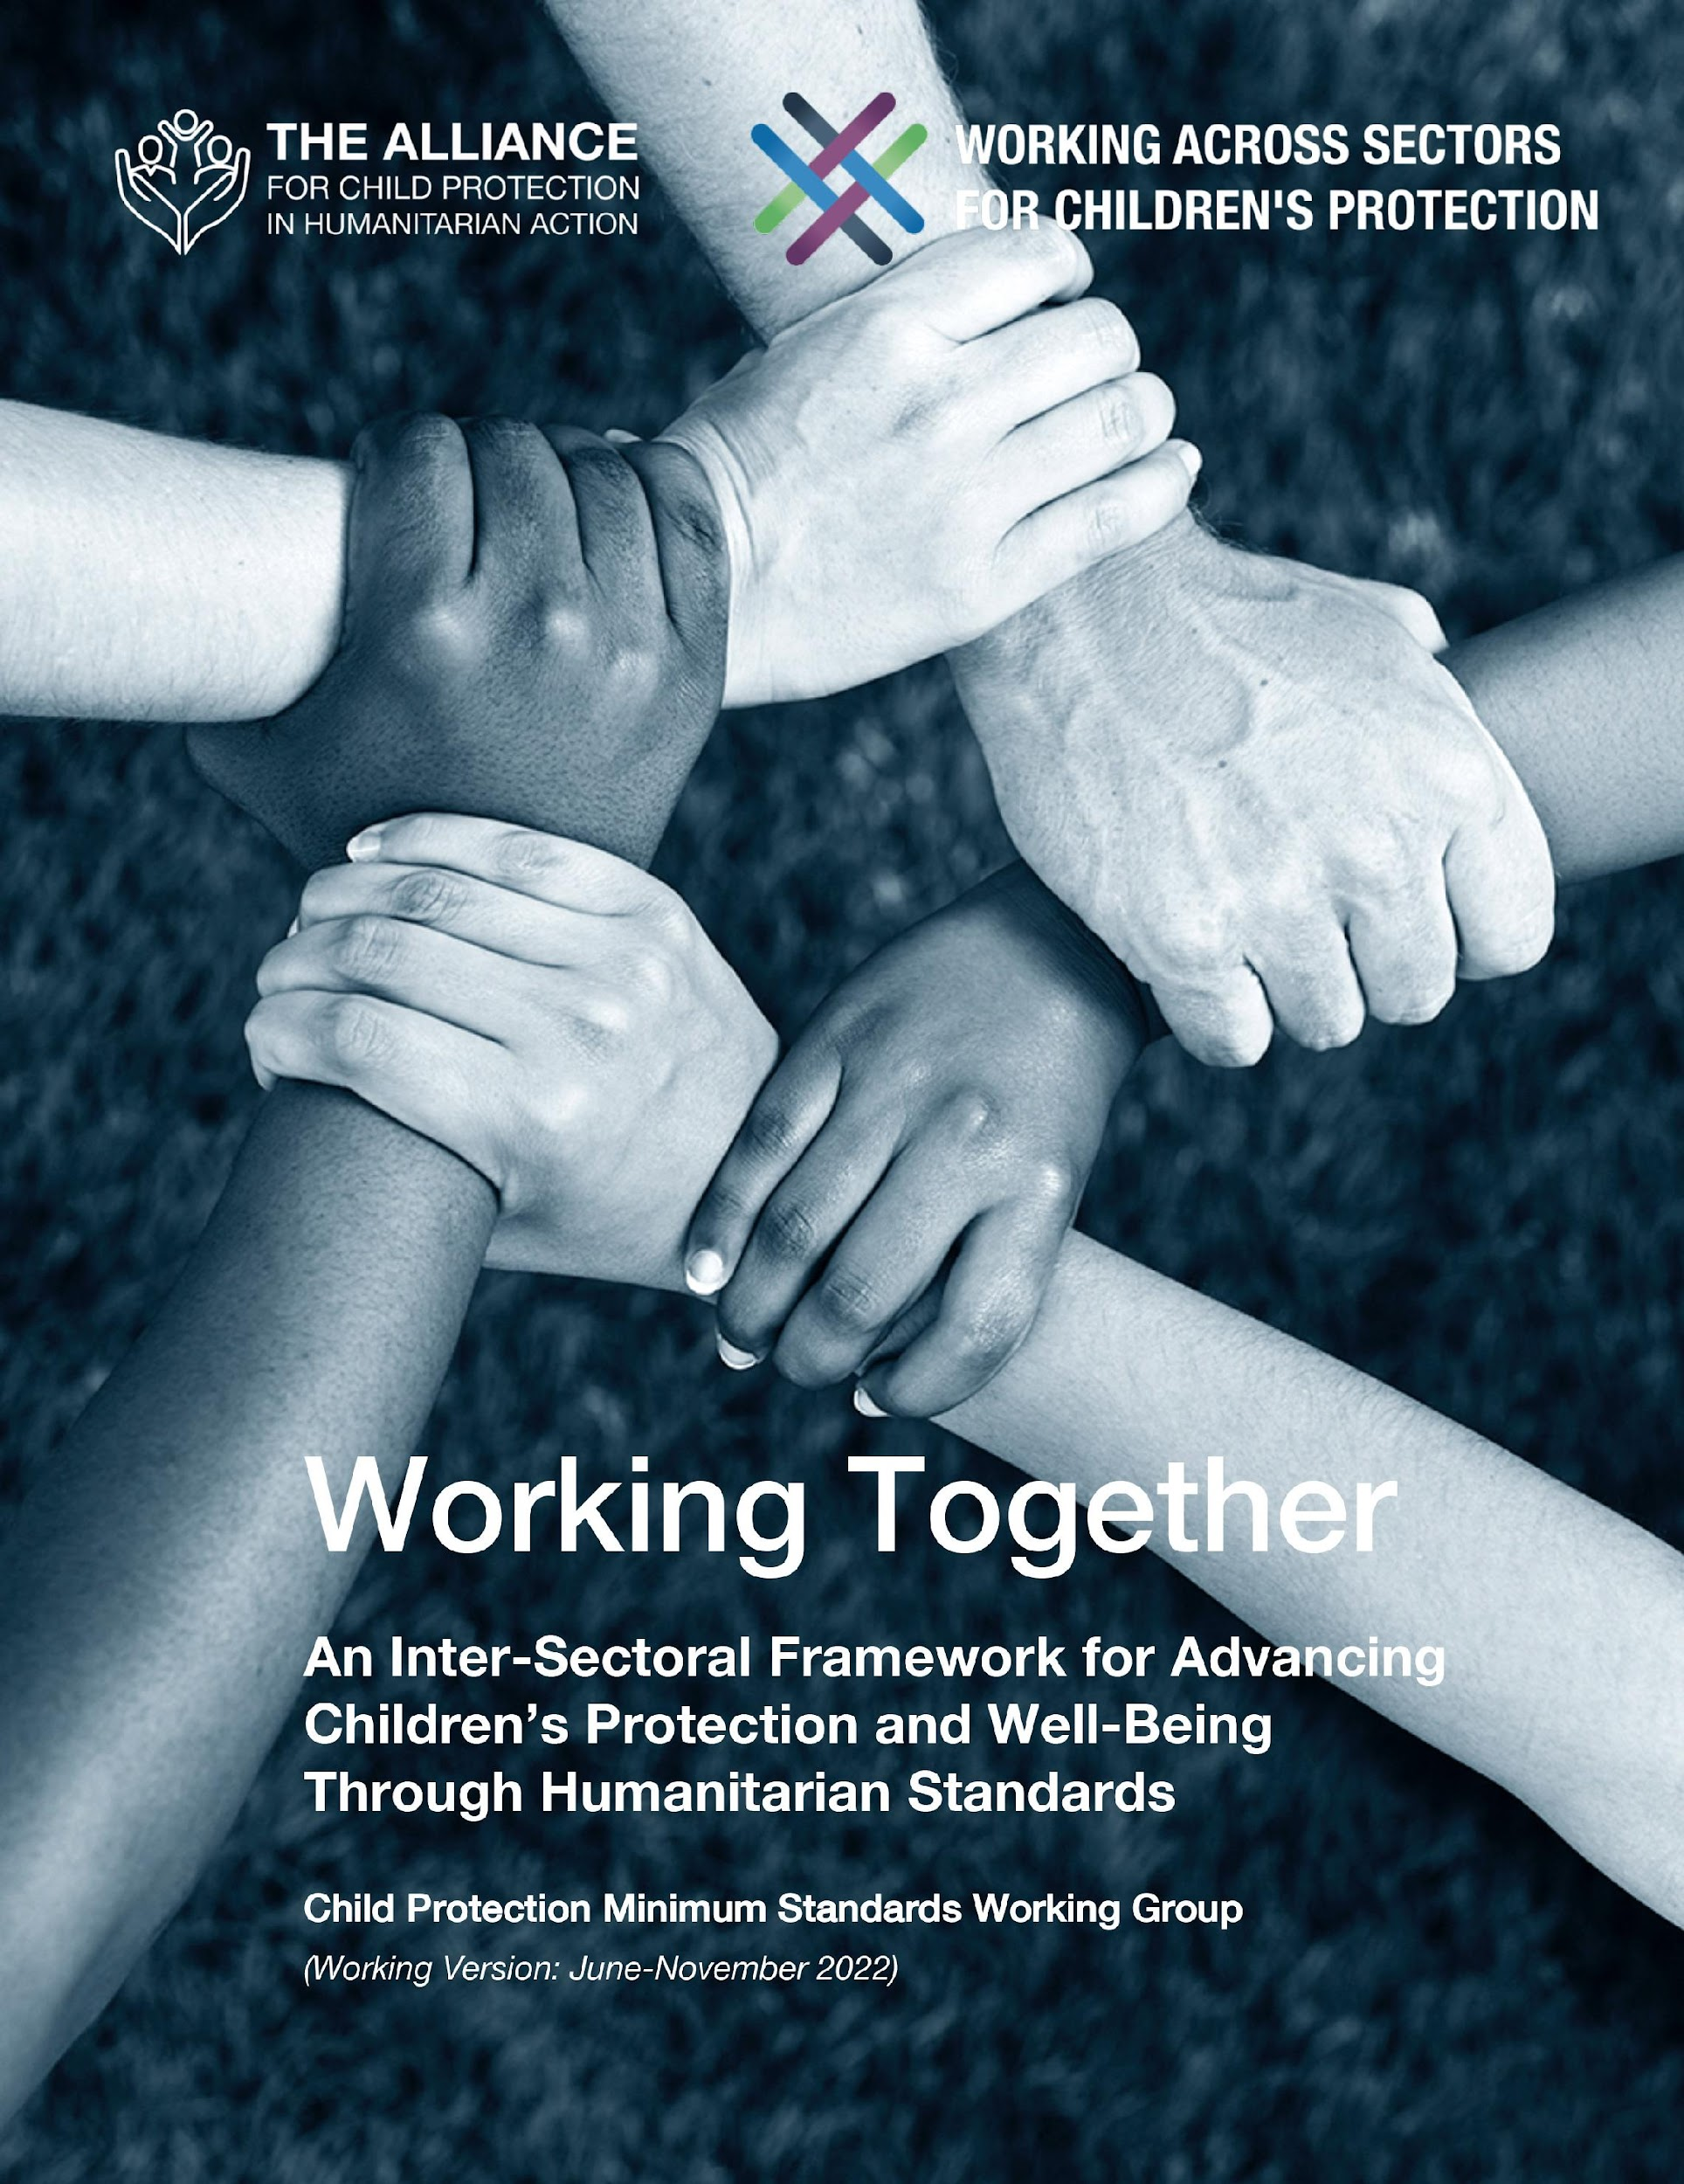
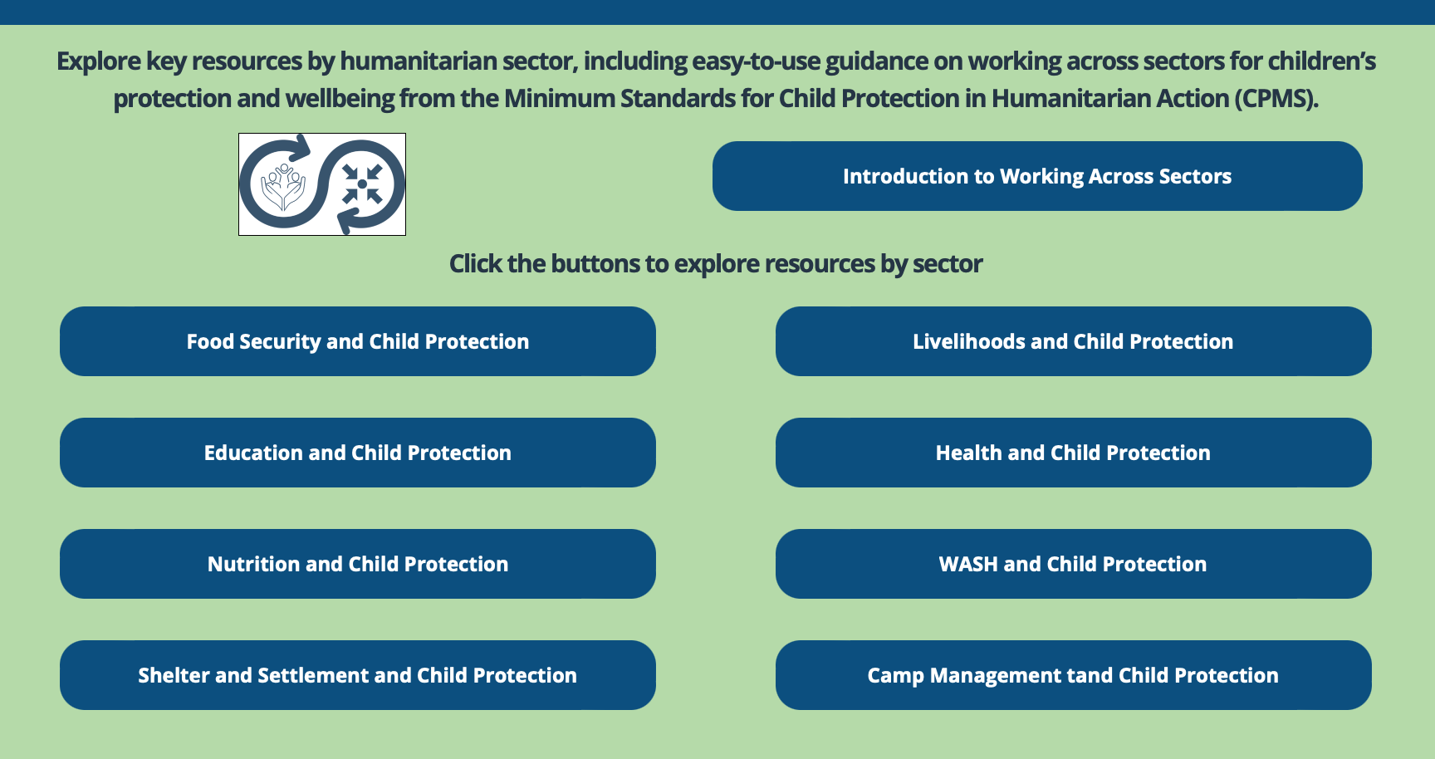
Working Together
Interconnected needs of children
Collective responsibility = Centrality of Protection
Higher-quality impact
Notes:
The CPMS have a complete section devoted to Child Protection personnel working with and learning from other humanitarian actors to improve protection and well-being outcomes for children.
CLICK: Multisectoral approaches reflect the interconnected needs of children and emphasise
CLICK: all humanitarian actors’ collective responsibility to protect children and their families. Children’s protection risks are closely linked with the work of humanitarian actors because they have needs that fall under all sectors.
CLICK: Multisectoral programming - that includes and addresses child protection considerations (such as children’s particular risks, vulnerabilities, developmental stages, etc.) can be an effective way to achieve real, higher quality outcomes for both / all sectors.
CLICK: Working Together is an inter-sectoral framework to promote children’s protection and well-being using humanitarian standards. It was created through a large-scale, consultative process, and is updated every 6 months. Currently, the prioritized sectors are: health, education, Food Security, and Camp Coordination and Camp Management.
CLICK: Check out the microsite for the global Working across Sectors initiative and the sector-specific resource folders.

Slide 5
An introduction to Standard 26
Interconnected needs of children
Collective responsibility = Centrality of Protection
Higher-quality impact
WASH practices, services, facilities & interventions, adapted to the needs of children
Behavioural change
Are collecting water and cleaning latrines OK for a child?
Notes:
This Standard is part of the fourth Pillar of Standards related to Working across Sectors.
Multisectoral approaches reflect the interconnected needs of children and emphasise all humanitarian actors’ collective responsibility to protect children and their families. Child protection risks are closely linked with the work of other sectors because children have needs that fall under all sectors.
One very effective way towards real & higher quality impact is multisectoral programming that includes and addresses child protection considerations (such as children’s particular risks, vulnerabilities, developmental stages, etc.).
Child protection staff should guide and advise water, sanitation and hygiene (WASH) staff so they are able to deliver safe and appropriate WASH practices, services, that are adapted to the needs of children. I.e: accessible and child-friendly WASH facilities
Behavioural change can be promoted through creative activities, messaging & basic WASH practices, during CP activities (such as drama, play and games)
Icons: all WASH workers (including subcontractors’ staff) and child protection staff should be trained on and sign safeguarding policies and procedures. Samewise, the way WASH programmes are designed, plan and implement have a great prevention potential, i.e: prioritisation criteria, support households at risk, safe, accessible, inclusive facilities…
Discussion Prompt: Are collecting water and cleaning latrines OK, for a child?
-> In many countries, children are responsible for collecting water and cleaning latrines. This choreis OK as long as it:
Is NOT assigned to a single, specific social group of children based on discriminatory practices;
Does NOT interfere with children’s education; and
Is NOT used to punish poor learning or bad behaviour.
To reduce the risk of child labour, involve children in decisions about what activities to perform and how. Verify that only children over the minimum working age are involved in decent WASH-related work (including cash-for-work programmes).
In contexts where children are expected to collect water, we can ensure containers are age- and size-appropriate. However, we have to be cautious about promoting the expectation that children carry water. Do not label containers as ‘for children’.

Slide 6
Joint Actions
“All children have access to appropriate water, sanitation and hygiene services that support their dignity and minimise risks of physical and sexual violence and exploitation.”
WASH in CP interventions
Safe WASH facilities
MHM
Hygiene-related care practices
Prevention on Child Labor
On which topics should CP and WASH staff be trained?
Notes:
Standard 26 states: “All children have access to appropriate water, sanitation and hygiene services that support their dignity and minimise risks of physical and sexual violence and exploitation.”
There are many areas of collaboration, including:
Providing WASH services in child protection interventions (school and learning centers/spaces)
Preventing children threats related to WASH activities (e.g. falling into pits, septic tanks, wells, being run over by water trucks, injured by heavy duty construction machinery on unprotected sites, etc.) + Adapting WASH facilities so that they (a) are accessible, safe, visible and child-friendly and (b) minimise potential risks to children and women. Children and women’s physical abilities, protection and safety concerns should be considered when designing, constructing and monitoring WASH facilities (minimal distance to walk, age- and size-appropriate containers, avoid dark cabins and large holes for pit latrines, no open water, providing adequate solar- or electrical-powered lights, lanterns and/or torches, separate toilets and bathing facilities, locks,…)
Implementing adequate and safe menstrual hygiene management (MHM) interventions for girls: management, supplies or information about menstrual items for children from 5 to 10 years and Adolescents above 10 years
Hygiene care practices related to 0-4 years old: infants’ faeces disposal, disposable or reusable diapers, bowel movements management, contact with animals and livestock, or contaminated soil or animal excrement…)
Prevention on Child Labor in WASH related activities (water collection, solid waste cleaning campaigns, latrine cleaning, drain/channel cleaning, underaged water truck drivers, etc.)
Discussion Prompt: On which topics should CP and WASH staff be trained?
-> Child protection workers should be trained on basic WASH practices, including:
Identification and referral of households at risk of WASH-related disease or infection;
Life-saving, disability- and gender-specific WASH messaging;
Hand, face and body washing;
Safe water and food handling;
Menstrual hygiene management;
Appropriate disposal of faeces and menstrual pads; and
Drainage and waste management.
WASH workers should be trained on basic child protection information such as:
Identification and referral of households at risk of child protection concerns;
Children adequate representation and participation in decision-making processes and community-based participation structures relating to WASH;
Child protection concerns, principles and approaches, including child-friendly communication;
Child-friendly, multisectoral child protection referral mechanisms;
The risks children might face around WASH facilities;
Psychological first aid;
Child-friendly communication skills;
Safeguarding policies and procedures, and
Child protection referral mechanisms.

Slide 7
Summary of training topics possible
Children representation and participation
CP concerns, principles and approaches;
Children risks in WASH facilities;
PFA;
Child-friendly communication skills;
Safeguarding policies and procedures, and
Child protection referral mechanisms.
WASH / Joint assessments
WASH monitoring & specific needs
Child protection prevention related to WASH activities
CP mainstreaming into HNO/HRP
CP Inclusion into WASH Core Coordination training package
Notes:
This is the summary of the discussion prompt, if participants want to take note, and/or need seeing it.
You may skip this slide if not necessary.
On WASH / Joint assessments focusing on children and adolescent specific needs (through child-friendly focus group discussions for example) in terms of access and design of WASH facilities as well as IEC for hygiene promotion
On WASH monitoring focusing on children and adolescent specific needs (as opposed to household or community level)
On child labor prevention related to WASH activities (e.g. carrying heavy loads during water collection, solid waste cleaning campaigns, latrine cleaning, drain/channel cleaning, hiring underaged water truck drivers, etc.)
On child protection prevention related to WASH activities (e.g. falling into pits, septic tanks or wells, being run over by water trucks, being injured by heavy duty construction machinery on unprotected sites, etc.)
Guidance to National Humanitarian WASH Coordination Platforms to mainstream CP in HNO/HRP
Inclusion of CP in WASH Core Coordination training package.
The right part of the slide is detailed on the previous slide, under Discussion Prompt.

Slide 8
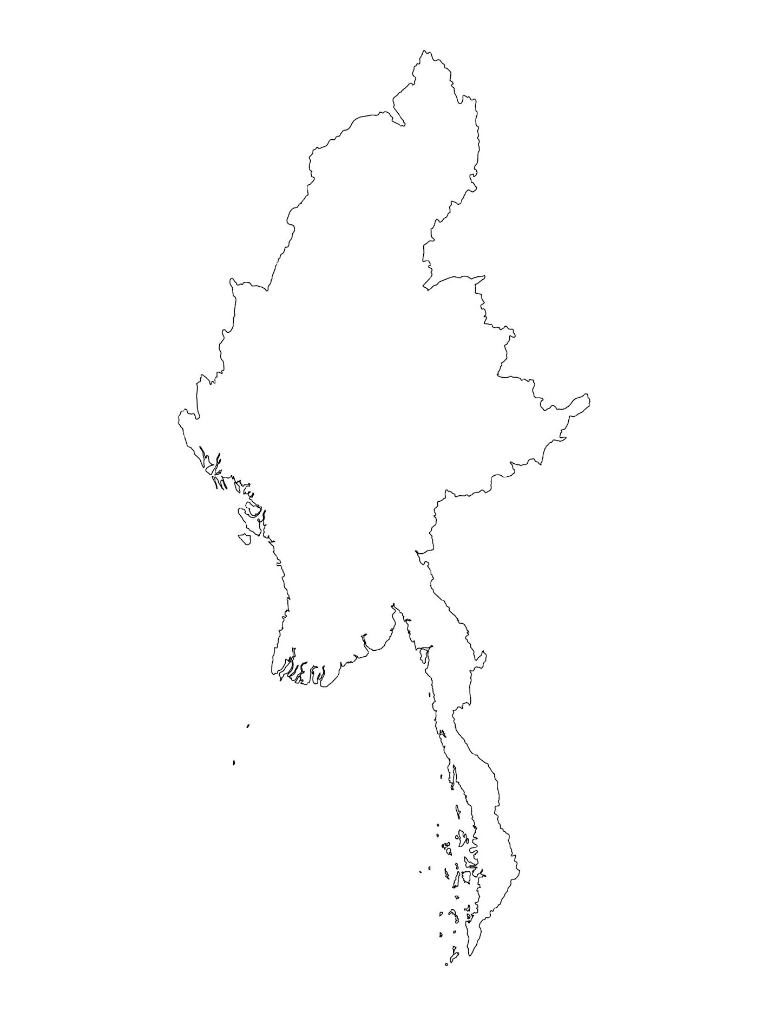
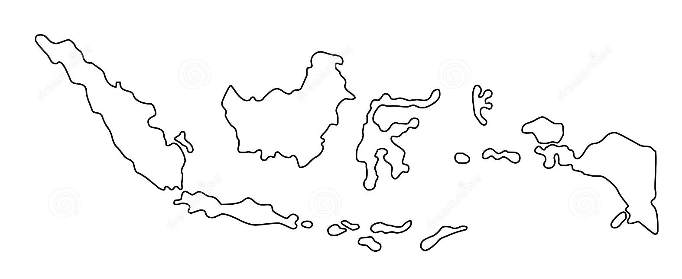
Examples from the Region
[COUNTRY NAME]
Add key presentation sentence about a specific program/project using Standard 26
Add name of organisations
Add key message / numbers
[ COUNTRY NAME]
Add key presentation sentence about a specific program/project using Standard 26
Add name of organisations
Add key message / numbers
[ COUNTRY NAME]
Add key presentation sentence about a specific program/project using Standard 26
Add name of organisations
Add key message / numbers
Notes:
Depending on the time you have for facilitation, consider adding here examples from the Region/ Country/ Response, of programming that meets the standards.
This could be a draft slide that you could update or remove if necessary.
For each example, you could add:
A short, concise, key presentation sentence about the specific program/project using Standard 26
Add the name of organisations and partners involved
Add practical lessons learnt, key actions, message or numbers, that will attract interest of your audience
Another option, if you have a longer facilitation span (and also depending on the audience you have), this slide can be completed in an interactive way during the session.
In that case, you could:
split the groups into 2 or 3 smaller groups,
allow 15 – 20 min for them to prepare a short presentation of an example from the Region/ Country/ Response, of programming that meets the standard
in plenary, have the groups present their examples, and discuss /compare lessons learnt out of them.
If you will be sending this presentation to the participants after the training, you can fill up this slide, to keep records of the presentations.
TIP: you can use https://thenounproject.com/ to get map outlines like those.

Slide 9
Need more than the hard copy?
On the Alliance website
PDF version
Briefing & Implementation Pack
25-page Summary
E-course
YouTube videos
A gallery of illustrated Standards
👉 www.AllianceCPHA.org
On the Humanitarian Standards Partnership website
Online, interactive version
HSP App for mobile phones and tablets
👉 www.HumanitarianStandardsPartnership.org
Notes:
[Facilitators - if you can project from the internet, then we suggest you navigate people there and show them]
HSP:
1. Online handbook
2. The Humanitarian Standards Partnership App
– It is the 2nd most popular app on that site after Sphere
CPMS page:
1. Interactive handbook – our greatest resource
2. A Summary: At just 32 pages, it means that it is topline but can be used to introduce the idea of minimum standards or start child protection discussions with government colleagues or other humanitarians without overwhelming them with the huge handbook.
Alliance website:
The PDF & all materials available can be downloaded if people want to print just portions of the CPMS, on the Alliance site
The “Introduction to CPMS” Briefing Pack contains this PPT and facilitation notes, plus the 2 page Introduction handout.
A gallery of illustrated Standards
Discover our free CPMS e-course with a range of modules
Videos on the Alliance Youtube channel
ASK: What should our next steps as a team/agency/individual be?
(i.e. you might schedule a longer meeting to digest the changes and create a plan; or ask colleagues to present certain new/revised standards and their implications for the programme; or set up a training or ask Senior Management for a meeting to discuss accountability to children, etc)
[Facilitators - Printed copies – there is a small stockpile of the Handbook and Summary that the global Alliance has in Geneva; however, countries and regions are encouraged to print & manage their own copies locally. Usually, this would be done through the inter-agency Coordination structure. On request, the Alliance can share a print-ready PDF.]
Thank you so much for coming together and starting to explore the CPMS. I will follow up on the next steps we discussed. And that’s the key – the CPMS is a gift that just keeps on giving every time you open it!

