Slide 1
The Minimum Standards for Child Protection in Humanitarian Action
CPMS
SLIDE DECK
Notes:
Facilitators:
This briefing is for any potential user of the CPMS. It is geared primarily toward child protection staff, so consider broadening some questions or providing more detail, if colleagues from other sectors join you.
It is assumed that the group is about 20 people and that everyone in the room knows each other (perhaps colleagues from your agency or the CP coordination group). if not, add 5 minutes for quick introductions.
PREPARE: a flipchart with the objectives of the session
By the end of the session, participants will be able to:
Describe the content of Standard 25
Explain & Share its key messages
Demonstrate how & why to use the handbook
NOTE: if you have already done a Session on Pillar(s), Principles or other Standard(s), skip slide 2 & 8
TIP: Slides are animated -> for each click you’ll make, some few words, a title or an image will appear on the slide.
Read the corresponding notes from the facilitators notes, before showing the following content, so participants have time to process what you say, and read each point.

Slide 2
Aim of the Standards
Benchmark for CPHA.
Collaborative, inter-agency tool
Links with Core Humanitarian Standard
Contextualisation for local ownership
Purpose:
quality and accountability
impact for children’s protection and well-being
Notes:
Donors, local governments, colleagues in other sectors and our beneficiaries themselves want to know what we are doing and why. The CPMS is our benchmark. They are the key way to operationalise or make real children's rights in the practice of humanitarian response.
They are a collaborative, inter-agency tool, that links with other initiatives, such as the Core Humanitarian Standard and the Humanitarian Inclusion Standards
Wherever relevant, the CPMS align with INSPIRE’s 7 strategies to end violence against children – initiative’s icons are actually scattered through the text. In addition, the Core Humanitarian Standard on Quality and Accountability is highlighted in the Introduction and resonates throughout the handbook.
Contextualisation is encouraged and can create ownership of the standards at every level. It builds a deeper understanding of child protection in the specific context for a wide range of actors. National coordination groups are therefore encouraged to adapt the CPMS. Please raise it with colleagues locally and then seek the guidance of the global CPMS team. For more information, watch the short contextualization video on the Alliance’s youtube channel.
BOX: The CPMS aim at improving the quality and accountability of our programing and increasing impact for children’s protection and well-being in humanitarian action (internal displacement and refugee contexts), by establishing common principles, evidence, prevention and goals to achieve. They provide a synthesis of good practice and learning to date.

Slide 3
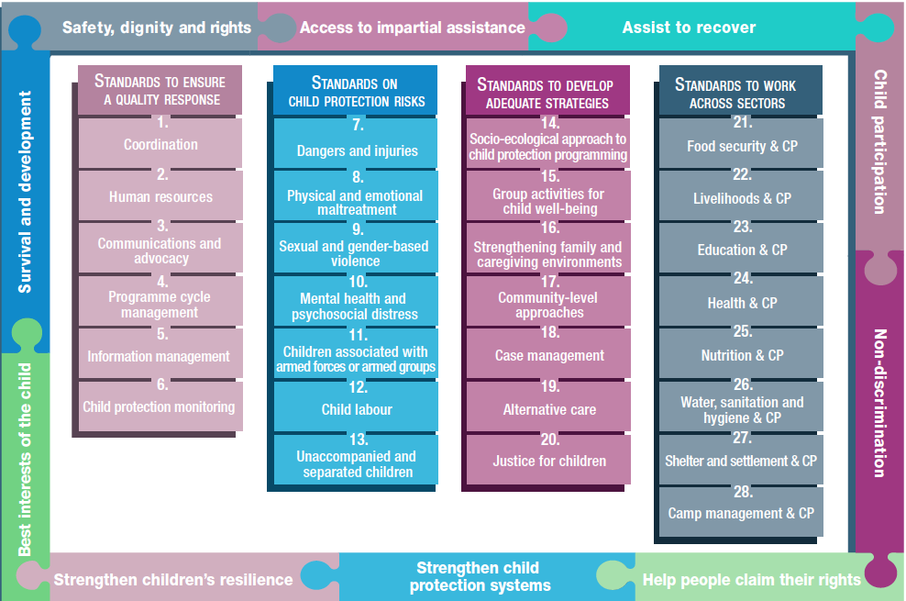
Overview
Notes:
This is an overview of the CPMS structure: there are 28 Standards across 4 pillars and 10 CPHA principles threaded throughout.
You can find this overview on the back of the CPMS handbook or in the online handbook; it’s a practical way of locating quickly a specific topic.
This presentation focuses on Standard 25: Nutrition & Child Protection

Slide 4
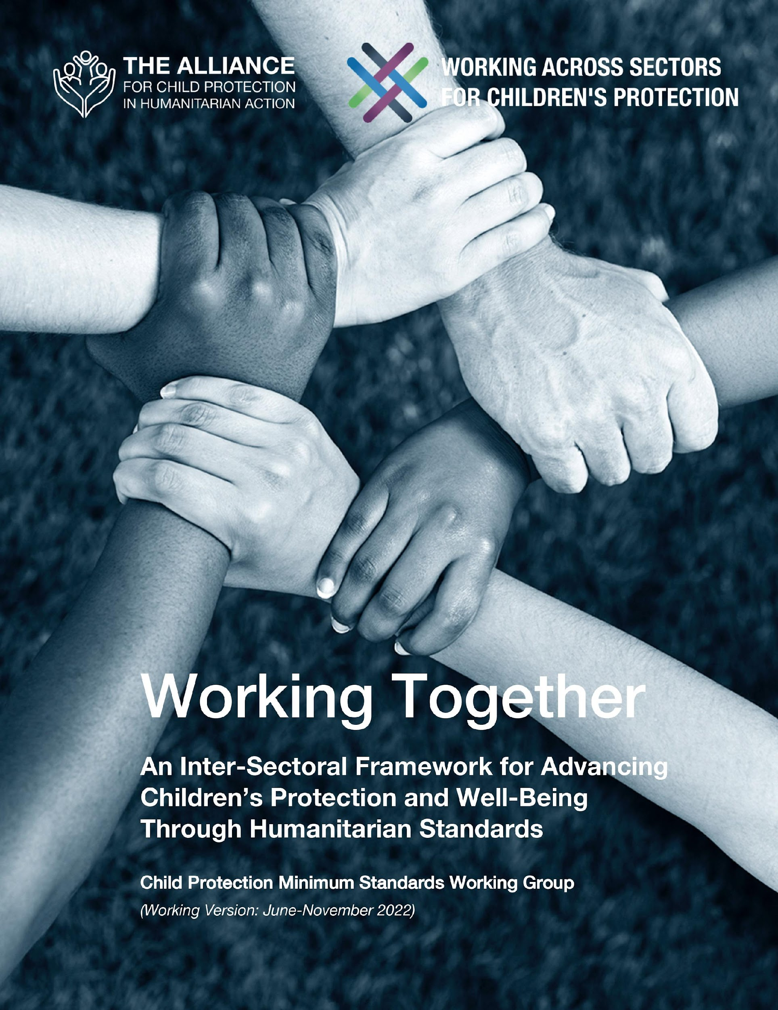
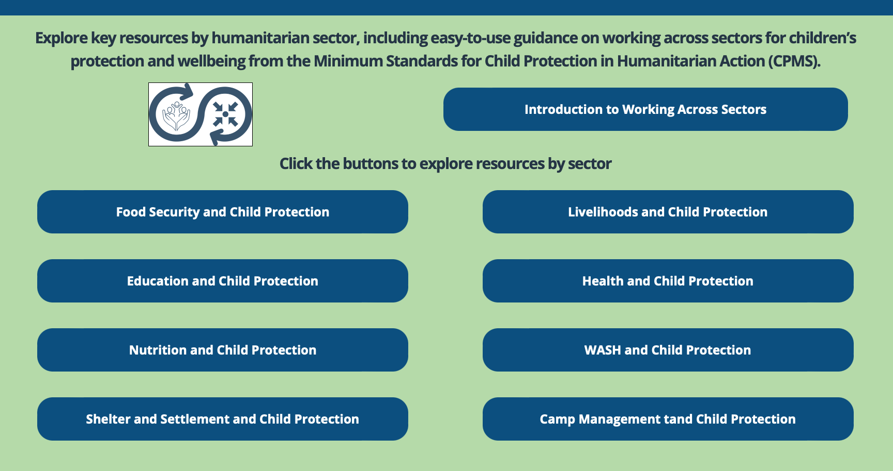
Working Together
Interconnected needs of children
Collective responsibility = Centrality of Protection
Higher-quality impact
Notes:
The CPMS have a complete section devoted to Child Protection personnel working with and learning from other humanitarian actors to improve protection and well-being outcomes for children.
CLICK: Multisectoral approaches reflect the interconnected needs of children and emphasise
CLICK: all humanitarian actors’ collective responsibility to protect children and their families. Children’s protection risks are closely linked with the work of humanitarian actors because they have needs that fall under all sectors.
CLICK: Multisectoral programming - that includes and addresses child protection considerations (such as children’s particular risks, vulnerabilities, developmental stages, etc.) can be an effective way to achieve real, higher quality outcomes for both / all sectors.
CLICK: Working Together is an inter-sectoral framework to promote children’s protection and well-being using humanitarian standards. It was created through a large-scale, consultative process, and is updated every 6 months. Currently, the prioritized sectors are: health, education, Food Security, and Camp Coordination and Camp Management.
CLICK: Check out the microsite for the global Working across Sectors initiative and the sector-specific resource folders.

Slide 5
An introduction to Standard 25
Interconnected needs of children
Collective responsibility = Centrality of Protection
Higher-quality impact
Link w/ school dropout, family separation or child labour, exploitation or violence
Population & vulnerability
Which groups face both child protection and nutrition risks?
Notes:
This Standard is part of the fourth Pillar of Standards related to Working across Sectors.
Multisectoral approaches reflect the interconnected needs of children and emphasise all humanitarian actors’ collective responsibility to protect children and their families. Child protection risks are closely linked with the work of other sectors because children have needs that fall under all sectors.
One very effective way towards real & higher quality impact is multisectoral programming that includes and addresses child protection considerations (such as children’s particular risks, vulnerabilities, developmental stages, etc.).
Nutritional imbalances often worsen in times of crisis when caregivers struggle to provide food, income and health care for their families. Family separation may become more likely. Children or caregivers may leave to find paid work, including hazardous labour, may drop out of school and lose peer support. Families may place their children in residential care so that their children can access food.
Nutrition and CP target similar groups that are especially vulnerable
Discussion Prompt: Which groups face both child protection and nutrition risks?
-> Child-headed households; Children without parental care or separated from their families; Pregnant and lactating mothers under the age of 18 years; Children with disabilities; Children showing signs of physical, sexual abuse; Children showing signs of mental distress; Children under the care of a parent/guardian experiencing mental distress; Children under the care of a parent/guardian unable to care for them etc
[🡪 the Adolescent / Infant icon] show linkage in programming, i.e: infant and young child feeding (IYCF) support; breastfeeding classes and peer support groups for pregnant adolescents. Nutrition and child protection actors have key opportunities for collaboration, particularly in children’s first three years of life and during adolescence.

Slide 6
Joint Actions
“Children and their caregivers, especially pregnant and lactating women and girls, have access to safe, adequate and appropriate nutrition services.
Risk assessment
Case management;
Holistic support;
Appropriate care and nurturing;
Therapeutic, supplementary or blanket feeding and positive parenting;
Multi-use spaces
Referral to appropriate, multisectoral services
Notes:
Standard 25 states: “Children and their caregivers, especially pregnant and lactating women and girls, have access to safe, adequate and appropriate nutrition services”
There are many opportunities to integrate approaches, including:
Risk assessments: Family separation is more likely where malnutrition exists. Children or caregivers may leave to find paid work, including hazardous labour. Families may place their children in residential care so that their children can access food. Children may drop out of school and lose peer support. Preventing child separation nin households at risk of malnutrition and/or child protection concerns is key.
Joint case management (overcome barriers to accessing nutrition services)
Holistic support for accessible services (nutrition interventions that do not encourage school dropout, family separation or child labour; positive parenting, psychosocial support and child resilience programmes)
Encouragement for appropriate care and nurturing (breastfeeding counselling, support and promotion);
Joint programmes with therapeutic, supplementary or blanket feeding and positive parenting; and
Multi-use spaces that meet both sectors’ needs
Referral to appropriate, multisectoral services

Slide 7
Integrated response interventions
Community mobilisation
Mother-to-mother support groups
Psychosocial stimulation activities
Infant feeding sensitisation programmes
Awareness
Training
Child-friendly, accessible and confidential feedback and reporting mechanisms
Safeguarding
Notes:
Integrated response interventions for households at risk of malnutrition and/or child protection concerns for children may include:
Community mobilisation;
Mother-to-mother support groups at health facilities and in communities;
Psychosocial stimulation activities for infants and young children;
Infant feeding sensitisation programmes;
Child-friendly (a) child protection messages in nutrition interventions and (b) malnutrition prevention messages in child protection activities
Remember that training nutrition staff on child protection concerns, principles and approaches is crucial, so they can correctly refer disclosed or identified child protection cases.
It is important to design, establish, implement and monitor joint, child-friendly, accessible and confidential feedback and reporting mechanisms for child protection concerns, and put in place safeguarding policies and procedures

Slide 8
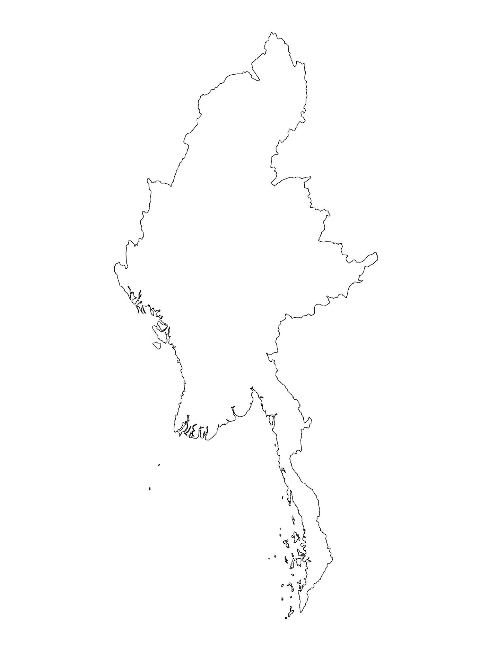
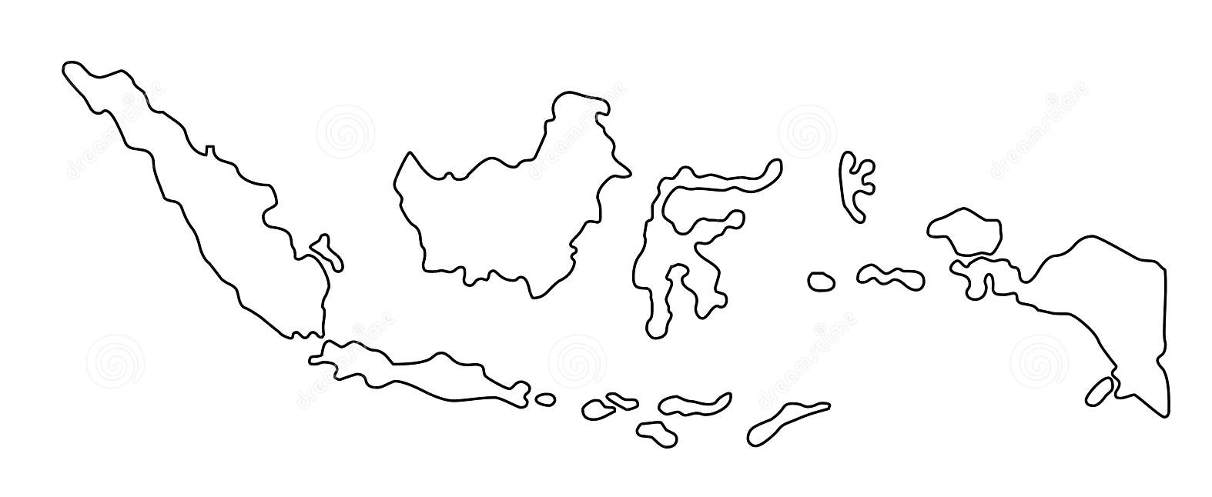
Examples from the Region
[COUNTRY NAME]
Add key presentation sentence about a specific program/project using Standard 25
Add name of organisations
Add key message / numbers
[ COUNTRY NAME]
Add key presentation sentence about a specific program/project using Standard 25
Add name of organisations
Add key message / numbers
[ COUNTRY NAME]
Add key presentation sentence about a specific program/project using Standard 25
Add name of organisations
Add key message / numbers
Notes:
Depending on the time you have for facilitation, consider adding here examples from the Region/ Country/ Response, of programming that meets the standards.
This could be a draft slide that you could update or remove if necessary.
For each example, you could add:
A short, concise, key presentation sentence about the specific program/project using Standard 25
Add the name of organisations and partners involved
Add practical lessons learnt, key actions, message or numbers, that will attract interest of your audience
Another option, if you have a longer facilitation span (and also depending on the audience you have), this slide can be completed in an interactive way during the session.
In that case, you could:
split the groups into 2 or 3 smaller groups,
allow 15 – 20 min for them to prepare a short presentation of an example from the Region/ Country/ Response, of programming that meets the standard
in plenary, have the groups present their examples, and discuss /compare lessons learnt out of them.
If you will be sending this presentation to the participants after the training, you can fill up this slide, to keep records of the presentations.
TIP: you can use https://thenounproject.com/ to get map outlines like those.

Slide 9
Need more than the hard copy?
On the Alliance website
PDF version
Briefing & Implementation Pack
25-page Summary
E-course
YouTube videos
A gallery of illustrated Standards
👉 www.AllianceCPHA.org
On the Humanitarian Standards Partnership website
Online, interactive version
HSP App for mobile phones and tablets
👉 www.HumanitarianStandardsPartnership.org
Notes:
[Facilitators - if you can project from the internet, then we suggest you navigate people there and show them]
HSP:
1. Online handbook
2. The Humanitarian Standards Partnership App
– It is the 2nd most popular app on that site after Sphere
CPMS page:
1. Interactive handbook – our greatest resource
2. A Summary: At just 32 pages, it means that it is topline but can be used to introduce the idea of minimum standards or start child protection discussions with government colleagues or other humanitarians without overwhelming them with the huge handbook.
Alliance website:
The PDF & all materials available can be downloaded if people want to print just portions of the CPMS, on the Alliance site
The “Introduction to CPMS” Briefing Pack contains this PPT and facilitation notes, plus the 2 page Introduction handout.
A gallery of illustrated Standards
Discover our free CPMS e-course with a range of modules
Videos on the Alliance Youtube channel
ASK: What should our next steps as a team/agency/individual be?
(i.e. you might schedule a longer meeting to digest the changes and create a plan; or ask colleagues to present certain new/revised standards and their implications for the programme; or set up a training or ask Senior Management for a meeting to discuss accountability to children, etc)
[Facilitators - Printed copies – there is a small stockpile of the Handbook and Summary that the global Alliance has in Geneva; however, countries and regions are encouraged to print & manage their own copies locally. Usually, this would be done through the inter-agency Coordination structure. On request, the Alliance can share a print-ready PDF.]
Thank you so much for coming together and starting to explore the CPMS. I will follow up on the next steps we discussed. And that’s the key – the CPMS is a gift that just keeps on giving every time you open it!

