Slide 1
The Minimum Standards for Child Protection in Humanitarian Action
CPMS
SLIDE DECK
Notes:
Facilitators:
This briefing is for any potential user of the CPMS. It is geared primarily toward child protection staff, so consider broadening some questions or providing more detail, if colleagues from other sectors join you.
It is assumed that the group is about 20 people and that everyone in the room knows each other (perhaps colleagues from your agency or the CP coordination group). if not, add 5 minutes for quick introductions.
PREPARE: a flipchart with the objectives of the session
By the end of the session, participants will be able to:
Describe the content of Standard 12
Explain & Share its key messages
Demonstrate how & why to use the handbook
NOTE: if you have already done a Session on Pillar(s), Principles or other Standard(s), skip slide 2 & 7
TIP: Slides are animated -> for each click you’ll make, some few words, a title or an image will appear on the slide.
Read the corresponding notes from the facilitators notes, before showing the following content, so participants have time to process what you say, and read each point.

Slide 2
Aim of the Standards
Benchmark for CPHA.
Collaborative, inter-agency tool
Links with Core Humanitarian Standard
Contextualisation for local ownership
Purpose:
quality and accountability
impact for children’s protection and well-being
Notes:
Donors, local governments, colleagues in other sectors and our beneficiaries themselves want to know what we are doing and why. The CPMS are our benchmark. CPMS are the key way to operationalise or make real children's rights in the practice of humanitarian response.
They are a collaborative, inter-agency tool, that links with other initiatives, such as the Core Humanitarian Standard, INSPIRE and the Humanitarian Inclusion Standards
Wherever relevant, the CPMS align with INSPIRE’s 7 strategies to end violence against children – initiative’s icons are actually scattered through the text. In addition, the Core Humanitarian Standard on Quality and Accountability is highlighted in the Introduction and resonates throughout the handbook.
Contextualisation is encouraged and can create ownership of the standards at every level. It builds a deeper understanding of child protection in the specific context for a wide range of actors. National coordination groups are therefore encouraged to adapt the CPMS. Please raise it with colleagues locally and then seek the guidance of the global CPMS team. For more information, watch the short contextualization video on the Alliance’s youtube channel.
BOX: The CPMS aim at improving the quality and accountability of our programing and increasing impact for children’s protection and well-being in humanitarian action (internal displacement and refugee contexts), by establishing common principles, evidence, prevention and goals to achieve. They provide a synthesis of good practice and learning to date.

Slide 3
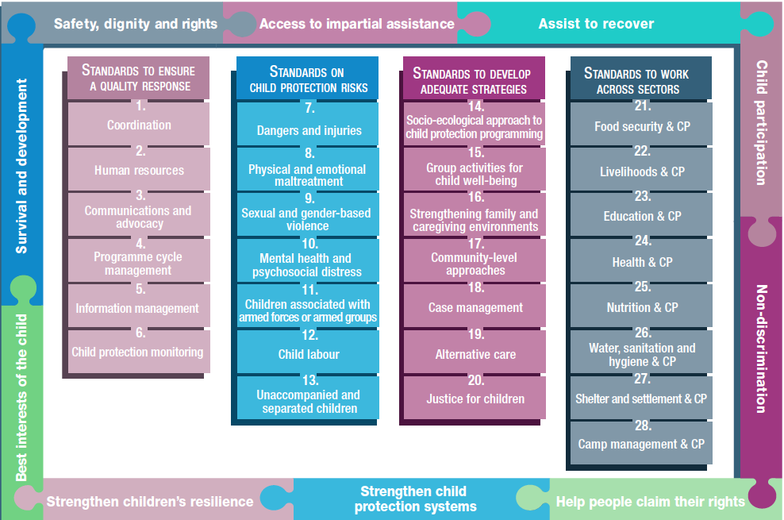
Overview
Notes:
This is an overview of the CPMS structure: there are 28 Standards across 4 pillars and 10 CPHA principles threaded throughout.
You can find this overview on the back of the CPMS handbook or in the online handbook; it’s a practical way of locating quickly a specific topic.
This presentation focuses on Standard 12: Child Labour

Slide 4
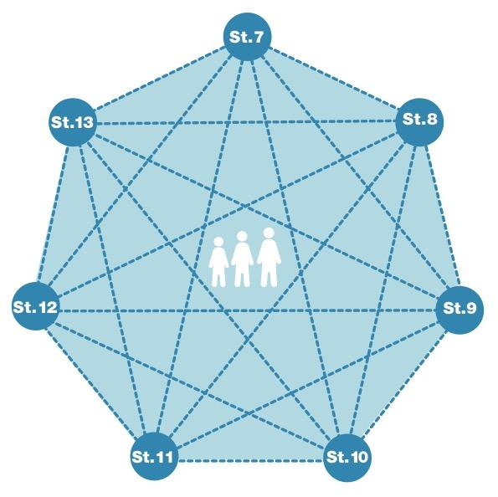
General intro to Standard 12
Part of 2nd Pillar, related to child protection risks
RISK = Nature & Extent of hazard + Vulnerability - Resilience
Relate to / made worse by the humanitarian crisis
Multisectoral coordination/services for response strategies
Community-level initiatives
What are the different concepts of child labour?
Notes:
This Standard is part of the second Pillar related to child protection risks that children may face in humanitarian settings. All the seven different risk standards are linked, as they address overlapping vulnerabilities and risks. The risks cannot be addressed in isolation.
Child protection risks are potential violations and threats to children's rights that will cause harm to children. To understand a child's risk, we need to understand the nature (type of hazard, situation, threat…) & extent of the risk and the individual child’s vulnerability to that risk, but also the family/child coping or survival strategies (meaning their resilience and ability to withstand the risk). Vulnerability is understood as the extent to which a child has characteristics that reduce his ability to withstand adverse impact. We have to record that vulnerability is specific to each person and each situation
DEF: Child labour is any work that deprives children of their childhood, their potential and their dignity, interfering with their education and negatively affecting their emotional, developmental and physical well-being. The worst forms of child labour (WFCL) include forced labour, recruitment into armed groups, trafficking for exploitation, sexual exploitation, illicit work or hazardous work.
Note that: CHILDREN IN CHILD LABOUR is the preferred term used to refer to children who are in child labour, including the worst forms of child labour. It is not recommended to use the term “child labourers” as children should not be defined by the harmful work they undertake.
Humanitarian crises may increase the prevalence and severity of existing forms of child labour or trigger new forms, including displacement (Refugees, internally displaced, migrants or stateless children are more vulnerable)
Multisectoral services (psychosocial support, education and family economic empowerment) & tailored child protection case management need to be provided to children already engaged in child labour and/or trafficking [→ the case management icon]
Providing targeted prevention support to children at risk, and supporting community-level initiatives to prevent child labour is also highlighted into this standard [→ the prevention icon]
Discussion Prompt: What are the different concepts of child labour?
Child work: not necessarily to be eliminated -> cite contextualized example
Child Labour: to be eliminated. SEE definition above in the note -> cite contextualized example
Worst form of child labour: to be eliminated as a matter of urgency -> cite contextualized example

Slide 5
“All children are protected from child labour, especially the worst forms of child labour, which may relate to or be made worse by the humanitarian crisis.”
Response:
Removal from work
Minimum services
What are the risk factors leading to child labour?
Notes:
Standard 12 states: “All children are protected from child labour, especially the worst forms of child labour, which may relate to or be made worse by the humanitarian crisis.”
Discussion Prompt: What are the risk factors leading to child labour?
-> cite contextualized examples
Factors commonly include:
Income poverty;
Social norms that support child labour; and
Lack of access to basic services, education, food security or decent work.
Depending on the setting, children who are particularly at risk may include those who are:
Already working;
Living in households that are headed by children, older people or single adults;
Living or working on the streets;
Unaccompanied or separated;
Living with disabilities or with caregivers with disabilities;
Refugees, internally displaced, migrants or stateless;
Identified with a certain social or political status;
Undocumented; and
Trafficked.
The idea is to prioritise the urgent removal of children from the worst forms of child labour, and provide minimum services to meet urgent protection needs of children in child labour.
Response actions for children in the worst forms of child labour include:
Engage with appropriate law enforcement and security services to immediately and safely withdraw children from illicit work in areas where criminal networks are involved.
Facilitate negotiation or mediation between the child, family and the employer, where safe and appropriate.
Remove children from work who are under the minimum working age and performing hazardous work.
Ensure that children who are over the minimum working age and performing hazardous work are (a) separated from the hazard or (b) allowed to continue working after the risk has been reduced to an acceptable level.
Increase access to services, education and decent work, taking into account specific barriers of children who are refugees, internally displaced, migrants or stateless.
Establish a Child labour monitoring systems (CLMS) to monitor child labour and refer children to services
Minimum services should include:
Tailored gender-, age- and disability-sensitive child protection case management;
Referral services (psychosocial support, education and family economic empowerment, like cash and voucher assistance for children over the minimum legal working age);
Appropriate alternative care (if required)
Provide trafficked children who are awaiting family tracing and reunification with:
○Specialised screening at the first point of contact;
○A risk assessment; and
○Placement into a temporary care arrangement (where appropriate).
Safeguarding & Prevention Icons:
Humanitarian actors across all sectors of work must ensure that their assistance does not push children into child labour or the worst forms of child labour. Mitigation strategies may include (a) implementing child safeguarding policies and (b) using age verification techniques to confirm children are not involved in hard and dangerous physical labour (such as distributions, construction or clearing debris).
Provide age-appropriate and accessible information to children, families and communities on (a) acceptable forms of (light) work for children under and over the minimum legal age for work and (b) ways to access services that help prevent child labour and the worst forms of child labour.
Develop and lead community-level initiatives to prevent and respond to child labour
Engage employers, workers’ organisations and civil society organisations in preventing and responding to child labour and promoting economic empowerment opportunities for children of legal working age and families of vulnerable children.

Slide 6
CHILD LABOUR TASK FORCE
Key links & resources
CLTF microsite with toolkit and training package
CLTF website with workplan, latest content
COVID-19 resources including technical note, synthesis, webinar and podcast
CPMS e-course with Child Labour module
CLTF Google drive with recordings
Contact : cltf@alliancecpha.org
TECHNICAL TOOLS AND GUIDANCE
CPMS 12, Inter-Agency Toolkit, COVID-19 resources, toolkit regional versions
CAPACITY BUILDING
E-course, training package, competency framework, global/regional/country launches
COORDINATION, POLICY AND ADVOCACY
World Day against Child Labour, International Year for the Ellimination of Child Labour, SDG 8.7, coordination calls
Notes:
The task force is co-led by Plan International and ILO

Slide 7
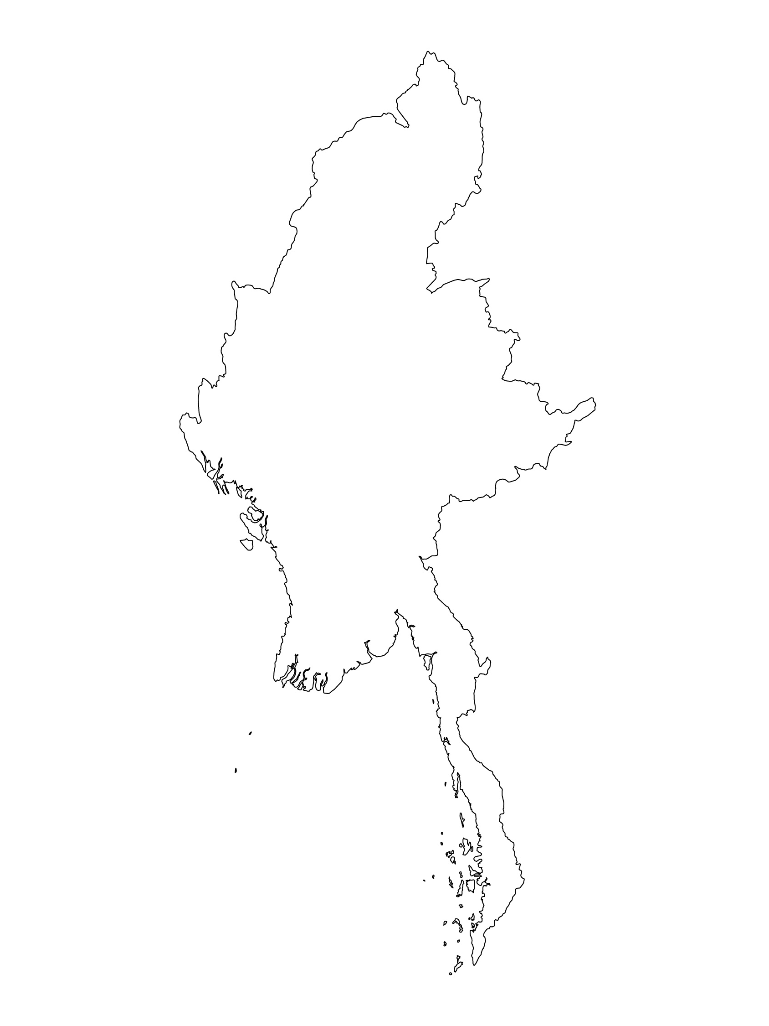
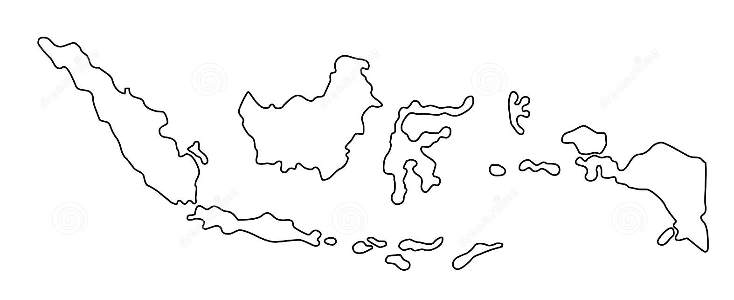
Examples from the Region
[COUNTRY NAME]
Add key presentation sentence about a specific program/project using Standard 12
Add name of organisations
Add key message / numbers
[ COUNTRY NAME]
Add key presentation sentence about a specific program/project using Standard 12
Add name of organisations
Add key message / numbers
[ COUNTRY NAME]
Add key presentation sentence about a specific program/project using Standard 12
Add name of organisations
Add key message / numbers
Notes:
Depending on the time you have for facilitation, consider adding here examples from the Region/ Country/ Response, of programming that meets the standards.
This could be a draft slide that you could update or remove if necessary.
For each example, you could add:
A short, concise, key presentation sentence about the specific program/project using Standard 12
Add the name of organisations and partners involved
Add practical lessons learnt, key actions, message or numbers, that will attract interest of your audience
Another option, if you have longer (and also depending on the audience you have), this slide can be completed in an interactive way during the session.
In that case, you could:
split the groups into 2 or 3 smaller groups,
allow 15 – 20 min for them to prepare a short presentation of an example from the Region/ Country/ Response, of programming that meets the standard
in plenary, have the groups present their examples, and discuss /compare lessons learnt out of them.
If you will be sending this presentation to the participants after the training, you can fill up this slide, to keep records of the presentations.
TIP: you can use https://thenounproject.com/ to get map outlines like those.

Slide 8
Need more than the hard copy?
On the Alliance website
PDF version
Briefing & Implementation Pack
25-page Summary
E-course
YouTube videos
A gallery of illustrated Standards
👉 www.AllianceCPHA.org
On the Humanitarian Standards Partnership website
Online, interactive version
HSP App for mobile phones and tablets
👉 www.HumanitarianStandardsPartnership.org
Notes:
[Facilitators - if you can project from the internet, then we suggest you navigate people there and show them]
HSP:
1. Online handbook
2. The Humanitarian Standards Partnership App
– It is the 2nd most popular app on that site after Sphere
CPMS page:
1. Interactive handbook – our greatest resource
2. A Summary: At just 32 pages, it means that it I CPHA topline but can be used to introduce the idea of minimum standards or start child protection discussions with government colleagues or other humanitarians without overwhelming them with the huge handbook.
Alliance website:
The PDF & all materials available can be downloaded if people want to print just portions of the CPMS, on the Alliance site
The “Introduction to CPMS” Briefing Pack contains this PPT and facilitation notes, plus the 2 page Introduction handout.
A gallery of illustrated Standards
Discover our free CPMS e-course with a range of modules
Videos on the Alliance Youtube channel
ASK: What should our next steps as a team/agency/individual be?
(i.e. you might schedule a longer meeting to digest the changes and create a plan; or ask colleagues to present certain new/revised standards and their implications for the programme; or set up a training or ask Senior Management for a meeting to discuss accountability to children, etc)
[Facilitators - Printed copies – there is a small stockpile of the Handbook and Summary that the global Alliance has in Geneva; however, countries and regions are encouraged to print & manage their own copies locally. Usually, this would be done through the inter-agency Coordination structure. On request, the Alliance can share a print-ready PDF.]
Thank you so much for coming together and starting to explore the CPMS. I will follow up on the next steps we discussed. And that’s the key – the CPMS is a gift that just keeps on giving every time you open it!

