Slide 1
The Minimum Standards for Child Protection in Humanitarian Action
CPMS
SLIDE DECK
Notes:
Facilitators:
This briefing is for any potential user of the CPMS. It is geared primarily toward child protection staff, so consider broadening some questions or providing more detail, if colleagues from other sectors join you.
It is assumed that the group is about 20 people and that everyone in the room knows each other (perhaps colleagues from your agency or the CP coordination group). if not, add 5 minutes for quick introductions.
PREPARE: a flipchart with the objectives of the session
By the end of the session, participants will be able to:
Describe the structure and content of the CPMS, especially Pillar 3
Demonstrate how & why to use the handbook
NOTE: if you have already done a Session on Pillar 1 and/or 2, skip slide 2 & 9
TIP: Slides are animated -> for each click you’ll make, a few words, a title or an image will appear on the slide.
Read the corresponding notes from the facilitators notes, before showing the content, so participants have time to process what you say, and read each point.

Slide 2
Aim of the Standards
Benchmark for CPHA.
Collaborative, inter-agency tool
Links with Core Humanitarian Standard
Contextualisation for local ownership
Purpose:
quality and accountability
impact for children’s protection and well-being
Notes:
Donors, local governments, colleagues in other sectors and our beneficiaries themselves want to know what we are doing and why. The CPMS is our benchmark. CPMS are the key way to operationalise or make real children's rights in the practice of humanitarian response.
They are a collaborative, inter-agency tool, that links with other initiatives, such as the Core Humanitarian Standard and the Humanitarian Inclusion Standards
Wherever relevant, the CPMS align with INSPIRE’s 7 strategies to end violence against children – initiative’s icons are actually scattered through the text. In addition, the Core Humanitarian Standard on Quality and Accountability is highlighted in the Introduction and resonates throughout the handbook.
Contextualisation is encouraged and can create ownership of the standards at every level. It builds a deeper understanding of child protection in the specific context for a wide range of actors. National coordination groups are therefore encouraged to adapt the CPMS. Please raise it with colleagues locally and then seek the guidance of the global CPMS team. Watch the contextualization video on the Alliance’s youtube channel.
BOX: The CPMS aim at improving the quality and accountability of our programing and increasing impact for children’s protection and well-being in humanitarian action (internal displacement and refugee contexts), by establishing common principles, evidence, prevention and goals to achieve. They provide a synthesis of good practice and learning to date.

Slide 3
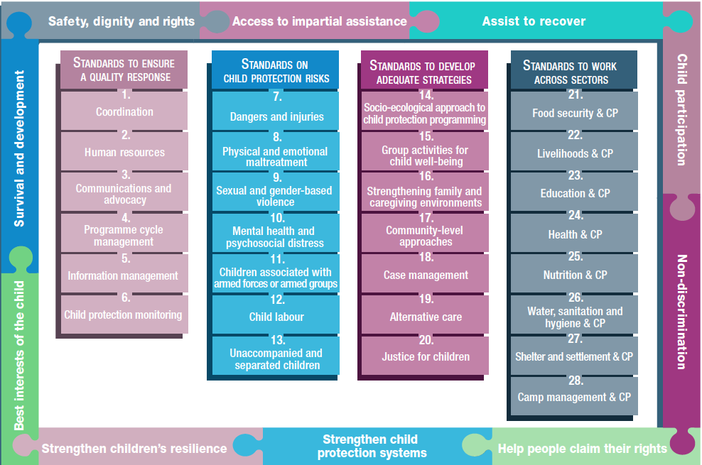
Overview
Notes:
This is an overview of the CPMS structure: there are 28 Standards across 4 pillars and 10 CPHA principles threaded throughout.
You can find this overview on the back of the CPMS handbook or in the online handbook; it’s a practical way of locating quickly a specific topic.
This presentation focuses on Pillar 3: Standards to Develop Adequate Strategies.

Slide 4
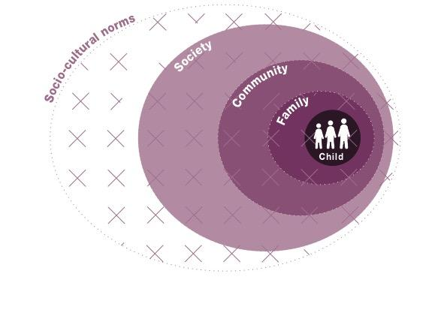
Pillar 3 – to develop adequate strategies
Key strategies, approaches and interventions
Prevention and response to child protection risks
15, 16, 17 = informal CP system elements
18, 19, 20 = formal CP system elements
Notes:
[FACILITATORS: This might be very familiar for your audience or something quite new, so please prepare your comments accordingly.]
SAY: Pillar 3 of the CPMS focuses on standards to develop adequate strategies, approaches and interventions for preventing and responding to the child protection risks outlined in Pillar 2. It is structured around the socio-ecological model.
For that reason, it is important to dive into Standard 14 before looking at the others. In addition, depending on the target audience, we may want to spend more time on the socio-ecological model to ensure everyone gets the importance of it. If you have time enough, please use the Standard 14 deck to complement the explanations.
In humanitarian settings, it is particularly critical to strengthen both formal and informal elements of the child protection system. Standards 15, 16 and 17 focus on children, families and communities and provide key actions and indicators for strengthening the informal elements of CP systems. Standards 18, 19, 20 focus more on the formal elements of the CP systems and provide key preventative and response strategies for strengthening the social welfare and justice systems.
The Pillar also links with the INSPIRE package, where appropriate, and builds on its strategies for preventing violence against children. Hence the ICON in the corner. More info about INSPIRE strategies on: http://inspire-strategies.org/
Discussion prompt: Can anyone name standards under Pillar 3?

Slide 5
Pillar 3 by Standard
St. 14: SE Approach
Incorporate a systems approach
Four levels
Problems, causes and the solutions for holistic, integrated protection
Contextualization
Evolution over time
St. 15: Group Activities
Group-based, planned activities
Safe, inclusive, contextually and age-appropriate approaches promoting protection
Realistic, measurable objectives
Notes:
[FACILITATORS: Depending on your public, their specific area of interest, your programming priorities, your context, or the time you have to facilitate, you may want select one or two keys standard under each pillar
This might be very familiar for your audience or something quite new, so please prepare your comments accordingly]
Standard 14: Socio-ecological approach to CP programming
promotes flexible programming that integrates new learning and adapts accordingly throughout implementation. Its point is to integrate approaches that work in partnership with the child, their family, community, and society, as well as with socio-cultural norms.
provides a concrete framework that supports systems thinking for child protection programming. It looks at an entire situation to (a) identify all the different elements and factors and (b) understand how they relate to and interact with each other.
considers the full range of problems facing the child, their root causes and the solutions available at all levels (rather than looking at a single protection issue or specific service in its own).
Is complementary to child protection systems thinking & seek to achieve the same goal: a holistic, integrated approach to protecting children.
It is important to note that CP systems differ by context and change, adapt, evolve over time: a thorough analysis of CP risks and protective factors, as well as a regular mapping of formal and informal system elements, are needed, to develop a plan to strengthen, scale up, adapt the system, especially as humanitarian settings can quickly change
*Links with ALL INSPIRE strategies and overall approach of systems strengthening
*Icon: increased emphasis on Prevention of child protection risks
Note: It is important to dive into Standard 14 before looking at the others, as it influences the way we read the Standard, and the way we conceive, think, plan all the interventions.
Standard 15: Group activities for child well-being.
promote protection, well-being and learning
ensure activities are delivered in safe, inclusive, contextually and age-appropriate approaches to have a positive impact on children’s well-being, enhance their resilience and reduce their stress.
Need to emphasize the importance of ensuring realistic measurable objective(s) are established for this sort of activities. There are different types of resilience capacities ( coping / adapting and transforming); according to the context, the age of the children, it is important to clarify what type of resilience is being supported, in order to set up realistic objective(s) and ensure the set up and type of activities are promoting the specific level of resilience needed in a specific context.
Icons: Links with INSPIRE strategies on Education and life skills + Safe environments
There has been a feeling of over-reliance on Child Friendly Spaces as the standard intervention, and instead it appears here, along with mobile programming, links to skills training, and other regular and consistent opportunities for improving children’s protection.

Slide 6
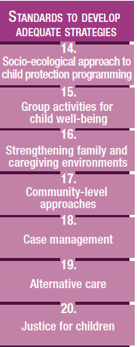
Strengthening Communities & Families
St. 16: Family strengthening
Prevention and response family strengthening program
Improve care:
access to services during and after a crisis
positive parenting
direct financial support
Improved interactions: knowledge of behaviors, and skills
St. 17: Community-level approaches
In-depth context analysis and mapping of community capacities and risk factors
Strengthen supportive practices
Influence change in practices that pose a risk
Strengthen links with formal system
Notes:
[FACILITATORS: Depending on your public, their specific area of interest, your programming priorities, your context, or the time you have to facilitate, you may want select one or two keys standard under each pillar
This might be very familiar for your audience or something quite new, so please prepare your comments accordingly]
Standard 16: Strengthening Family & Caregiving Environments:
This is core prevention and response work, as the focus is on holistic support to families to improve the care they provide to children whether through positive parenting programming, direct financial support or improving access to services
The goal is that caregivers present increased caring and protective behaviours, and enhance their skills to fulfil their responsibilities towards their children, to allow positive change in their interactions with them.
Icons: Link with Inspire strategies on Parent & Caregiver support + Income and economic strengthening
Standard 17: Community-level approaches:
Communities play a significant role in preventing and responding to risks faced by children in humanitarian settings. Communities organize themselves in a variety of ways to protect children, but these may be disrupted in humanitarian crises, particularly during displacement.
Avoid a one-sized fits all approach and rather base community approaches on an in-depth context analysis and mapping.
Aim to strengthen and support practices that support children’s protection and influence change in practices that pose a risk
External agencies should avoid bringing in unfamiliar processes, concepts, structures or groups that can weaken existing resources and introduce unsustainable, culturally insensitive approaches, but rather build on communities’ resources for and commitment to children. Community-level approaches are most effective and sustainable when communities see them as meeting their collective responsibility to children.
Where appropriate, support community connections to formal child protection systems (police, social workers, health workers, child-welfare services, education services, sexual and reproductive health services, the juvenile justice system, mental health services, etc).
Icons: Link with INSPIRE Strategies: Safe Environments and Norms and Values

Slide 7
Strengthening Formal Systems
St. 18: CM
Direct one-on-one, individualized, coordinated, holistic, multisectoral support + link to relevant service providers
Address 3 levels of the SE Model
Preparedness is key!
St. 19 : Alternative care
Protective and suitable care arrangements
Family-based care & family unity
St. 20 : Justice
Assess legal and justice systems
Develop interventions to reinforce protection and overcome risks
Notes:
[FACILITATORS: Depending on your public, their specific area of interest, your programming priorities, your context, or the time you have to facilitate, you may want select one or two keys standard under each pillar
This might be very familiar for your audience or something quite new, so please prepare your comments accordingly]
Standard 18: Case management.
Address needs through individualized case management process, including direct one-on-one support and connections to relevant service providers.
CM systems are an essential part of the child protection response. CM is implemented at three levels of the social ecological model: child, family/caregivers and community.
However, before starting CM services, preparedness is a major component. It is crucial to determine if CM is a current gap and is contextually appropriate and what approach is more suitable; to adapt globally endorsed case management processes and tools to the context ; to implement for the staff a phased capacity-building plan & to coach and supervise them on technical competence and practice
Icons: Link with Inspire strategies on Response and support services
Standard 19: Alternative care.
Seeks protective and suitable care; children must receive alternative care according to their rights, specific needs, wishes and best interests
Priority is always given to family-based care, family unit and stable care arrangements
Alternative care should only be considered when family strengthening and support to the family have failed. Residential care alternatives are the last resort option
Local cultural norms, practices, laws and policies have to be taken into account
Links to Unaccompanied & Separated Children, but also Case Management and the Standard on Strengthening Family & Caregiving Environments.
Icons: Link with Inspire strategies on Parent and caregiver support + Response and support services
Standard 20: Justice for children.
Ensure children in contact with formal and informal justice systems (i.e. courts, police, border guards) are treated in a child-friendly, non-discriminatory manner and receive services tailored to their needs and best interests.
Improving the content and application of formal and customary laws during a time of crisis
Using the socio-ecological model, we can collaborate with the full range of actors to (a) assess the ways in which legal and justice systems at all levels either provide protection or present risks and (b) develop interventions to reinforce protection and overcome risks.
Icons: Link with Inspire strategies on Response and support services + Implementation and enforcement of laws

Slide 8
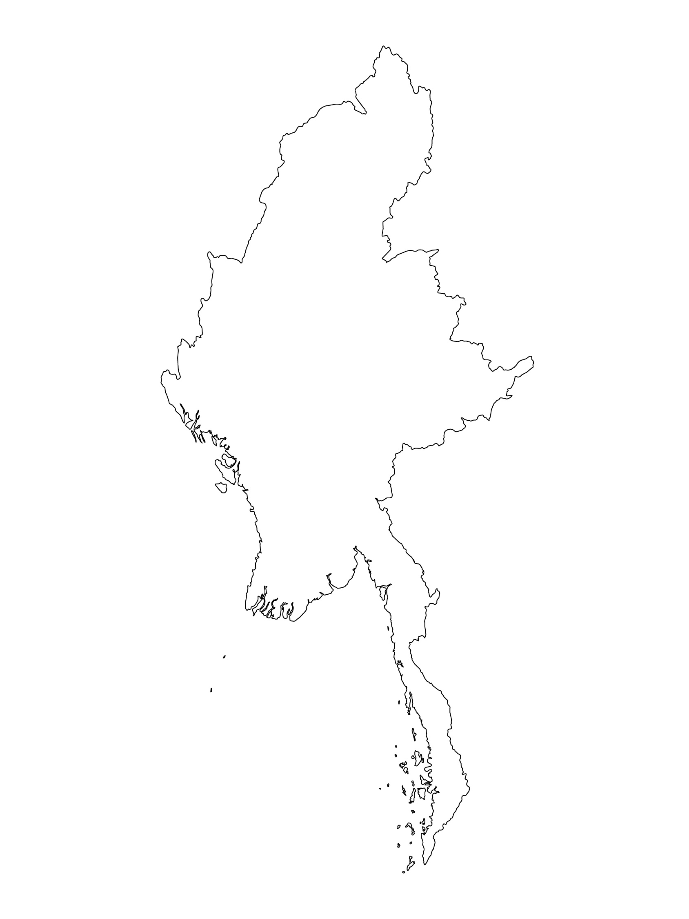
Examples from the Region
[COUNTRY NAME]
Add key presentation sentence about a specific program/project using Pillar 2
Add name of organisations
Add key message / numbers
[ COUNTRY NAME]
Add key presentation sentence about a specific program/project using Pillar 2
Add name of organisations
Add key message / numbers
[ COUNTRY NAME]
Add key presentation sentence about a specific program/project using Pillar 2
Add name of organisations
Add key message / numbers
Notes:
Depending on the time you have for facilitation, consider adding here examples from the Region/ Country/ Response, of programming that meets the standards.
This could be a draft slide that you could update or remove if necessary.
For each example, you could add:
A short, concise, key presentation sentence about the specific program/project using Pillar 3
Add the name of organisations and partners involved
Add practical lessons learnt, key actions, message or numbers, that will attract interest of your audience
Another option, if you have longer (and also depending on the audience you have), this slide can be completed in an interactive way during the session.
In that case, you could:
split into 2 or 3 smaller groups,
allow 15 – 20 min for them to prepare a short presentation of an example from the Region/ Country/ Response, of programming that meets the standard
in plenary, have the groups present their examples, and discuss /compare lessons learnt out of them.
If you will be sending this presentation to the participants after the training, you can fill up this slide, to keep records of the presentations.
TIP: you can use https://thenounproject.com/ to get map outlines like those.

Slide 9
Need more than the hard copy?
On the Alliance website
PDF version
Briefing & Implementation Pack
25-page Summary
E-course
YouTube videos
A gallery of illustrated Standards
👉 www.AllianceCPHA.org
On the Humanitarian Standards Partnership website
Online, interactive version
HSP App for mobile phones and tablets
👉 www.HumanitarianStandardsPartnership.org
Notes:
[Facilitators - if you can project from the internet, then we suggest you navigate people there and show them]
Alliance website.
The PDF & all materials available can be downloaded if people want to print just portions of the CPMS, on the Alliance site
The “Introduction to CPMS” Briefing Pack contains this PPT and facilitation notes, plus the 2 page Introduction handout.
A Summary: At just 32 pages, it means that it is very topline but can be used to introduce the idea of minimum standards or start child protection discussions with government colleagues or other humanitarians without overwhelming them with the huge handbook.
Discover our free CPMS e-course with a range of modules
Videos on the Alliance Youtube channel
A gallery of illustrated Standards
HSP:
1. Online handbook
2. The Humanitarian Standards Partnership App
– It is the 2nd most popular app on that site after Sphere
ASK: What should our next steps as a team/agency/individual be?
(i.e. you might schedule a longer meeting to digest the changes and create a plan; or ask colleagues to present certain new/revised standards and their implications for the programme; or set up a training or ask Senior Management for a meeting to discuss accountability to children, etc)
[Facilitators - Printed copies – there is a small stockpile of the Handbook and Summary that the global Alliance has in Geneva; however, countries and regions are encouraged to print & manage their own copies locally. Usually, this would be done through the inter-agency Coordination structure. On request, the Alliance can share a print-ready PDF.]
Thank you so much for coming together and starting to explore the CPMS. I will follow up on the next steps we discussed. And that’s the key – the CPMS is a gift that just keeps on giving every time you open it!

