Slide 1
The Minimum Standards for Child Protection in Humanitarian Action
CPMS
SLIDE DECK
Notes:
Facilitators:
This briefing is for any potential user of the CPMS. It is geared primarily toward child protection staff, so consider broadening some questions or providing more detail, if colleagues from other sectors join you.
It is assumed that the group is about 20 people and that everyone in the room knows each other (perhaps colleagues from your agency or the CP coordination group). if not, add 5 minutes for quick introductions.
PREPARE: a flipchart with the objectives of the session
By the end of the session, participants will be able to:
Describe the structure and content of the CPMS, especially Pillar 2
Demonstrate how & why to use the handbook
NOTE: if you have already done a Session on Pillar 1, skip slide 2 & 9
TIP: Slides are animated -> for each click you’ll make, a few words, a title or an image will appear on the slide.
Read the corresponding notes from the facilitators notes, before showing the content, so participants have time to process what you say, and read each point.

Slide 2
Aim of the Standards
Benchmark for CPHA.
Collaborative, inter-agency tool
Links with Core Humanitarian Standard
Contextualisation for local ownership
Purpose:
quality and accountability
impact for children’s protection and well-being
Notes:
Donors, local governments, colleagues in other sectors and our beneficiaries themselves want to know what we are doing and why. The CPMS is our benchmark. CPMS are the key way to operationalise or make real children's rights in the practice of humanitarian response.
They are a collaborative, inter-agency tool, that links with other initiatives, such as the Core Humanitarian Standard and the Humanitarian Inclusion Standards
Wherever relevant, the CPMS align with INSPIRE’s 7 strategies to end violence against children – initiative’s icons are actually scattered through the text. In addition, the Core Humanitarian Standard on Quality and Accountability is highlighted in the Introduction and resonates throughout the handbook.
Contextualisation is encouraged and can create ownership of the standards at every level. It builds a deeper understanding of child protection in the specific context for a wide range of actors. National coordination groups are therefore encouraged to adapt the CPMS. Please raise it with colleagues locally and then seek the guidance of the global CPMS team. Watch the contextualization video on the Alliance’s youtube channel.
BOX: The CPMS aim at improving the quality and accountability of our programing and increasing impact for children’s protection and well-being in humanitarian action (internal displacement and refugee contexts), by establishing common principles, evidence, prevention and goals to achieve. They provide a synthesis of good practice and learning to date.

Slide 3
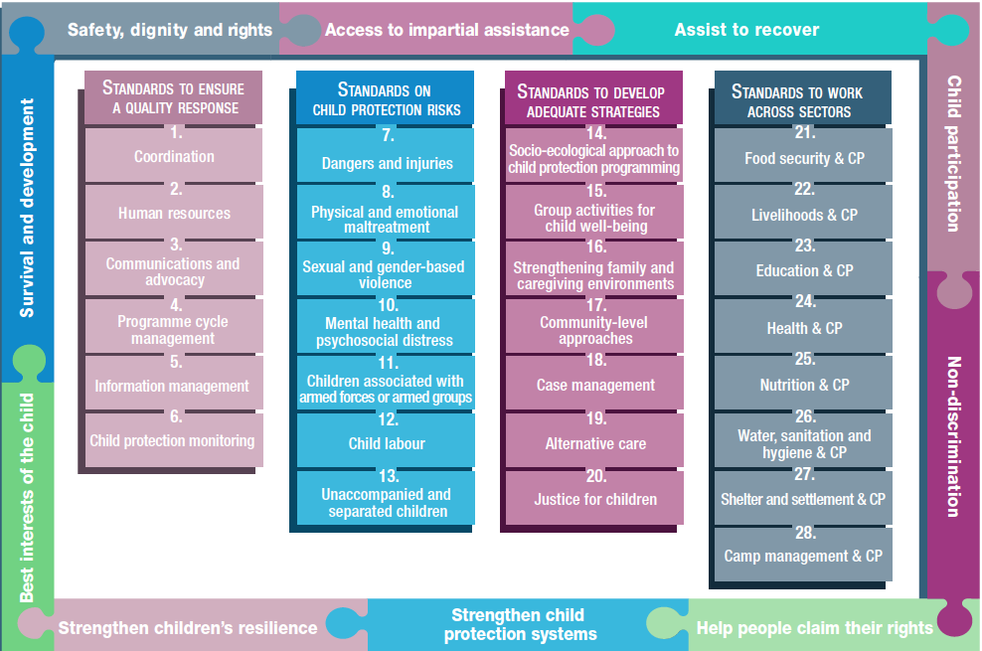
Overview
Notes:
This is an overview of the CPMS structure: there are 28 Standards across 4 pillars and 10 CPHA principles threaded throughout.
You can find this overview on the back of the CPMS handbook or in the online handbook; it’s a practical way of locating quickly a specific topic.
This presentation focuses on Pillar 2: Standards on Child Protection Risks

Slide 4
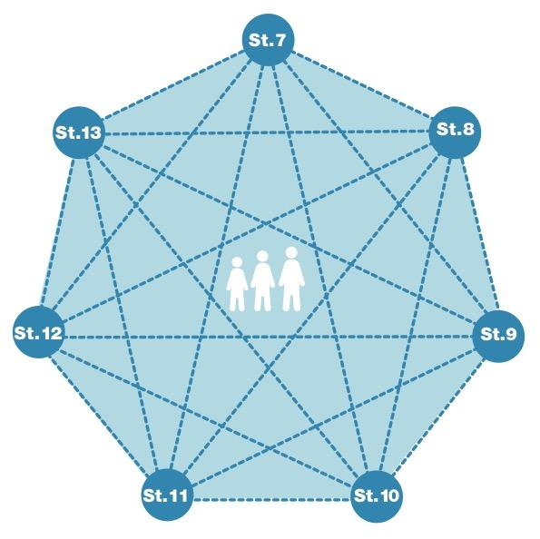
Pillar 2 – Child Protection risks
Understanding a child’s risk
Nature & Extent of hazard
+
Vulnerability
-
Resilience
Notes:
Before delving into this pillar, let’s stress the interconnected nature of the standards. The seven different risk standards are linked, as they address overlapping vulnerabilities and risks. The risks cannot be addressed in isolation. A child may be experiencing multiple risks at the same time. It is always necessary to look at the situation of the child holistically, identifying the vulnerabilities and strengths within each child and their environment.
Child protection risks are potential violations and threats to children's rights that will cause harm to children. To understand a child's risk, we need to understand the nature (type of hazard, situation, threat…) & extent of the risk and the individual child’s vulnerability to it, but also the family/child’s coping or survival strategies (meaning their resilience and ability to withstand the risk). Vulnerability is understood as the extent to which a child has characteristics that reduce their ability to withstand adverse impact. We have to note that vulnerability is specific to each person and each situation.
The standards in this pillar also provide actions to mitigate risks by increasing the resilience of the child, family, community and society and to remove or reduce the risk itself. Hence the prevention ICON in the corner.
Discussion prompt: Can anyone name standards under Pillar 2?
The standards in this pillar cover the seven main child protection risks that children may face in humanitarian settings:
Dangers and injuries;
Physical and emotional maltreatment;
Sexual and gender-based violence;
Mental health and psychosocial distress;
Children associated with armed forces or armed groups;
Child labour; and
Unaccompanied and separated children.

Slide 5
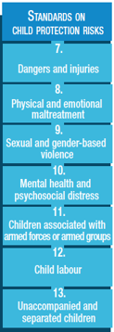
Pillar 2 – description of the Standards
St. 7: Dangers & Injuries
Protection against injury, impairment and death
Multisectoral and coordinated response
St. 8: Maltreatment
Physical and emotional neglect/abuse
Widespread
Short- and long-term effects
Comprehensive and coordinated interventions
St. 9: SGBV
Widespread, often hidden, underreported
Life-saving interventions
Well-coordinated, sensitive, multisectoral survivor-centered response
Include sexual violence, harmful practices, gender norms, social barriers, stigma, discrimination
Notes:
[Below are the key points of each standard. Depending on your public, their specific area of interest, your programming priorities, your context or the time you have to facilitate, you may want select only one or two keys standard under each pillar
This might be very familiar for your audience or something quite new, so please prepare your comments accordingly]
Standard 7: Dangers and injuries.
Humanitarian crises can increase everyday hazards and risks, as well as create new ones, particularly for children who are displaced in unfamiliar surroundings. This standard addresses the prevention of and response to physical and environmental dangers that injure, impair and kill children in humanitarian crises, considering that children consistently identify their physical safety as a priority concern.
It calls for a multisectoral and coordinated response, a linkage with sectors like health, and tailored support. The Standard stresses the importance to establishing and strengthening data-sharing protocols, injury case definitions and systematic referrals between child protection, health and other sectors’ service providers. [→ the case management icon]
Standard 8: Physical and emotional maltreatment
Maltreatment is widespread and may increase in humanitarian settings where protective environments are weakened.
The standard emphasizes the serious, short and long-term, negative impacts on children of physical and emotional maltreatment in a range of settings
All humanitarian actors, including those working on child protection, should engage in comprehensive and coordinated interventions to both prevent and respond to cases of maltreatment
It provides guidance on prevention : strengthen appropriate, local strategies; identification by service providers; positive coping and parenting skills; positive discipline skills for teachers … [→ the prevention icon]
Standard 9: Sexual and gender based violence:
DEF: ‘Sexual violence’ is defined in this standard as any form of sexual activity with a child by an adult or by another child who has power over the child.
DEF: ‘Gender-based violence’ (GBV) is a general term for any harmful act that is perpetrated against a person’s will and that is based on socially ascribed (gender) differences between males and females.
This standard has a broad focus on gender-based violence while also recognizing that children – both girls and boys –face particular risks and needs related to sexual violence.
Sexual and gender-based violence is widespread but often hidden and underreported. All humanitarian actors should assume that it is taking place.
It stresses the fact that mitigation, prevention and response to SGBV against children are life-saving interventions that require a multisectoral & coordinated response. [→ prevention and case management icons] It also strengthens guidance on a survivor-centred approach and confidentiality
It acknowledges the root causes of SGBV are harmful social and gender norms that promote gender-based discrimination and unequal power -> interventions aiming at promoting gender equality and systemic change to social and gender norms are encouraged, whenever possible. ‘Child survivors’ refers to child survivors of SGBV, including harmful practices (child marriage or female genital mutilation/cutting)
[Facilitators – if you have a few minutes, try to inject some fun into the session! It helps the participants feel more comfortable with the handbook itself. You may not have time for all of the activities suggested into this presentation]
→ Discuss the linkages of those 3 standards with Prevention, by seeking the icons in St 7 – 9 of the handbook

Slide 6
Pillar 2 – description of the Standards
St. 10 : MHPSS
Psychological and social suffering
Prevent/ reduce stress
Coping mechanisms and resilience
Community level supports
Across all ages and all stages of child development
Context-dependent
St. 11: CAAFAG
Emphasis on child-centred prevention of recruitment
Multi-sectoral community-based reintegration programmes
Advocacy
Notes:
[Below are the key points of each standard. Depending on your public, their specific area of interest, your programming priorities, your context or the time you have to facilitate, you may want select only one or two keys standard under each pillar
This might be very familiar for your audience or something quite new, so please prepare your comments accordingly]
Standard 10: Mental health and psychosocial distress.
Humanitarian crises can cause immediate and long-term psychological and social suffering to children and caregivers, who can develop mental health conditions that require specialised support.
Humanitarian actors must prioritise interventions that help reduce children and caregivers’ distress, promote their resilience, and where appropriate, link children to specialised supports.
The Standard points to the importance of community level supports, and programming across all ages and all stages of child development. [→ the early childhood and adolescent icons]
Also stresses the importance to tailor delivery of psychosocial interventions to the nature of the crisis. I.e: For example, group activities may not be possible during infectious disease outbreaks (need to opt for community-based, home-based, peer-to-peer and one-on-one care). I.e: In refugee or internal displacement settings, community structures may be weakened (need to encourage community cohesion as a first step) [→ see icons]
Standard 11: Children associated with armed forces or armed groups.
DEF: ‘Recruitment’ refers to the compulsory, forced or unforced enlistment of any child into any armed force or armed group.
Recruitment and use deprive children of their rights and have immediate and long-term negative consequences for the socio-economic, psychological and physical health of children, families and communities. Children, including girls, who are used or recruited by armed forces or armed groups are often forced to witness, experience and commit abuse, exploitation or violence.
Humanitarian actors must take action to prevent recruitment and use of children and to address the immediate and long-term negative consequences for children, families and communities through multi-sectoral community-based reintegration programmes, as well as advocacy for the release of all associated children. This standard calls for an emphasis on child-centred prevention, especially protecting them from recruitment [→ the prevention icon]
Where child recruitment and use are not yet prohibited by national law, advocate for such legislation. Where they are prohibited, authorities and stakeholders (including, where appropriate, armed forces or groups) should be encouraged to fulfil their legal obligations.
This standard points the need to establish and support case management services, to screen, identify, verify and document children; provide information about available support services; accompany release or disengagement processes; work on tracing and reunification & support reintegration [→ the case management icon]

Slide 7
Pillar 2 – description of the Standards
St. 12: CL
Related to / made worse by the humanitarian crisis
Removal from WFCL
Multisectoral coordination/services for response strategies
Community-level initiatives
St. 13: UASC
Rights, BIA and centrality of children
Family unity is priority
Case management and immediate FTR
Specific contexts call for specific actors
Notes:
[Below are the key points of each standard. Depending on your public, their specific area of interest, your programming priorities, your context or the time you have to facilitate, you may want select only one or two keys standard under each pillar
This might be very familiar for your audience or something quite new, so please prepare your comments accordingly]
Standard 12: Child labour.
DEF: Child labour is any work that deprives children of their childhood, their potential and their dignity, interfering with their education and negatively affecting their emotional, developmental and physical well-being. The worst forms of child labour (WFCL) include forced labour, recruitment into armed groups, trafficking for exploitation, sexual exploitation, illicit work or hazardous work.
Humanitarian crises may increase the prevalence and severity of existing forms of child labour or trigger new forms. It should be noted that refugees, internally displaced, migrants or stateless children are often more vulnerable.
The idea is to prioritise the urgent removal of children from the worst forms of child labour, and provide minimum services to meet urgent protection needs of child labourers.
Multisectoral services (psychosocial support, education and family economic empowerment) & tailored child protection case management need to be provided to children already engaged in child labour and/or trafficking [→ the case management icon]
Providing targeted prevention support to children at risk, and supporting community-level initiatives to prevent child labour is also highlighted into this standard [→ the prevention icon]
Standard 13: Unaccompanied and separated children.
Care and protection has to be provided in timely, safe, appropriate and accessible ways, in accordance with their rights and best interests.
This standard highlights the commitment to keeping the child at the centre of humanitarian efforts
The humanitarian response should work to reduce separation, to reunite children with family members and to provide quality, family-based interim care where necessary. Preserving family unity is key.
Ensure case management and immediate family tracing and reunification (FTR) [→ see icon]
It calls for coordinated efforts to prevent and respond to child separation and provide assistance, protection and services to UASC (including in refugee context and cross border situations) [→ the displacement icon] Contextualised measures for preventing separation are especially important in non-camp or urban contexts where communities may be dispersed.
The Standard identifies the key actors involved in national or international family tracing activities, depending on the context.
[Facilitators – if you have a few minutes, try to inject some fun into the session! It helps the participants feel more comfortable with the handbook itself. You may not have time for all of the activities suggested into this presentation]
→ Do you know who is involved in UASC support in each specific context? (internal displacement, refugees, migration, cross-border situations, armed conflicts). Check the related table in St 13!

Slide 8
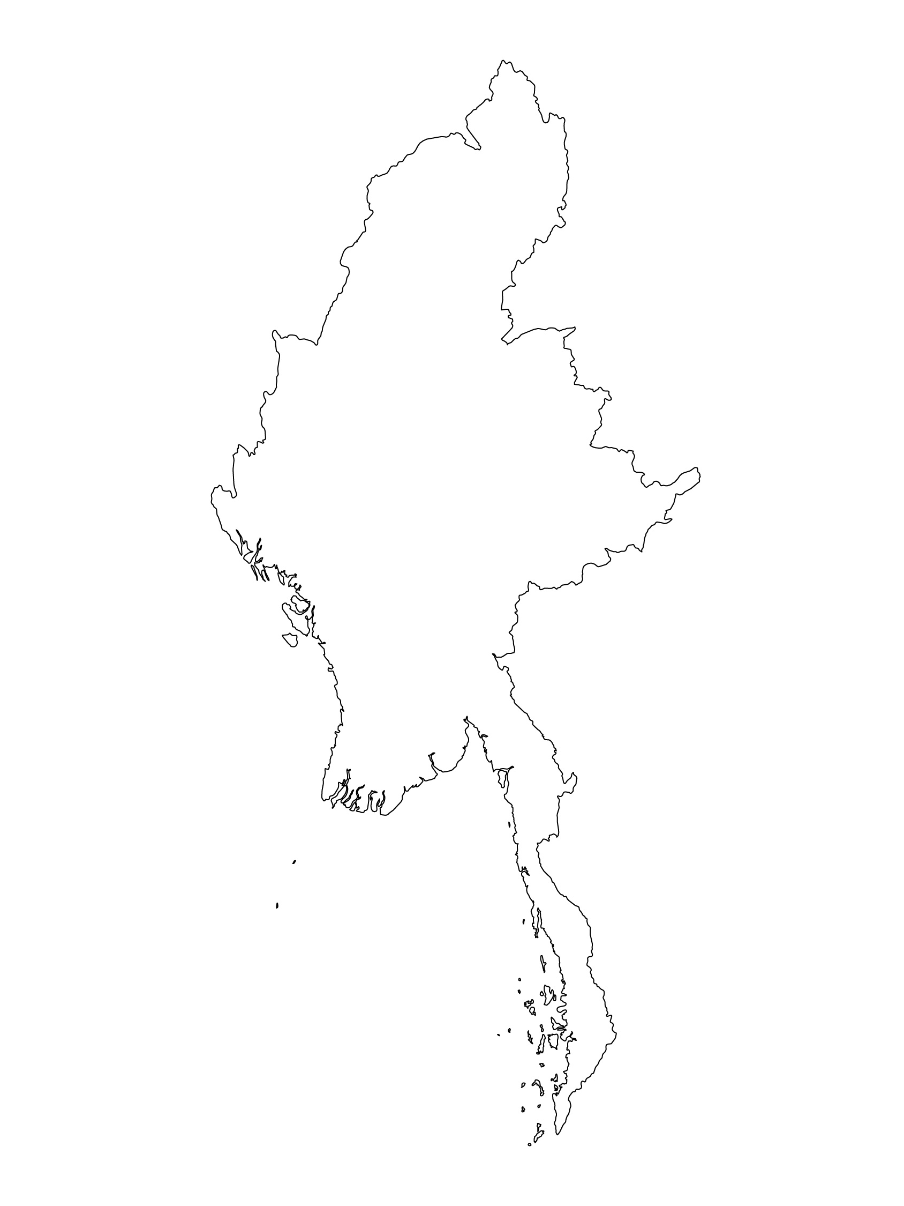
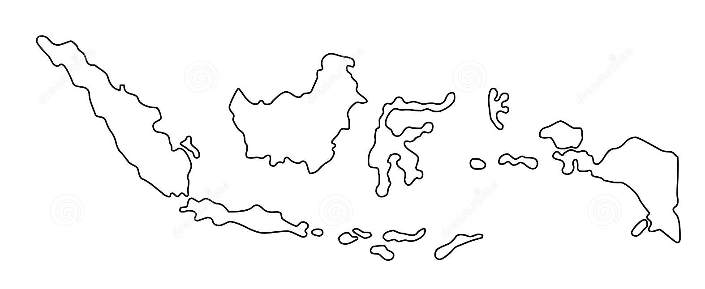
Examples from the Region
[COUNTRY NAME]
Add key presentation sentence about a specific program/project using Pillar 2
Add name of organisations
Add key message / numbers
[ COUNTRY NAME]
Add key presentation sentence about a specific program/project using Pillar 2
Add name of organisations
Add key message / numbers
[ COUNTRY NAME]
Add key presentation sentence about a specific program/project using Pillar 2
Add name of organisations
Add key message / numbers
Notes:
Depending on the time you have for facilitation, consider adding here examples from the Region/ Country/ Response, of programming that meets the standards.
This could be a draft slide that you could update or remove if necessary.
For each example, you could add:
A short, concise, key presentation sentence about the specific program/project using Pillar 2
Add the name of organisations and partners involved
Add practical lessons learnt, key actions, message or numbers, that will attract interest of your audience
Another option, if you have longer (and also depending on the audience you have), this slide can be completed in an interactive way during the session.
In that case, you could:
split into 2 or 3 smaller groups,
allow 15 – 20 min for them to prepare a short presentation of an example from the Region/ Country/ Response, of programming that meets the standard
in plenary, have the groups present their examples, and discuss /compare lessons learnt out of them.
If you will be sending this presentation to the participants after the training, you can fill up this slide, to keep records of the presentations.
TIP: you can use https://thenounproject.com/ to get map outlines like those.

Slide 9
Need more than the hard copy?
On the Alliance website
PDF version
Briefing & Implementation Pack
25-page Summary
E-course
YouTube videos
A gallery of illustrated Standards
👉 www.AllianceCPHA.org
On the Humanitarian Standards Partnership website
Online, interactive version
HSP App for mobile phones and tablets
👉 www.HumanitarianStandardsPartnership.org
Notes:
[Facilitators - if you can project from the internet, then we suggest you navigate people there and show them]
Alliance website.
The PDF & all materials available can be downloaded if people want to print just portions of the CPMS, on the Alliance site
The “Introduction to CPMS” Briefing Pack contains this PPT and facilitation notes, plus the 2 page Introduction handout.
A Summary: At just 32 pages, it means that it is very topline but can be used to introduce the idea of minimum standards or start child protection discussions with government colleagues or other humanitarians without overwhelming them with the huge handbook.
Discover our free CPMS e-course with a range of modules
Videos on the Alliance Youtube channel
A gallery of illustrated Standards
HSP:
1. Online handbook
2. The Humanitarian Standards Partnership App
– It is the 2nd most popular app on that site after Sphere
ASK: What should our next steps as a team/agency/individual be?
(i.e. you might schedule a longer meeting to digest the changes and create a plan; or ask colleagues to present certain new/revised standards and their implications for the programme; or set up a training or ask Senior Management for a meeting to discuss accountability to children, etc)
[Facilitators - Printed copies – there is a small stockpile of the Handbook and Summary that the global Alliance has in Geneva; however, countries and regions are encouraged to print & manage their own copies locally. Usually, this would be done through the inter-agency Coordination structure. On request, the Alliance can share a print-ready PDF.]
Thank you so much for coming together and starting to explore the CPMS. I will follow up on the next steps we discussed. And that’s the key – the CPMS is a gift that just keeps on giving every time you open it!

