Slide 1
Strengthening community based child protection in humanitarian settings An initiative from the CBCP in Emergencies Task Force
The Alliance for Child Protection in Humanitarian Action
February 2018 | Webinar

Slide 2
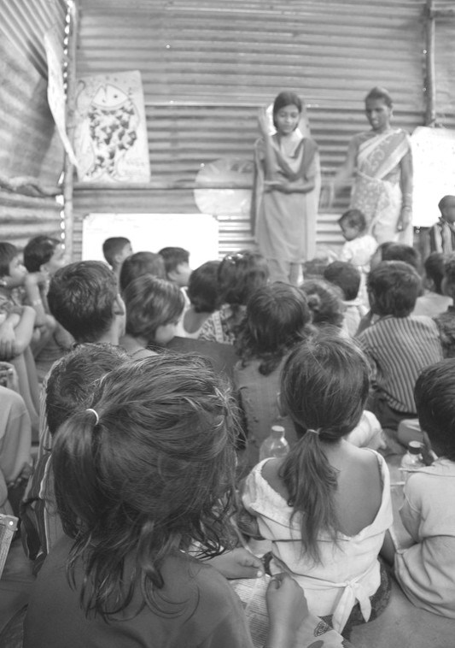
Agenda
Community Based Child Protection in Emergencies Task Force
The Initiative - Strengthening Community Based Child Protection in Humanitarian Settings
Application Process/Invitation
Questions and Discussion

Slide 3
Community Based Child Protection in Emergencies Task Force (CBCP TF)
In 2015, an annual face to face meeting of the Child Protection Working Group (what has now evolved into two entities: the Alliance for Child Protection in Humanitarian Action and Child Protection Area of Responsibility). At this meeting, the following aspects of CBCP was discussed at length:
An evaluation of current practices across contexts in 2009 and 2012 confirmed that humanitarian actors often use a top down approach (ex: Child Protection Committees) which break down after the agency leaves or funding is gone
Practitioners expressed a lack of access to guidance and tools to improve practices
The need for more coordinated interagency efforts towards strengthening CBCP work was recognized
Notes:
- Explain the CP AoR and the Alliance and their roles.
In 2014, a structural review of the CPWG suggested that its work might be more effectively carried forward by two separate but interconnected entities. Two years later, this led to the transition from the CPWG to the Alliance for Child Protection in Humanitarian Action and the Child Protection Area of Responsibility. While the CP AoR is mandated to lead child protection coordination efforts in humanitarian settings under the IASC, the working groups and task forces of the Alliance are responsible for standard setting and global guidance, which have migrated out of the CPWG, forming the Alliance. For more on the Alliance and its Working Groups and Task Forces, please refer to this link: https://alliancecpha.org/stepping-up-child-protection-in-humanitarian-action/how-we-work-2/

Slide 4
Community Based Child Protection in Emergencies Task Force (CBCP TF)
In 2016, the Community-Based Child Protection in Emergencies Task Force (CBCP TF) was formed to address this gap.
The CBCP TF is co-led by Plan International, World Vision International, and UNICEF and has over 20 members organizations*
The main objectives of the CBCP TF remain to collect evidence and lessons learned, develop guidance and facilitate research, and to strengthen learning and knowledge-sharing among practitioners, donors, academics, other initiatives
Notes:
Care, Child Frontiers, Child Fund, Child Safe Horizons, Community Child Protection Exchange, Child Protection AOR, CPC Learning Network, ICCRD, International Rescue Committee, Islamic Relief Worldwide, Plan International, RISE Learning Network, Save the Children, Terres de Hommes, Alliance, UNHCR, UNICEF, War Child Holland, World Vision International

Slide 5
Community Based Child Protection in Emergencies Task Force (CBCP TF)
So what have we done so far?!
Contribution to Other Initiatives
Terms Database
Webinars and Case Studies
Mobile Programming Key Considerations
CPMS Standard Revision
Resource Database
In 2017, the CBCP TF received funding from USAID/OFDA to develop a Field Guide to Strengthening CBCP in Humanitarian Settings (Field Guide) and accompanying capacity building initiative that includes face to face training and funding to test the Field Guide.
Notes:
Admittedly, the first two years of the TF were fairly challenging. It was mostly spent connecting different initiatives, building relationships, and understanding the gaps in CBCP and the needs from the field. Slowly we have built some successes.
Our biggest success to far, has been the USAID/OFDA grant, which will help to address some of the major gaps and challenges identified in 2015

Slide 6
The Strengthening CBCP Initiative
The Strengthening CBCP in Humanitarian Settings has three core components:
Developing a Field Guide: to provide evidence-based tips, or “key considerations” that we know support effective, community-driven, and sustainable CBCP and to address gaps in practical resources through “how to guides” quick reference guidance and tools on ways community based prevention and response approaches can be implemented in various contexts.
Deliver capacity building to practitioners through a Training of Trainers (TOT) face-face roll-out of the Field Guide and additional skills building, in addition to developing an e-learning module.
Implement the Field Guide through seed funding opportunities which participating agencies can apply for.
Notes:
The guides may include the following components: start-up checklist, preparedness actions or adaptations, budgeting tools, evidence on effectiveness and limitations, common contexts where it is successful including case studies, lesson learnt, and how to measure results.

Slide 7
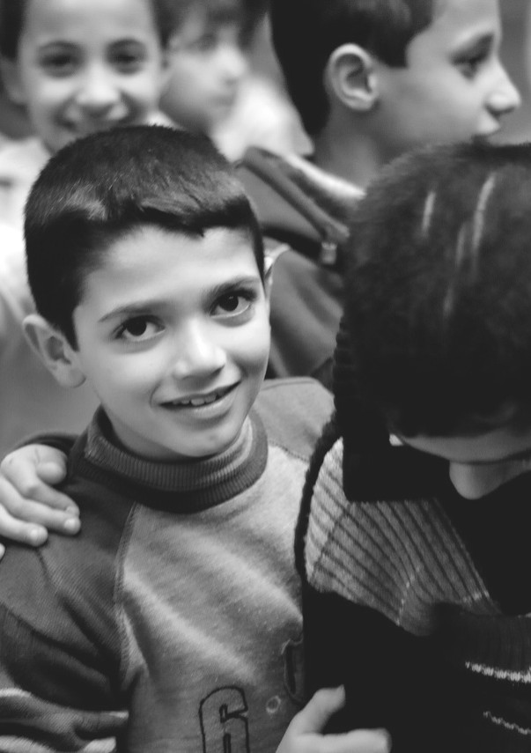
The Strengthening CBCP Initiative
Invitation: The CBCP in Emergencies TF would like to welcome you to participate in the development of this Guidance and Training. We want to ensure that:
The Field Guide is significantly informed by the work at the country level
Meets the needs of field level practitioners
The process benefits the country programs that support the initiative
To increase practitioners’ confidence and skills when working with communities to deliver the highest quality community based approaches.

Slide 8
Overview
Systematic Review
Key Considerations
Key Consideration Validation Workshops
How to Guide Documentation
= Country Level Activities
Field Guide to Strengthening CBCP in Humanitarian Settings
Inputs/feedback will be sought from Countries
Development of Training Package (face-face and e-learning)
Delivery of TOT Training
Application for Seed Funding
Technical Assistance
Field Testing

Slide 9
Timeline
 | Initiative Phase | Description of Content
Apr-Jun | Phase I: Key Considerations Validation Workshop and How to Guide Documentation Mission | Workshop to validate/change/adapt key considerations Documentation of promising practices in CBCP Workshop to collect existing tools, identify gaps in resources Field mission to document innovative practices
Jul-Sep | Phase 2: Provide Feedback on the Field Guide | The technical lead will request remote edits/feedback to various components of the Field Guide as it is developed including: Follow-up on collected Case Studies Verification of How to Guide documentation Another look at final considerations AOB
Oct-Jan | Phase 3: Training Participation and Roll-out | Monthly Skype calls to plan the roll-out of training Pre-training course work/reading Delivery of training in country Final evaluation/feedback survey and discussion
Feb-May | Phase 4: Application for Seed Funding | Submit a Concept Note and Action Plan to implement a component of the Field Guide (must include a roll-out of the training) Activity and Training report(s) submitted Feedback on the use of the Field Guide to the technical lead Teams receive three months of technical support (remote/in-person)
Notes:
Additional months built in in case there are delays, or additions to the project.

Slide 10
Responsibilities of the Global CBCP TF
Development of the technical content of the Field Guide and training materials based on the systematic review, country and global consultations.
Selection of two countries to participate in workshops and trainings
Pre-training course work will be made accessible to participants 1 month in advance for each training
Travel costs and per-diem for all participants in the 5-day training
Selection of Seed Fund recipients and 3 months of technical support
Monitoring and analysis of the initiative
Notes:
Our biggest success to far, has been the USAID/OFDA grant

Slide 11
Responsibilities of the Country Response
Participation in the validation workshops for the Field Guide
Nomination of a country team who will be responsible for the roll-out of the training received in country
Organizing the logistics, coordination and roll-out of country-level workshops and trainings
Advocacy for the funding for community based capacity building initiatives
Documentation, monitoring and reporting on the training roll-out
Gathering and sharing lessons learned with the CBCP TF
Submit additional application for Seed Funds
Notes:
Our biggest success to far, has been the USAID/OFDA grant

Slide 12
Application Process
Sub-national CPWG/CP sub-clusters are invited to submit an application to the CBCP TF (in coordination with national CPWG/CP counterparts)
Two countries will be selected to participate in the initiative by a Reference Committee made up of CBCP TF members.
With each country CPWG/Sub-Cluster application, a Capacity Building Team should also be nominated (15 participants who will engage fully in the Initiative)
Please consider having a diversity of agencies (government, national and international agencies and UN)
The suggested profile of the nominated members for the capacity building team is outlined below:
Maintains positive rapport with a variety of community members
Is a resourceful, creative thinker and able to motivate civil society
Ability to lead training and coach practitioners
Experience in the current country context and knowledge of the community
Each nominated participant should submit a copy of their CV and a signed commitment statement as an appendix to the country application
Notes:
The runner up countries will be asked to participate in the e-learning modules and provide feedback. As modules are developed, the team will be asked to take the module and provide feedback either written or verbal through a Skype call. This feedback will be incorporated and another module will be shared, etc. etc.
Focus on English and French for Pilot Countries – translations for the Field Guide in other languages will follow as budget allows.

Slide 13
ELIGIBILITY CRITERIA
Required:
Have active sub-national groups that: 1) meet once/month, 2) have at least 10 organizations that attend regularly 3) have strong leadership 4) 50% of membership are national civil society groups/government
The availability of a host agency, who has the interest, staff capacity and time to fulfill the planned activities
Can demonstrate the existence of effective or impactful Community-based Child Protection interventions
Child Protection Working Group/Sub-Cluster has prioritized CBCP in the strategy/work plan and/or there is a clear interest in investing further in community engagement/services in their country response
Preferred:
Existence of innovative CBCP interventions and/or tools and resources that have been developed or adapted
Have an existing Task Force/Sub-Group on CBCP
Notes:
Comments so far from call/emails: demonstrated experience in ensuring that community leaders are prominent in sub-cluster decision-making; or evidence of direct participation of community groups in priority setting? Something that demonstrates that the sub-cluster is engaging meaningfully with communities. Strong Civil Society presence, CBCP prioritized by coordination group
Prefer countries not engaged in community based research in the past 5 years (2013-2017)’ under the requirements. Why: if all went well, we have the research report included in the resource database, ensuring that the learning from the related countries/contexts will feed into the project already
Interesting to select one pilot country with CP Systems Linkages and one without clear linkages

Slide 14
Application Process – How to Apply!
The application documents can be found at: https://alliancecpha.org/community-based-child-protection/
Country-level application and participant applications to be submitted to cbcp.tf@alliancecpha.org.
Deadline: February 21st, 2018.
Questions? Please contact Malia Robinson, CBCP in Emergencies Project Manager at Malia.Robinson@planusa.org or Alexandra Shaphren, CPiE Specialist and CBCP TF Co-chair at Alexandra.Shaphren@plan-international.org.

